Slide 1
Remarks on Model Misspecification in Revenue Management and Pricing Optimization
  Rice University, November 12, 2012
  Darius Walczak
  PROS Inc., Houston, TX

Slide 2
Agenda
Introduction
Basic Concepts of Revenue Management
PROS timeline
Three main mathematical themes
Spiral-down example
Pricing optimization
Other industries

Slide 3
About PROS
We help companies use their data to make better sales decisions.
Unlock your data. Unleash your sales.

Slide 4



PROS
Year Incorporated: 1985
Listed NYSE: PRO
Employees: 500+
Annual Revenue: $74.2M in 2010
$96.6M in 2011
Customers: 150+
Implementations: 500+
Countries: 50+
Maintenance Renewal Rate: 95%
Industries: Distribution, Manufacturing,
Services and Travel
Industry Focus:
Airline
Manufacturing
Distribution
Services
Hotel
Rental
Cruise
Cargo

Slide 5
Basic Concepts of Revenue Management

Slide 6
Overbooking
Balancing spoilage (flying with empty seats) with costs of denying boarding to an overbooked customer. Typical business measures used:
  Probability of show-ups exceeding capacity
  Expected number of denied boardings
  Net expected profit contribution
Common assumption:
  Independent no-shows, same distribution
  Implies binomial distribution of show-ups, can be approximated by normal
Example:
  Physical capacity M, current reservation level N, normal show-ups with mean Na and standard deviation Nb, where a and b are parameters
  Probability that the number of booked passengers who show-up at departure does not exceed the capacity can be expressed as:
Notes:
Colorful history, law suits, various compensations mechanisms (some suggested by Nobel laureates

Slide 7
Overbooking
Actually the first application YM/RM application (1960s)
Colorful history
  Wikipedia: “[Julian] Simon was also the first to suggest that airlines should provide rewards for travelers to give up their seats on overbooked flights, rather than arbitrarily taking random passengers off the plane (a practice known as "bumping").^{[3]} Although the airline industry initially rejected it, his plan was later implemented with resounding success, as recounted by Milton Friedman in the foreword to The Ultimate Resource II. Economist James Heins said in 2009 that the practice had added $100 billion to the United States economy in the last 30 years.^{[7]} Simon gave away his idea to federal de-regulators and never received any personal profit from his solution.^{[7]}”
Notes:
Colorful history, law suits, various compensations mechanisms (some suggested by Nobel laureates

Slide 8
Littlewood’s Formula
Fundamental question: Faced with a request for a discount seat (fare f₂), accept it or wait in hopes of selling later to a higher paying passenger (fare f₁> f₂)?
Littlewood’s Rule: Protect n₁ seats for high fare demand, where n₁ satisfies
f₂ = f₁ Pr (D₁ ≥ n₁)

Slide 9
Discount allocation
First recorded: capacity controlled ‘Earlybird’ discounts at BOAC (later BA), 1972:
  Experiment: differentiated fares for essentially the same seats
  Stimulate demand for seats that would otherwise fly empty
Most famous: Yield Management at American Airlines (AA), 1976/1977
  Planes flying half full---“Super Saver Fares” to fill them, capacity controlled (e.g. 30% of seats) + advance purchase, 1970s
  Realization: Not a cost problem but a revenue problem
  Name: Yield Management (Bob Crandall)
YM as a competitive weapon, 1985:
  Low price entrant People Express Airlines threatens AA
  AA responds with (even lower) “Ultimate Super Saver Fares” that carefully control when to undercut
“Using the tools of revenue management, Crandall could nominally offer competitive fares, yet hold back inventory to sell at a higher price after People Express sold out at a low price. He ultimately drove People Express out of business (Cross 1997) with better management of seat inventory and better service.”
Other carriers and other industries follow (Delta, Marriott …)
Notes:
Note: started with “public charters” in 1970s (allowed by CAB) that were allowed to price below the cost-plus fares offered by scheduled airlines
Realization: different prices for different level of service were acceptable (“red-eye”)

Slide 10
Revenue Management in History
Data
collection
and storage
1st generation
4th generation
(1-2% incremental gains)
Origin-destination forecasting and inventory control
3rd generation
(4-6% revenue gains)
Forecasting and optimization of individual flight legs
2nd generation
Monitoring and comparison of actual bookings to historical bookings
Source: Belobaba, P. P. (2011)

Slide 11
US Airline Profitability
Source: MIT Airline Data Project
(http://web.mit.edu/airlinedata)

Slide 12
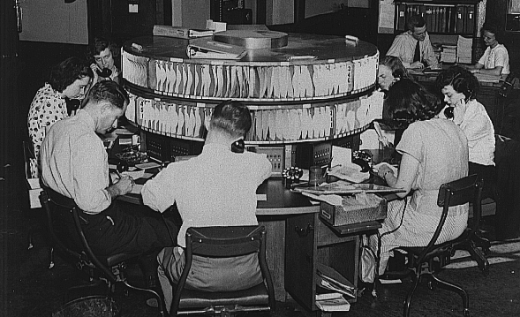
Source: Revenue Management in the US Airline Industry
Smith, Barry C. (AGIFORS, 2007)

Slide 13
Evolution of revenue management
Airline Deregulation Act
Oct 24, 1978
First RM System
American Airlines introduces DINAMO (live in January)
PROS Overbooking
PROS introduces its first RM system, consisting of overbooking only
PROS O&D Solution
Full-blown O&D solution, including network inventory control
Next generation RM
Choice based RM
Joint pricing and RM
Segmentation applications
1978
…
1985
1988
2001
2005-08
2012+
Major changes
Expansion of CRSs and GDSs
Hub and spoke networks
Low fare new entrants
Increased competition
PROS RM Solution
Overbooking, forecasting and optimization solution
PROS RTDP
Real time dynamic availability tool
PROS Low Fare
Introduction of low-fare solutions for leg carriers
Expansion to full OD hybrid RM

Slide 14
Three Main Mathematical Themes
Stochastic and dynamic demand
Network effects
Choice behavior

Slide 15
Stochastic and Dynamic Demand
As revenue management advanced, at least three major themes evolved. The first was the introduction of time dynamics, replacing fare class demand-to-come estimates with stochastic processes describing fare class arrivals. Beyond providing greater realism, this change brought to light an alternative to nested protection levels for controlling the sale of inventory; a method discussed in more detail in the remaining sections.
A second theme was that of capturing network effects. As airlines developed route structures that required passengers to travel on more than one flight, the limitations of leg level models became increasingly clear to practitioners and mathematical modelers alike. For practitioners, the limitations manifested themselves in questions such as “what is the Y class fare on a leg when there are 100 different itineraries drawing upon Y class inventory, each with its own fare?” Mathematical modelers not only saw the need for network models, but devoted considerable effort to the problem while developing important theoretical insights along the way.
Just as important were business considerations. For airlines, which often operate under razor-thin profit margins, the quest for fraction-of–a-percentage point improvements in revenue made good sense. Theoretical results as well as simulations were promising since every new class of models was more comprehensive and better reflective of actual customer behavior. While not every airline jumps on the bandwagon of any new theoretical development, models that are dynamic in nature and/or capture network effects explicitly have become accepted worldwide since they deliver promised improvements. Implementation of those run-time consuming methods was in no small measure made possible by the incredible increase in computing power available at little cost, and to better numerical approaches.
A third theme was the development of better demand models, as was touched upon in Section 1.2.4. In the remainder of this section we address each of these topics in more detail. In contrast to the first two themes, the development of the demand models was mainly driven by airlines suffering losses due to shifts in passenger buying behavior caused by several factors. We will have more to say about this phenomenon in Section

Slide 16
EMSRa
Extend Littlewood’s formula to more than two classes
Three -class EMSRa, example
  The protection level n₂ for fare classes 1 and 2 would be calculated as n₂ = m₁ + m₂ where m₁ and m₂ are defined by
  f₃ = f₁ Pr(D₁ ≥ m₁)
and
  f₃ = f₂ Pr(D₁ ≥ m₂)
while the protection level n₁ = m₁ would be calculated from
  f₂ = f₁ Pr(D₁ ≥ m₁).
In general, the protection level for fare classes 1,…,j is calculated as
n_{j} = m₁ + m₂ + … + m_{j}, where
  f_{j+1} = f_{i} Pr(D_{i} ≥ m_{i}) i = 1,…,j-1.
  Observe that m_{i} changes from the calculation of one protection level to the next.

Slide 17
EMSRb
Builds upon Littlewood’s formula but in a different way
Three -class EMSRb example
  Uses the sum of the class 1 and 2 demands and apply Littlewood
  Use F₂ , the demand weighted average fare of fare classes 1 and 2, calculate the protection level n₂ from the intuitive expression
  f₃ = F₂ Pr(D₁ + D₂ ≥ n₂)
The protection level n_{j} for the first j fare classes calculated as
  f_{j+1} = F_{j} Pr(D₁ + D₂ + … + D_{j} ≥ n_{j})
  where
  F_{j} = ( f₁E[D₁] + f₂E[D₂] + … + f_{j} E[D_{j}] ) / ( E[D₁] + E[D₂] + … + E[D_{j}] )
Assume that each D_{i} is normally distributed to simplify calculations

Slide 18
Low-Before-High
Characterization of the optimal policy (Brumelle and McGill (1993)) in terms of protection levels (continuous demand setting): the protection levels n₁,…, n_{J-1} are optimal if
  f₂ = f₁ Pr (D₁ ≥ n₁)
  f₃ = f₁ Pr(D₁ ≥ n₁ and D₁ + D₂ ≥ n₂)
  …
  f_{j+1} = f₁ Pr(D₁ ≥ n₁ and D₁ + D₂ ≥ n₂ and … D₁ + D₂ + … D_{j} ≥ n_{j}).
Note: probability that a fare class nest will sell out (under the optimal policy) is proportional to the ratio of the fares:
  if the protection levels n₁ and n₂ are set optimally, then the proportion of time classes 1 and 2 both sell out relative to the total number of flight departures should be approximately f₃ / f₁; similarly, the proportion of time fare class 1 will sell out should be approximately f₂ / f₁.

Slide 19
Complete (Yield) MDP Solution, Single Resource
Subramanian, Stidham, and Lautenbacher (1999)
  Cancellation
  Cancellation refunds (possibly class dependent)
  Overbooking explicitly included

Slide 20
Continuous Time MDP Solution
The discrete time formulation can be thought of as an approximation (forward Euler) to the continuous time formulations
This in turn can viewed as a specific case of a problem with semi-Markov arrivals (perhaps time-inhomogeneous)

Slide 21
Networks of Flights
Emergence of network carriers
Banks of inbound and outbound flights in the same time interval
Much better coverage than point-to-point flights

Slide 22
Network Effects
A much more complex picture:
  Different fare class demands on Seattle-Atlanta leg compete not only with each other but also against the fare class demands on Seattle-Miami through itinerary
  Same holds for Atlanta – Miami demand
  The through itinerary Seattle-Miami competes against Seattle-Atlanta and Atlanta-Miami

Slide 23
Network Effects
Q class on the Seattle-Atlanta-Miami itinerary sells for $600, while Q class on the Memphis-Atlanta-Miami itinerary sells for $300. Both itineraries draw from the same Q class inventory on the Atlanta-Miami flight leg
“The $300 Memphis-Atlanta-Miami Q class fare [may] turn out to be more valuable than the $600 Seattle-Atlanta-Miami Q class fare once the cost of displacing other passengers is taken into account.”

Slide 24
Network Dynamic Programming
“Curse of dimensionality”
  In fact at least two, and sometimes three “curses”
    State space
    Action space
    Transition probabilities
Some of the earliest and most successful network revenue management models were based on mathematical programming formulations
Perhaps the most well known is the demand-to-come linear program which has arisen in many different contexts, including but not limited to Glover et al. (1982), Alstrup et al. (1986), and Wollmer (1986)
The formulation looks at the expected demand-to-come on all itineraries and in all fare classes and chooses the collection of passengers that yields the maximum network revenue while not exceeding the network capacity

Slide 25
General Remarks
Reassuring asymptotic properties
  Ratio of revenue obtained via DLP over the optimal revenue converges to 1 as capacity and demand scaled up by the same factor
Resolving (reoptimizing) using the DLP may end up in revenue being strictly worse than without it
  “within a class of suboptimal policies, taking more information into account need not always be better.” (Cooper 2000)

Slide 26
Approximate Dynamic Programming
The value function can be decomposed using various classes of functions. E.g. the DLP can be understood viewed as assuming that
A richer class yield time-dependent bid prices:
In DP Decomposition we use for each resource i
Other decompositions
  Non-separable
  Product-oriented
  Combine with simultaneous DPs

Slide 27
Barber’s Dilemma
A barbershop gets crowded and cannot accommodate all customers on Saturday
On Tuesday, however few customers come for a haircut---offer discount on Tuesday and raise price on Saturday
Stimulate demand on Tuesday, go for profit on Saturday
Is it Yield Management or Pricing?

Slide 28
Changing Business Environment
While the late 1990s and early 2000s saw a push, led by academia, for more and more sophisticated algorithms the focus has since shifted mainly due to business considerations:
  Competition from a new generation of low fare carriers (LCCs)
  Growth of internet ticket sales
Simplified fare structure:
  Few or no ticketing restrictions,
  Legacy carriers in many cases reacting by emulating LCC practices.
Competitive fares becoming transparent
Ease of search
Traditional RM algorithms called into question

Slide 29
Spiral-down Example
Source: The Spiral-down effect in Revenue Management (or the Importance of a Good Demand Model)
William L. Cooper, Tito Homem-de-Mello, Anton J. Kleywegt (2010)

Slide 30
What is Spiral Down?
Airline estimates high-fare demand using historical data, without properly accounting for customer behavior.
Availability of low-fare tickets reduces sales of high-fare tickets.
New data begins to reflect lower demand for high-fare tickets.
Source: The Spiral-down effect in Revenue Management (or the Importance of a Good Demand Model)
William L. Cooper, Tito Homem-de-Mello, Anton J. Kleywegt (2010)

Slide 31
What is Spiral Down?
Protection levels are set lower on subsequent flights, making more seats available at the low fare.
Even fewer high-fare tickets are sold.
The process continues, so protection levels, high-fare ticket sales, and revenues spiral down.
Source: The Spiral-down effect in Revenue Management (or the Importance of a Good Demand Model)
William L. Cooper, Tito Homem-de-Mello, Anton J. Kleywegt (2010)

Slide 32
Related Phenomena
Inventory-dependent demand
  Balakrishnan, et al., Mgmt. Sci., 2004.
Newsvendor salvage values that depend upon end-of-season inventory
  Cachon and Kok, 2003
Response-time spiral in manufacturing planning
  Suri, 1998
Source: The Spiral-down effect in Revenue Management (or the Importance of a Good Demand Model)
William L. Cooper, Tito Homem-de-Mello, Anton J. Kleywegt (2010)

Slide 33
The Framework
Repeated instances of some flight:
  8 AM Monday flight between Minneapolis and San Diego.
  Same flight on April 25, May 2, May 9, May 16, May 23, May 30, etc.
Source: The Spiral-down effect in Revenue Management (or the Importance of a Good Demand Model)
William L. Cooper, Tito Homem-de-Mello, Anton J. Kleywegt (2010)

Slide 34
What are the long-term effects of using a “slightly” flawed model?
The interplay between forecasting and optimization is a key aspect of RM---and of OR in general.
Mathematical models are only an approximation to reality.
Many models have assumptions that are clearly incorrect.
Source: The Spiral-down effect in Revenue Management (or the Importance of a Good Demand Model)
William L. Cooper, Tito Homem-de-Mello, Anton J. Kleywegt (2010)

Slide 35
The Littlewood Rule
There is distinct demand for fare class 1 and fare class 2.
Class 2 customers arrive before class 1 customers.
Demand is exogenous. That is, the protection level does not affect the demand distribution.
Demands for fare class 1 and fare class 2 are stochastically independent.
Source: The Spiral-down effect in Revenue Management (or the Importance of a Good Demand Model)
William L. Cooper, Tito Homem-de-Mello, Anton J. Kleywegt (2010)

Slide 36
The Littlewood Rule
In order to maximize its expected revenue, an airline should set protection level L that satisfies
f₁ × Prob(Class 1 Demand > L) = f₂
Source: The Spiral-down effect in Revenue Management (or the Importance of a Good Demand Model)
William L. Cooper, Tito Homem-de-Mello, Anton J. Kleywegt (2010)

Slide 37
Example
# of Seats = 10
# of Customers = D
Suppose D is (approximately) Normally distributed with mean = 8, std dev = 2
Fares: f₁=$500, f₂ = $200
If a cheap ticket is available, a customer buys it. Otherwise, buys expensive ticket.
Source: The Spiral-down effect in Revenue Management (or the Importance of a Good Demand Model)
William L. Cooper, Tito Homem-de-Mello, Anton J. Kleywegt (2010)

Slide 38
How might a revenue manager actually choose L?
The revenue manager does not know the information on the previous slide.
Source: The Spiral-down effect in Revenue Management (or the Importance of a Good Demand Model)
William L. Cooper, Tito Homem-de-Mello, Anton J. Kleywegt (2010)

Slide 39
How might a revenue manager actually choose L?
The revenue manager initially estimates that high-fare demand is Normal with mean 8 and std dev 2.
He will update the estimate of high-fare demand distribution as he gradually acquires more data.
For each flight, the protection level L is obtained by applying the Littlewood rule to the estimated distribution of high-fare demand.
Source: The Spiral-down effect in Revenue Management (or the Importance of a Good Demand Model)
William L. Cooper, Tito Homem-de-Mello, Anton J. Kleywegt (2010)

Slide 40
Data Collection and Forecast Updating
After each flight, the revenue manager updates the estimate of mean high-fare demand by smoothing previous estimate with:
High-Fare Sales + Turn Aways
Source: The Spiral-down effect in Revenue Management (or the Importance of a Good Demand Model)
William L. Cooper, Tito Homem-de-Mello, Anton J. Kleywegt (2010)

Slide 41
More Forecasting
New Estimate of the Mean =
0.25*(High-Fare Sales + Turn Aways)
+ 0.75*(Old Estimate of the Mean)
Source: The Spiral-down effect in Revenue Management (or the Importance of a Good Demand Model)
William L. Cooper, Tito Homem-de-Mello, Anton J. Kleywegt (2010)

Slide 42
Initial Estimate
P. Level = 8

Slide 43
Flight #1
P. Level = 8
D = 5
High-fare Sales = 3
Low-fare Sales = 2
Revenue = $1900
Turn Aways = 0
New Est. Mean = 6.75
Next P. Level = 7

Slide 44
Flight #2
P. Level = 7
D = 7
High-fare Sales = 4
Low-fare Sales = 3
Revenue = $2600
Turn Aways = 0
New Est. Mean = 6.06
Next P. Level = 6

Slide 45
Flight #3
P. Level = 6
D = 8
High-fare Sales = 4
Low-fare Sales = 4
Revenue = $2800
Turn Aways = 0
New Est. Mean = 5.55
Next P. Level = 6

Slide 46
Flight #10
P. Level = 3
D = 7
High-fare Sales = 0
Low-fare Sales = 7
Revenue = $1400
Turn Aways = 0
New Est. Mean = 2.44
Next P. Level = 2

Slide 47
Flight #20
P. Level = 0
D = 8
High-fare Sales = 0
Low-fare Sales = 8
Revenue = $1600
Turn Aways = 0
New Est. Mean = 0.28
Next P. Level = 0

Slide 48
Expected Revenue vs. Protection Level
Source: The Spiral-down effect in Revenue Management (or the Importance of a Good Demand Model)
William L. Cooper, Tito Homem-de-Mello, Anton J. Kleywegt (2010)

Slide 49
Is this a problem with unconstraining?
The problem is not unconstraining; the revenue manager saw every customer.
Rather, the fundamental problem is that the revenue manager was using an incorrect demand model.
Source: The Spiral-down effect in Revenue Management (or the Importance of a Good Demand Model)
William L. Cooper, Tito Homem-de-Mello, Anton J. Kleywegt (2010)

Slide 50
Conclusions (for RM)
When availability decisions of the airline affect data used to estimate the “high-fare demand distribution,” then the performance of the RMS can become progressively worse, rather than progressively better.
Source: The Spiral-down effect in Revenue Management (or the Importance of a Good Demand Model)
William L. Cooper, Tito Homem-de-Mello, Anton J. Kleywegt (2010)

Slide 51
Conclusions (for RM)
This can be a particular problem if the airline is using a demand model that does not accurately reflect how consumers choose among the available ticket classes.
There is more work to be done to understand what types of models and methods best avoid spiral down.
Source: The Spiral-down effect in Revenue Management (or the Importance of a Good Demand Model)
William L. Cooper, Tito Homem-de-Mello, Anton J. Kleywegt (2010)

Slide 52
Conclusions (in General)
It is known and accepted that answers arising from simplified models can produce suboptimal results.
What is less understood is how the use of such models interacts over time with forecasting.
If assumptions may be flawed, it is important to test for robustness within a framework that captures the sequential interaction of forecasting and optimization.
Source: The Spiral-down effect in Revenue Management (or the Importance of a Good Demand Model)
William L. Cooper, Tito Homem-de-Mello, Anton J. Kleywegt (2010)

Slide 53
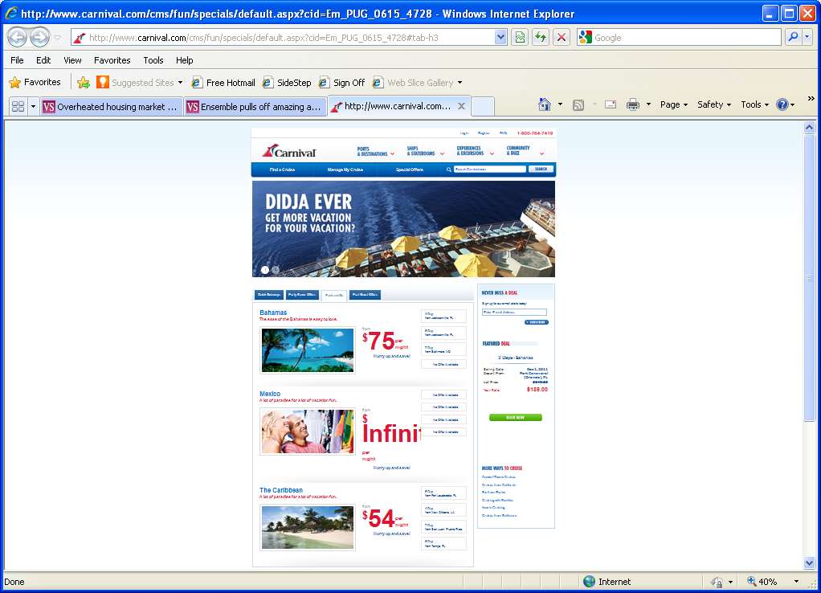
Extreme Spiral-up?

Slide 54

Rules are not enough: Amazon’s $23,698,655.93 book about flies
From http://www.michaeleisen.org/blog/?attachment_id=368

Slide 55
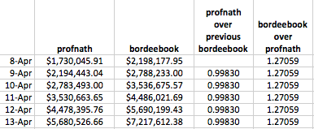
“Endless Possibilities for Chaos and Mischief…”
  “Once a day profnath set their price to be 0.9983 times bordeebook’s price. The prices would remain close for several hours, until bordeebook “noticed” profnath’s change and elevated their price to 1.270589 times profnath’s higher price. The pattern continued perfectly for the next week.”
  “But, alas, somebody ultimately noticed. The price peaked on April 18th, but on April 19th profnath’s price dropped to $106.23, and bordeebook soon followed suit to the predictable $106.23 * 1.27059 = $134.97. But Peter Lawrence can now comfortably boast that one of the biggest and most respected companies on Earth valued his great book at $23,698,655.93 (plus $3.99 shipping).”

Slide 56
Some better demand models
Models with “sell-up”
  Brumelle, McGill, et al.,Trans. Sci., 1990
Hybrid Model
  Walczak et al., JRPM 2010
Consumer choice models
  Talluri and van Ryzin, Mgmt. Sci., 2004

Slide 57
Low Fare Problem
In traditional revenue management, fare fences and restrictions ‘keep’ passengers within their fare class
Y
B
M
Q

Slide 58

Yieldable Demand Model
The “Price not announced” model, Kincaid and Darling (1963)
Independent Demand Model, Talluri and van Ryzin (2004)
  It’s the most popular demand model until recently, underlies EMSR, yield DP, and many network models
???

Slide 59
Low Fare Problem
With weak fare fences and restrictions, passengers may ‘buy-down’ to less expensive classes
Y
B
M
Q

Slide 60
Priceable Demand
  The “Price announced” model, Kincaid and Darling (1963)
  Lowest Available Fare model, Gallego and van Ryzin (1994), Talluri and van Ryzin (2004)
  Buy Down model (Kambour, 2001)
Hybrid Demand Model
  Demand with a yieldable and a priceable component
60

Slide 61

Market Priceable Demand Model
Demand model typically considered in the microeconomics
Price sensitive
Market Hybrid Demand Model
  Demand with a yieldable, a priceable, and a market priceable component
$450
$600

Slide 62
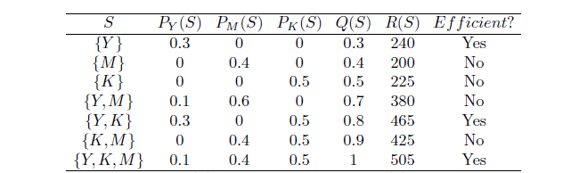
Choice Modeling
Three fare products: Y , M, and K:
  Y is the most expensive ($ 800) and has no restrictions
  M requires a 21-day advance purchase and costs $ 500.
  K is the least expensive ($ 450) but in addition it requires a Saturday-night stay-over.
The airline can offer any combination of the products (an offer set), including an empty offer set (which is efficient).

Slide 63
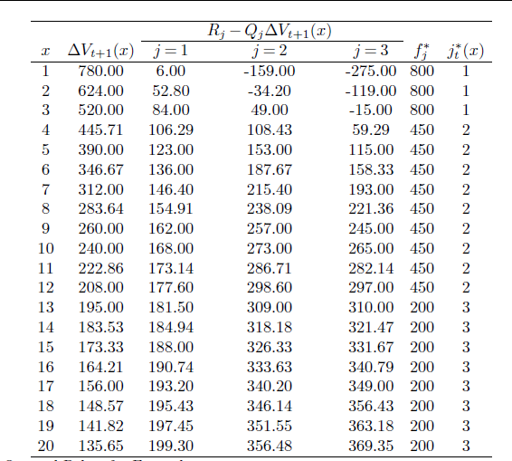
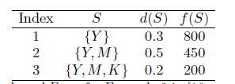
Marginal Revenue Data Transformation

Slide 64
Choice on Network
Gallego et al. (2004), Liu and van Ryzin (2008)
It is worth noting that the demand-to-come linear program can be extended to accommodate discrete choice models of demand. The idea was first raised in Iyengar, Phillips, Gallego, and Dubey (2004) in the context of introducing more complex products than fare classes, and elaborated upon by van Ryzin and Liu (2004). For completeness, we present this model below after introducing some notation. Let S be a set of products offered to the customer (the offer set) and D_{j}(S) the amount of product j sold when S is offered; S is a subset of a set of all available products N. We define the revenue
R(S) = ∑_{j ε S} F_{j}D_{j}(S) and the resource consumption Q(S) = A D(S), where A is the incidence matrix, D is the product demand vector, and F_{j} is the product price.

Slide 65
Network Effects and Choice
Stochastic and dynamic demand
where

Slide 66
Future of Revenue Management
Data
collection
and storage
Monitoring and comparison of actual bookings to historical bookings
Forecasting and optimization of individual flight legs
Origin-destination forecasting and inventory control
1st generation
2nd generation
3rd generation
4th generation
What’s next?
5th generation
Passenger
Pricing
Science
Seasonality
Low fare RM
Segmentation
PNR no show
Hybrid RM
Choice based RM
Market priceable
Cancel/rebook
Fare families

Slide 67
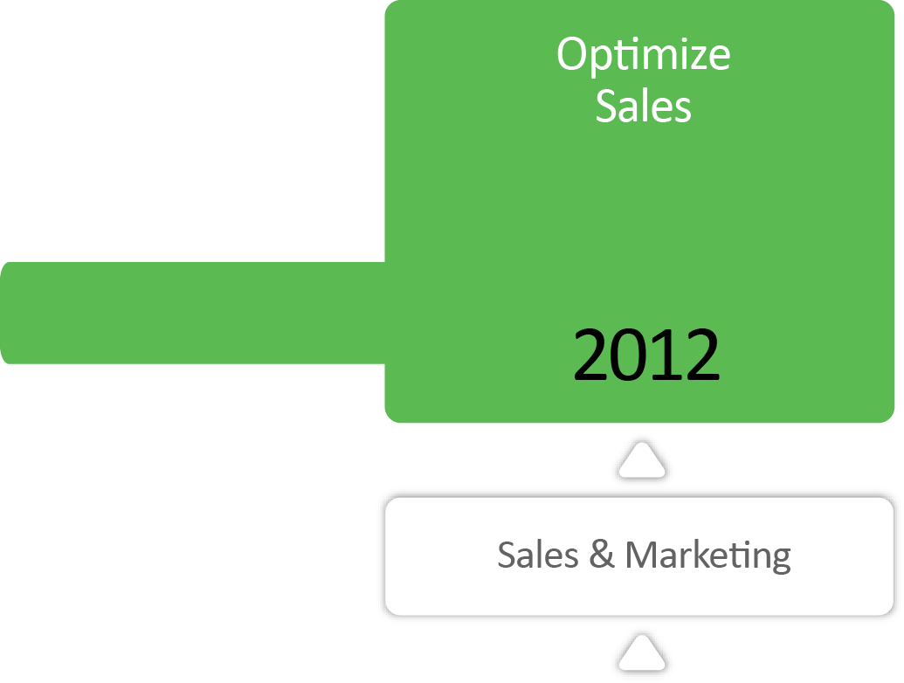
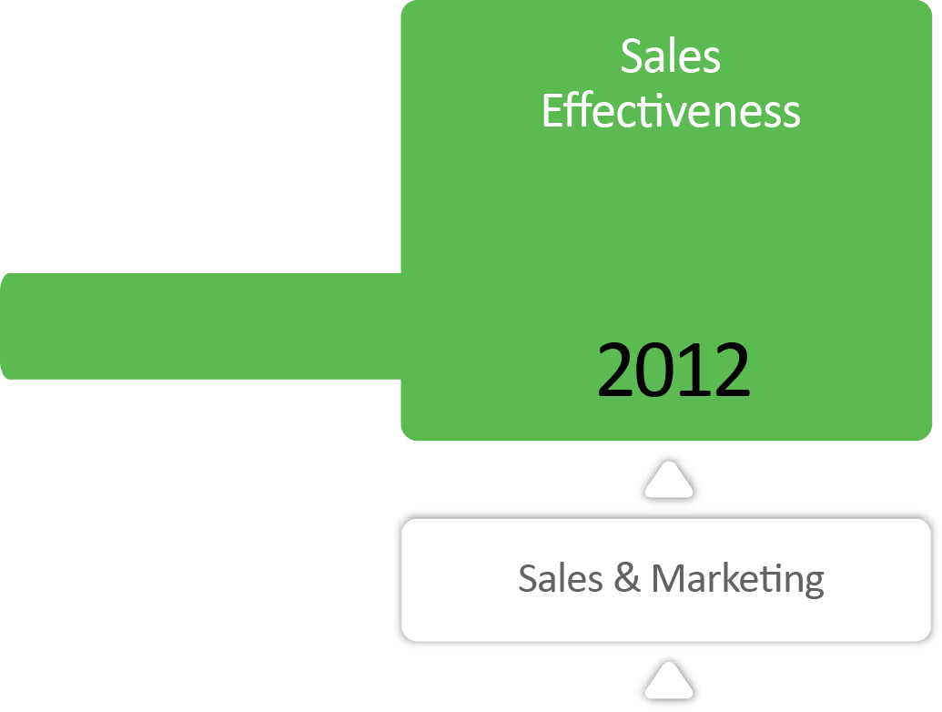

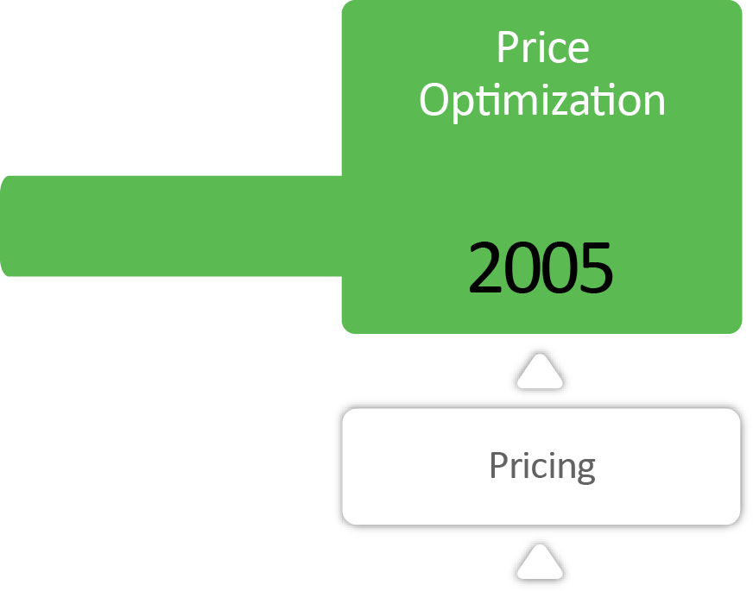

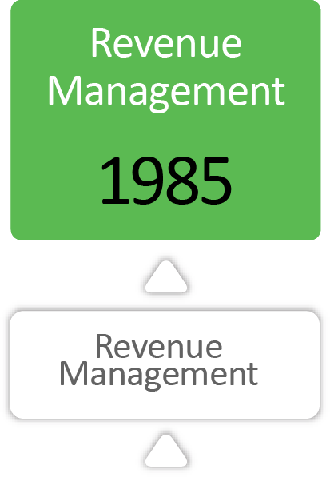
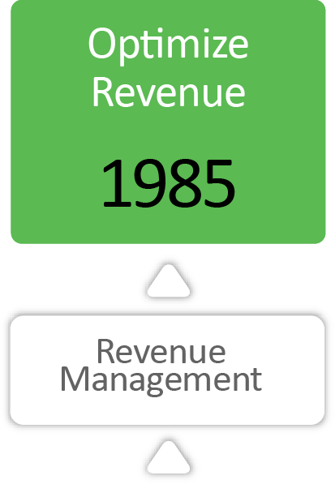

The Bigger Picture

Slide 68











































World-class Companies Choose PROS
Manufacturing
Distribution
Services
Travel
Die Bahn

Slide 69
Appendix

Slide 70
Some References
Brumelle, S. L., and J. I. McGill (1993) Airline Seat Allocation with Multiple Nested Fare Classes. Operations Research. 41(1) 127-137.
Cross, R. G., J. A. Higbie, Z. N. Cross (2011) Milestones in the application of analytical pricing and revenue management. JRPM 10, 8—16.
Talluri, K., G. van Ryzin (2004) “The Theory and Practice of Revenue Management” Kluwer Academic Publishers.
Walczak, D., E. A. Boyd, R. Cramer, (2012) “Revenue Management” – in: Smith, Barnhart (Eds.) “Quantitative Problem Solving Methods in the Airline Industry: A Modeling Methodology Handbook,” Springer, in press.

Slide 71
The Role of Forecasting
Yield to Revenue
Revenue to Pricing
Why not just call it stochastic optimization?

Slide 72
Beyond Revenue
  Revenue Management and Pricing are primarily centered on maximizing expected revenue or profit contribution. However, several other metrics are also of importance:
  Resource utilization (load factor in airline industry, re-constrained demand)
  Probabilities of certain events, e.g. sellout of capacity
  Metrics related to risk and variability of expected revenue or profit contribution
Most RM system do provide reporting based on (typically) static approximations

Slide 73
Motivation
  RM and Pricing managers and analysts are often faced with this type of
  “executive” questions or requests:
“I want increased yield and increased load factor” or
“I want increased revenue and increased load factor”
However, these are different optimization objectives which
“diverge” at some point, so each can only increase at the
expense of the other.
Therefore what is needed is a tool that shows possible tradeoffs,
sometimes called “what-if” analysis
Need a set of solutions with different values of, say, revenue and load factor so that user can select the one fitting his strategic or tactical objectives

Slide 74
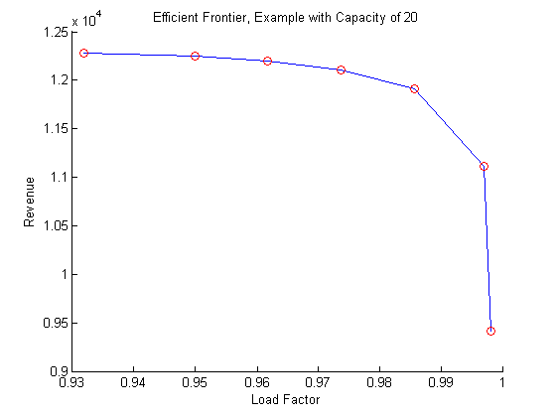
Simple Stochastic Problem, Efficient Frontier

Slide 75
Answering the Business Question
  A revenue management analyst can now respond to management by presenting some alternatives:
  “Best revenue of $... With load factor of …,” or
  “Best load factor with revenue of .$...”, or
  “Can give you the best revenue or increase load factor by …, with only … drop in revenue”

Slide 76
Customer Centric RM
Marketing
Ideas
Promotions
Business Objectives
Offer
Templates
Measure
& Forecast
Performance
Forecasts
Determine
Segment
Optimize
Offer
Win/Loss,
Revenue
Transactional Data
Request,
Customer
Segment
Info
Customer
Each property has an individual
RM system`
Capacities,
Bid Prices
CRM
Property A
Property …
Property X
76
Notes:
76

