Slide 1
Research Directions
John A. Dobelman
George R. Brown School of Engineering - STATISTICS
STAT 600, Graduate Seminar
April 11, 2016

Slide 2
PIP’s
Professor in the Practice in Statistics
  Gene Frantz, ECE
  Ray Simar, ECE
  Gary L. Woods, ECE
  Mr. Jim Blackburn, CEVE
  Mr. Joseph M. Cibor, CEVE
  Mr. Ed Segner, CEVE
  Kenneth Cox, Chemical & Biomolecular Engineering (CHBE)
  Z. Maria Oden, Ph.D., BIOE
  Ann Saterbak, Ph.D, BIOE
  Scott Cutler, COMP/ECE
  Peter Loos, MSNE
  John Dobelman, Ph.D., STAT
  n/a, MECH
  n/a, CAAM

Slide 3
Director of Professional Master’s Program
  Professional degree
  Prepare for career in industry
  Feeder for Ph.D. programs at Rice and other institutions

Slide 4
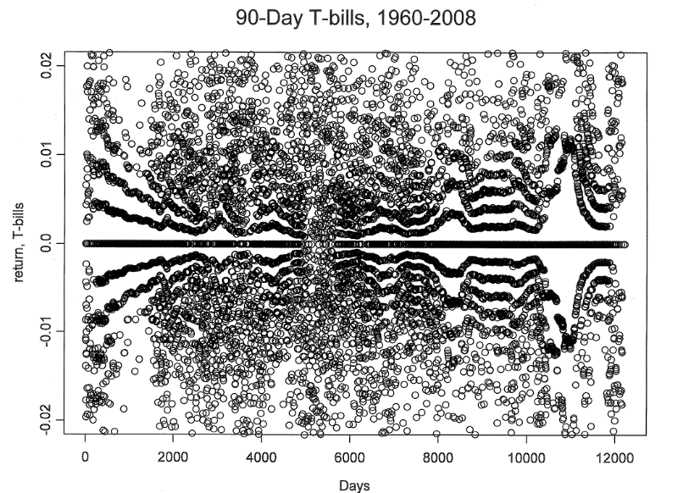
Typical Overview
Stochastic modeling for finance markets
Simulation-based and quantitative portfolio selection and management
Deception in patterns of noise
Display of quantitative information, and
Communication

Slide 5
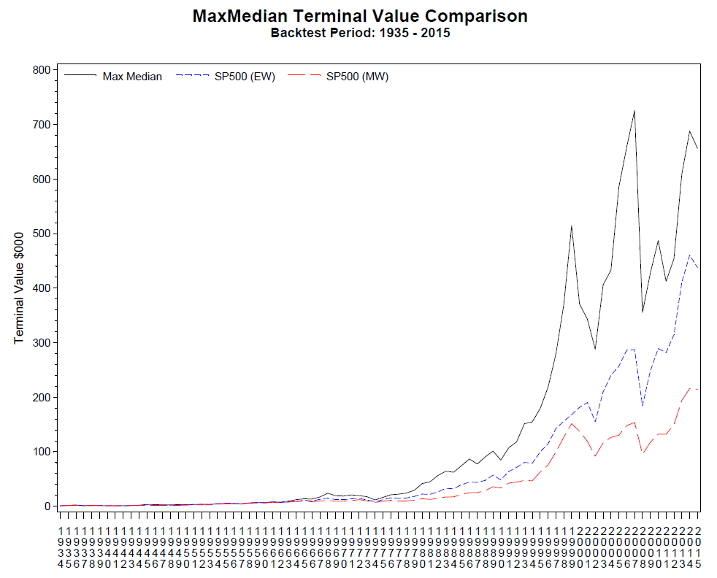


Slide 6

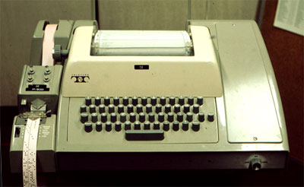

Actual program
Notes:
8-hole punched paper tape to CDC xxxxxx CPU

Slide 7
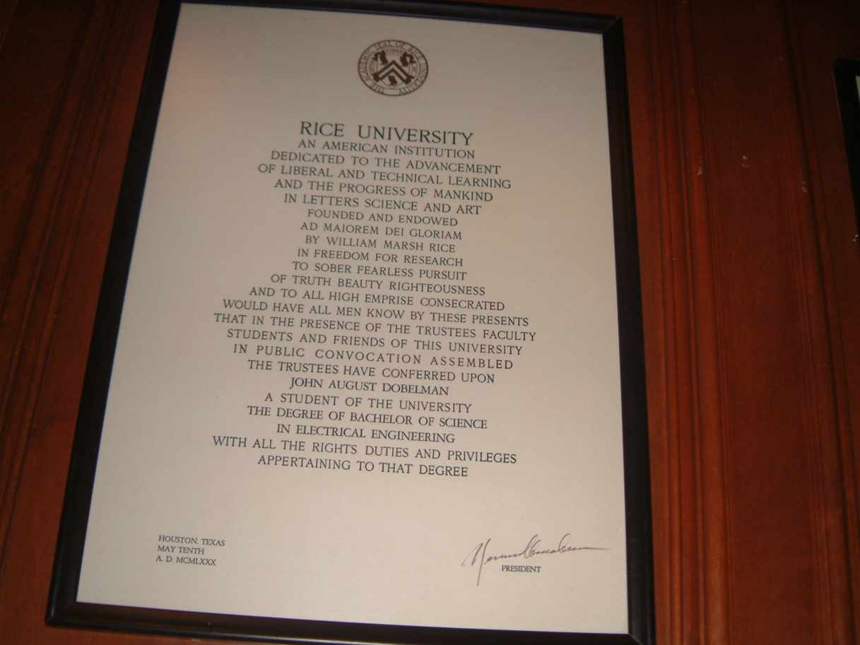

Slide 8

Old School S&E
First real job: Bindery Operator

Slide 9
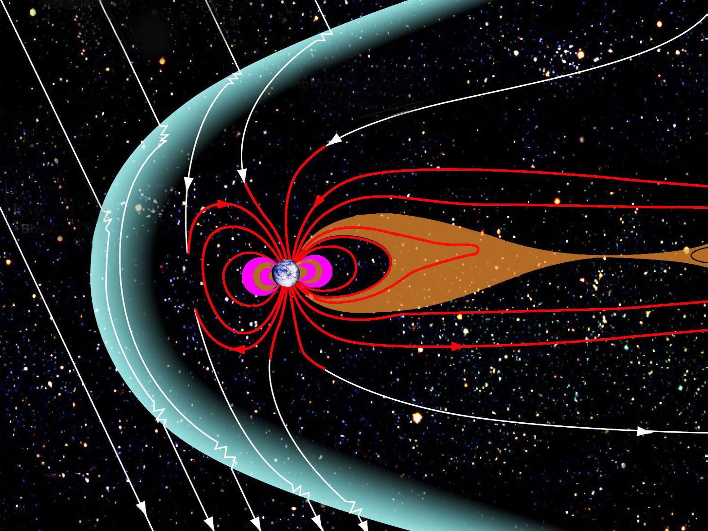
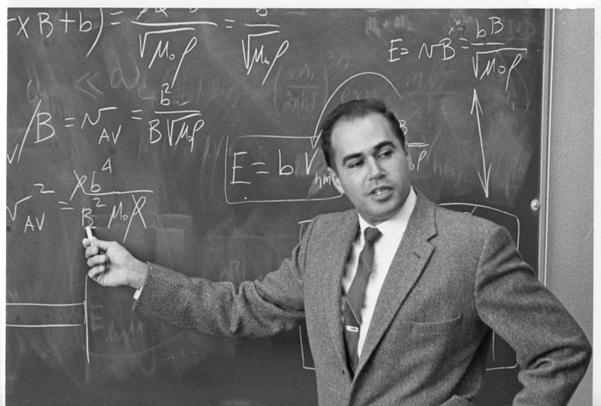
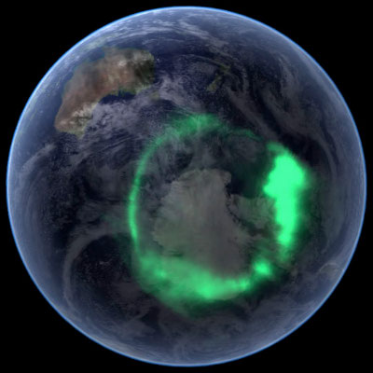

Space Physics and Astronomy
Notes:
Dessler, professor emeritus of space physics and astronomy, joined Rice in 1963 and founded the world’s first university department of space science.
The shape of the Earth's magnetosphere is the direct result of being blasted by solar wind. It prevents most of the particles from the Sun, carried in the solar wind, from hitting the Earth. The Sun and other planets have magnetospheres, but the Earth has the strongest one of all the rocky planets.

Slide 10
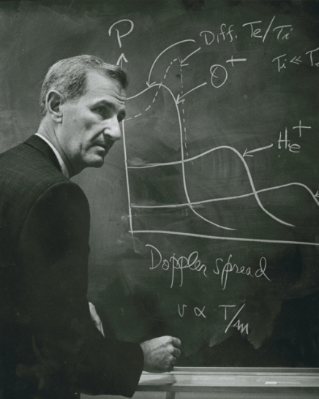
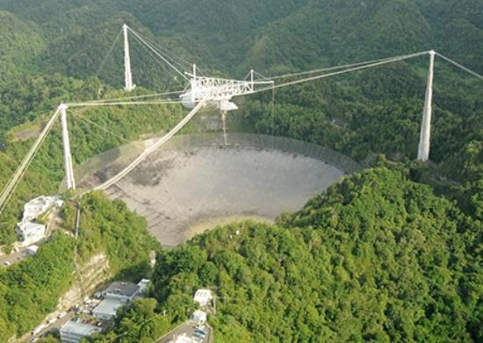
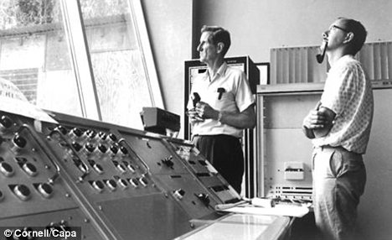
Prof. W.E. Gordon

Slide 11
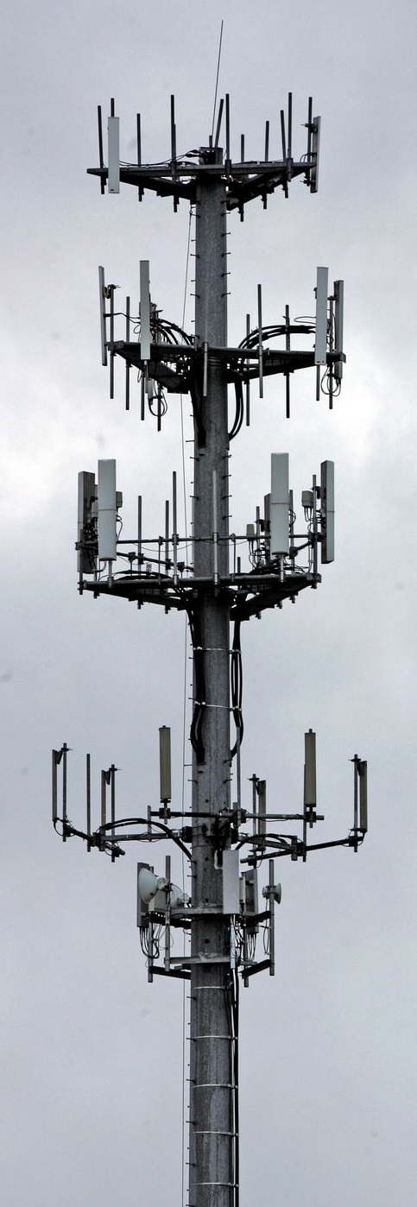
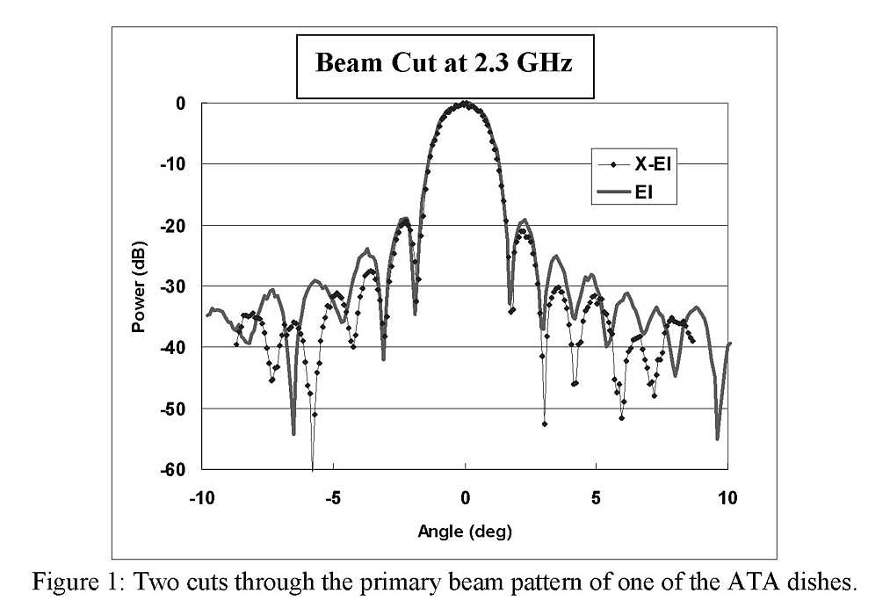
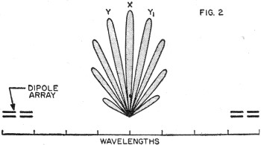
Down to Earth
Notes:
Enroute aircraft (5 mi)
Troposphere 20 km (12 mi)
Ionosphere 50-400 km (30-240 miles)
Low Earth Orbit (100mi)
Geosynchronous orbit (22,236 mi)

Slide 12
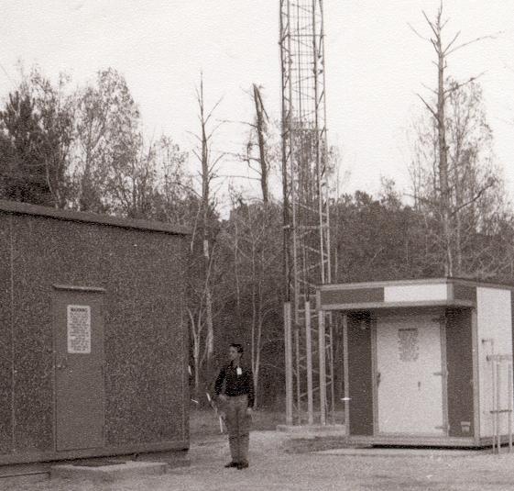
IAH RTR

Slide 13
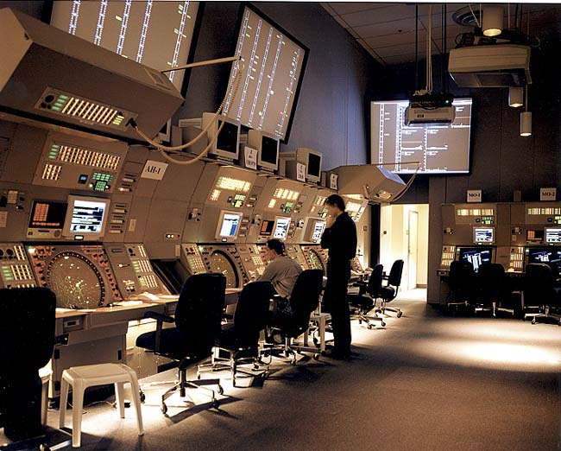
Terminal CNS
Notes:
NY TRACON

Slide 14

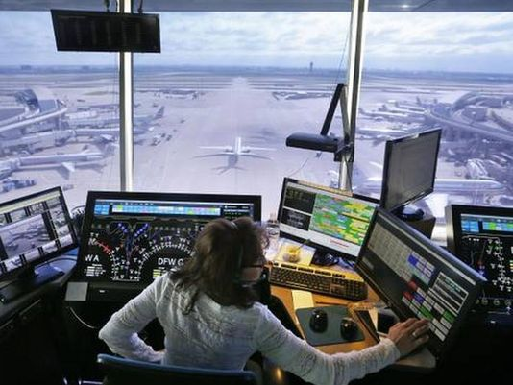

ATCT
Notes:
EWR ATCT at night
DFW AA Ops
Pei ATCT

Slide 15
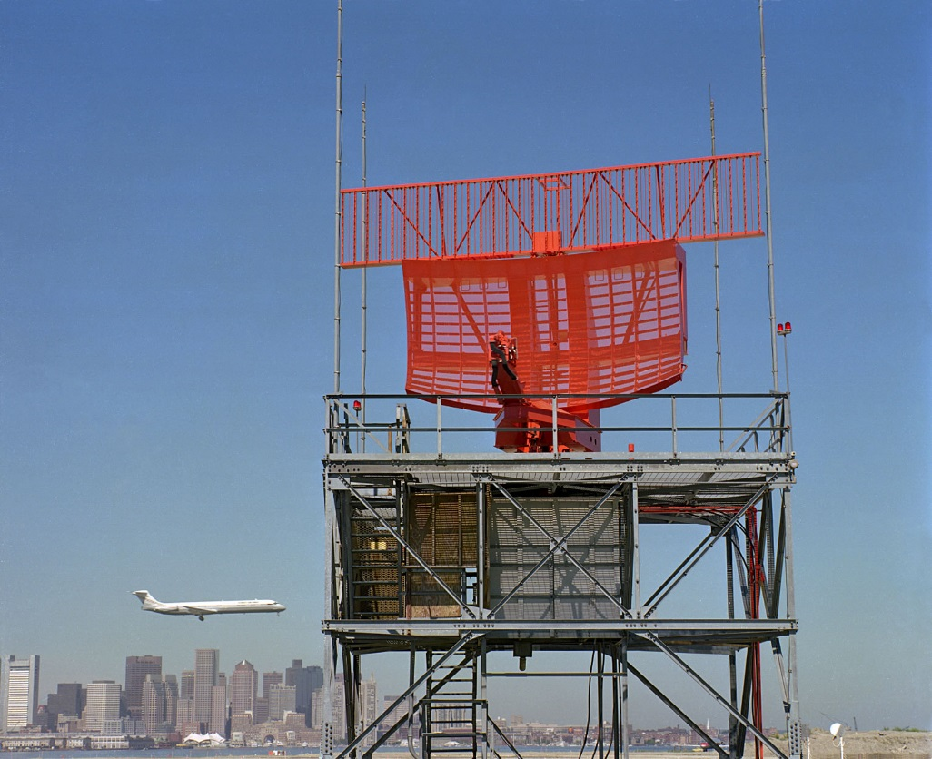

Surveillance

Slide 16

ILS/NAV

Slide 17
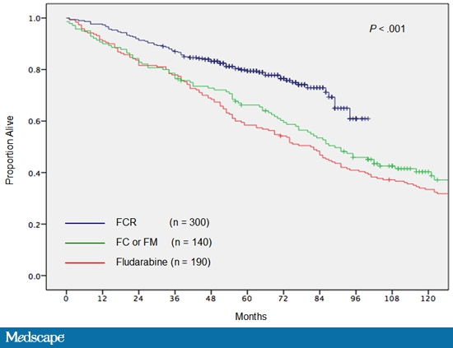
Catharsis/Epiphany
Notes:
Catharsis: the process of releasing, and thereby providing relief from, strong or repressed emotions.
Epiphany: a sudden, intuitive perception of or insight into the reality or essential meaning of something, usually initiated by some simple, homely, or commonplace occurrence or experience. (Revelation of Christ to the Magi)

Slide 18
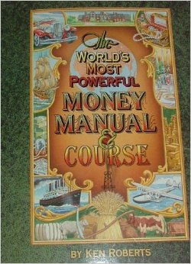
Quit your Day Job

Slide 19
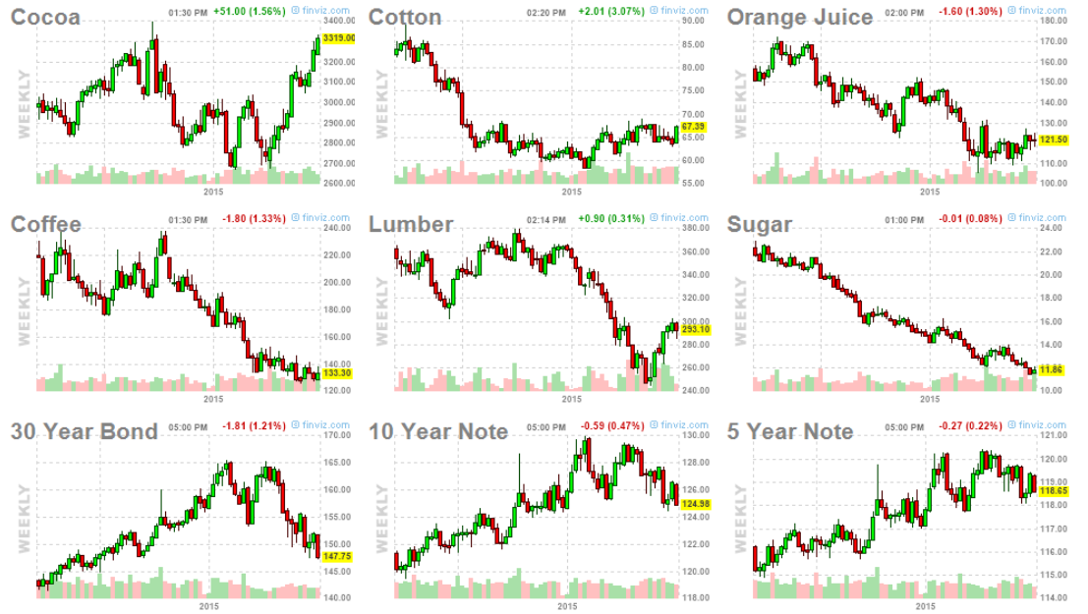
$500 a week!
CC: 10T CT: 50k# JO: 15k# KC: 37.5k# (250 bags)
Notes:
CC 10T CT /50k# ($500/cent) JO 15k# $150/cent KC 37.5k# LB 110k ft
SB 112k # US 100k 10Y 5Y7

Slide 20
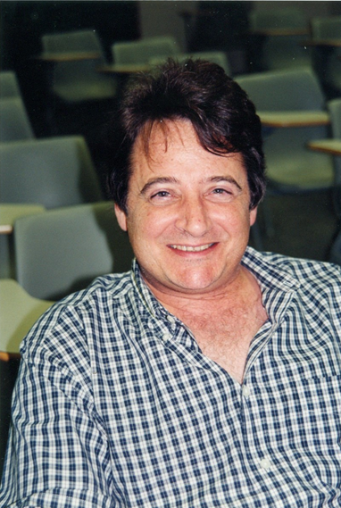

Back to Rice!

Slide 21

Lets Go to Work
22-32 (2020-2030, 10 years)
32-42 (2030-2040, 10 years)
42-52 (2040-2050, 10 years)
52-62 (2050-2060, 10 years) → 40 Years

Slide 22

Accumulation Model
Starting salary (2020)
  $17,680 minimum wage (+ SNAP)
  $50,000 Rice undergraduate degree BA/BS
Cost of living raises (COLA) = 2.5% per yr.
Investment rates of return ✓
  Bonds rate of return = 4% per year
  Stocks rate of return = 9% per year
401k retirement savings account
  Employee contributes 5% of salary
  Employer matches 4%
  Total contributions 9% of salary (off top)

Slide 23
Benchmark Summaries

Slide 24
Assuming 4%/9%
Notes:
Salary panel is just expo growth of salary at 2.5%
Retirement account is the program vallue

Slide 25
Investment Options

Slide 26
Add Some Variability
Promotion model
  10% promotion/raise on average every 5 years
Job change model
  25% salary increase upon job change average every 10 years
Focus on at terminal value of retirement account after 40 years

Slide 27
Just one Path

Slide 28
Investment Options

Slide 29
Do this 5,000 Times

Slide 30
Ongoing Program
What makes markets tick
QPM
Trading

Slide 31
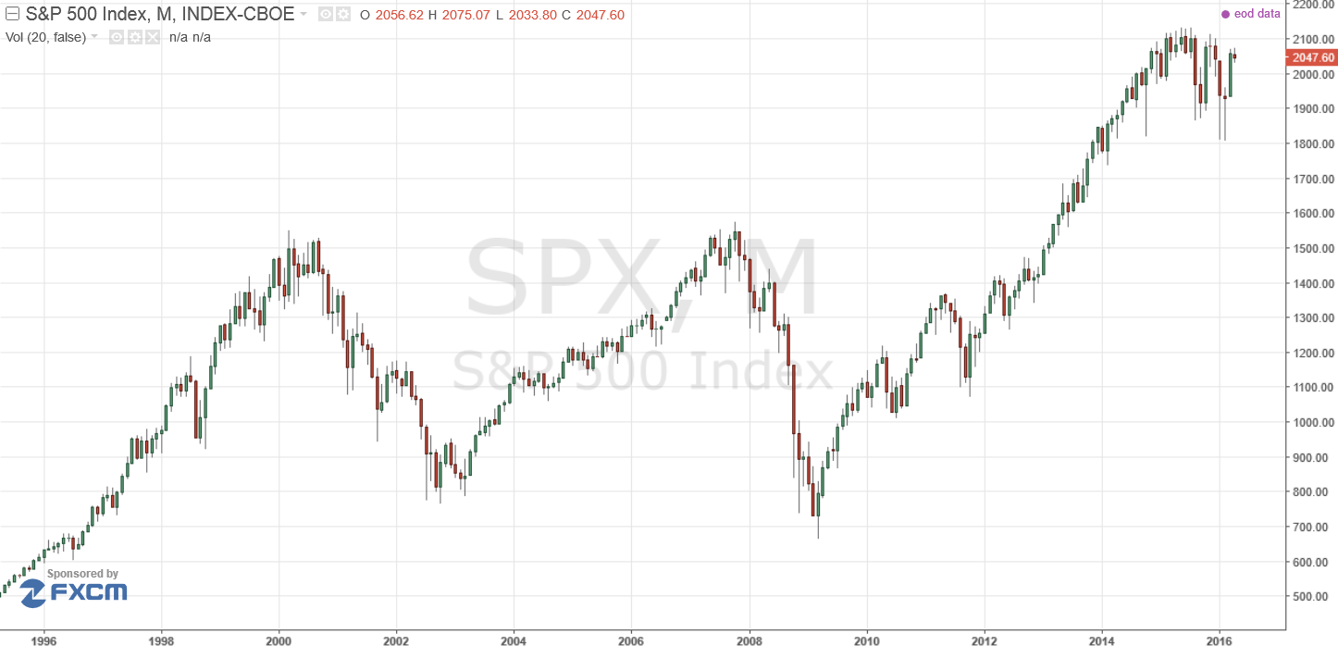
S&P 500
Practitioners immediately recognize, 10 years (Monthly bars)
Notes:
3: October 17-18, 2011
2: October 18-19, 2010
1: March 23-24, 2009

Slide 32
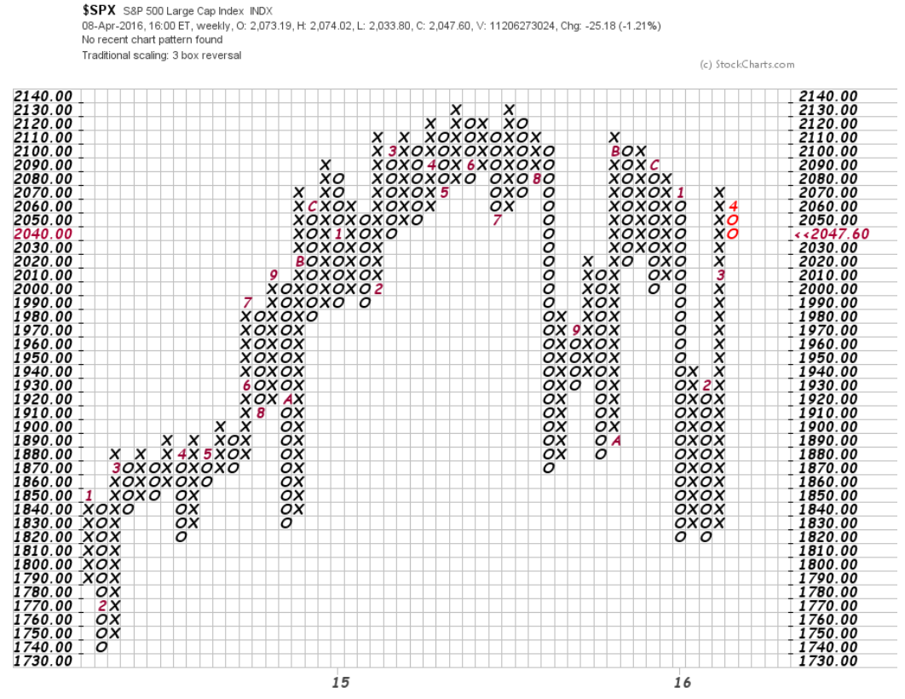
Also S&P 500

Slide 33
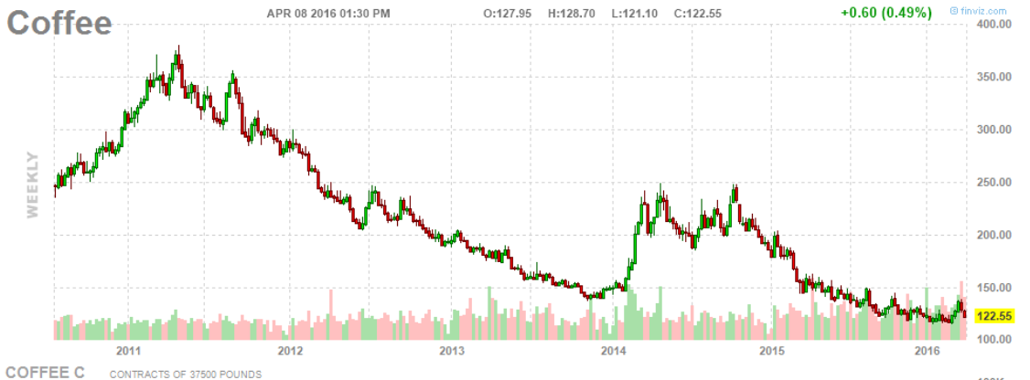

Slide 34
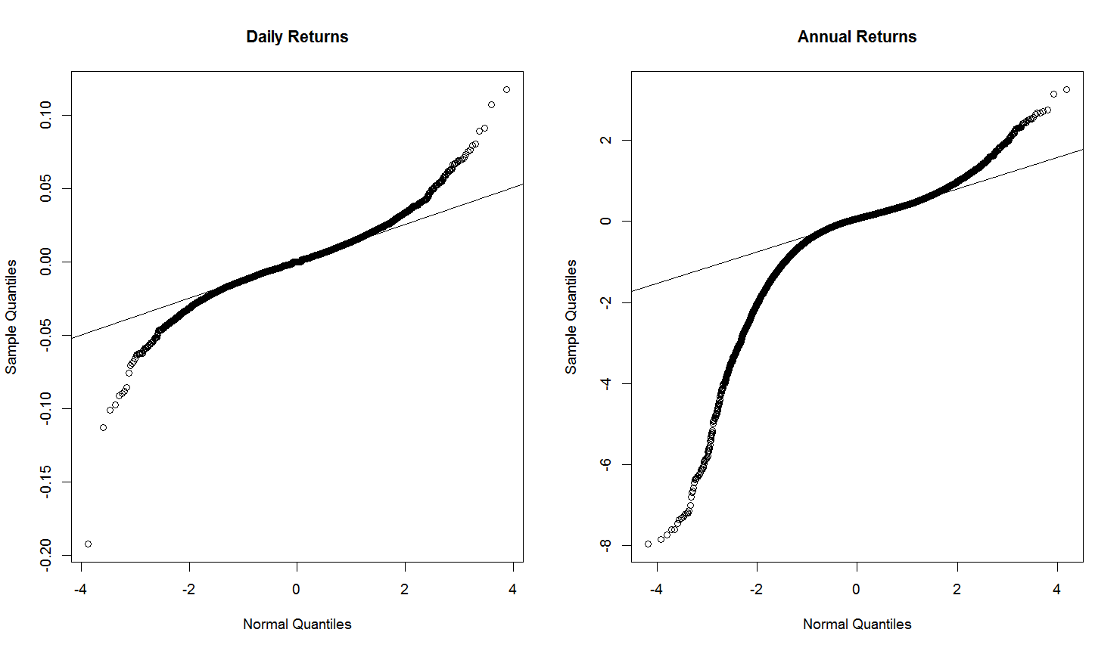

Slide 35
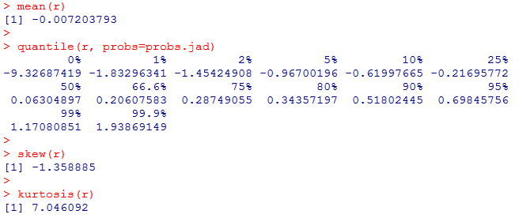
Finance is based on expected returns
Need expectation to exist
Expectation not very good proxy for the story

Slide 36
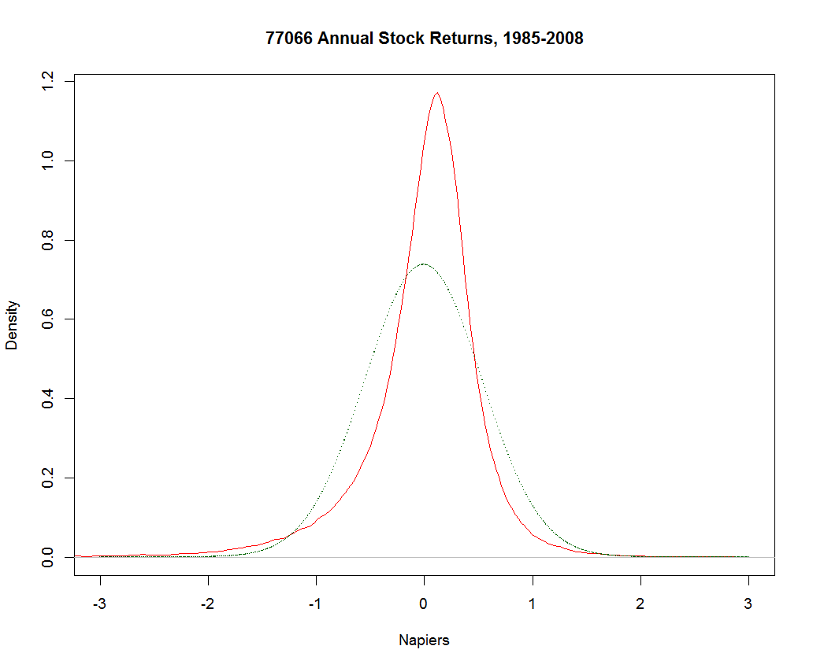

Slide 37
DGP Theory
Gaussian
Stable
Mixture
Pearson
Stochastic volatility

Slide 38
Trading

Slide 39
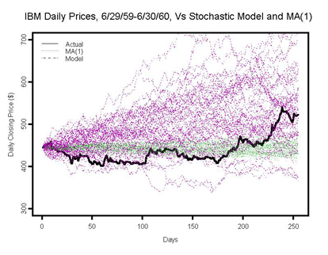

Slide 40
Notes:
This is general electric resampled returns

Slide 41
Some courses taught:
  STAT 699 Mathematical Sciences - Computational Finance
  STAT 649 Financial Engineering
  STAT 682 Quantitative Financial Analytics
  ECON 504/STAT 604 Advanced Economic Statistics
  STAT 431 Overview of Mathematical Statistics (now STAT 518/519)
  STAT 686 Computational Finance I: Market Models

Slide 42


