Slide 1
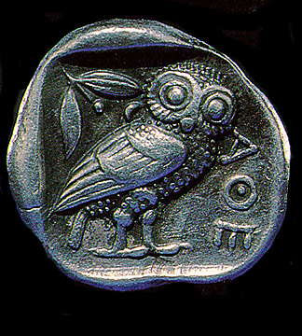


Quant Gaffes
George R. Brown School of Engineering STATISTICS
Third Eubank Conference
REAL WORLD MARKETS - INVESTING DURING TROUBLED TIMES
John A. Dobelman
Department of Statistics
October 17, 2011
Notes:
1912. He drew his inspiration from the design on a 430 B.C. Greek coin, the tetradrachm.

Slide 3
Industrialists
Fundamentals
Technicals
Investors
Q

Slide 4
Previous Discussions
Historical back- testing vs. Real-World Positions (2010)
Rags or Riches: Short Options Trading Program (2009)
Notes:
2010: 132 periods, 99-09; Comparison of in and out of sample; the left panels are for a group of factors developed without the 2008 data; when you include the out of sample results, note the drawdown!
2009: 1 strike, 25 years, draw from 10 to 65%; ticks are $1M

Slide 5
SPX: 1.04% CAGR
10/10/11
1194.89
10/17/01
1,077.09
30 Yr: 3%
10 Yr: 2%

Slide 6
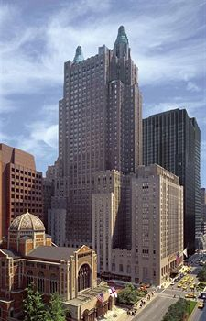
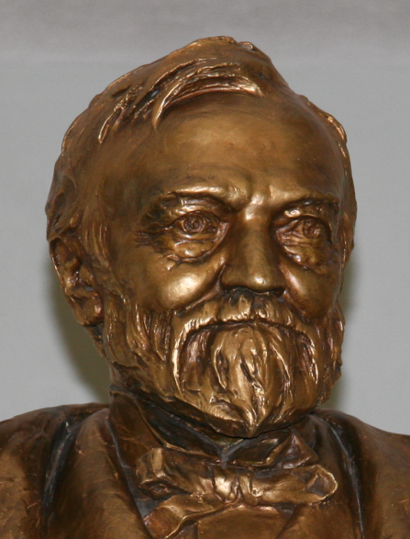
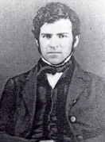


Industrialists
Robber Baron → Industrial Statesmen
John Astor ($M, Opium, RE NYC)
Thomas Edison (Inventor)
Andrew Carnegie (Steel)
Jay Gould (Railroad)
J.P. Morgan (Financial Services)
John D. Rockefeller ($B, Oil)
Notes:
1892 Morgan arranged the merger of Edison General Electric and Thomson-Houston Electric Company to form General Electric.

Slide 7
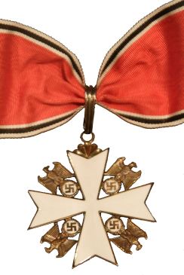
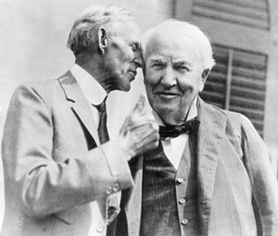
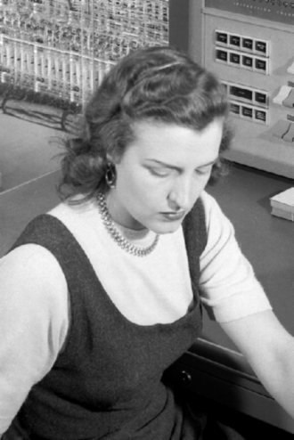
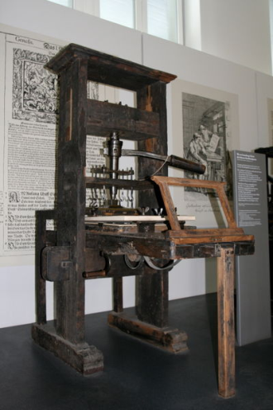

Industrialists
Henry Ford (Automobile)
$5 per day in 1914
SPC
Thomas J. Watson (IBM) 1914
Chester Carlson (1959) Xerox
Lennon & McCartney
Bill Gates/Paul Allen (1975)
Steve Jobs/R. Wayne/S. Wozniak (1976)
Notes:
Ford: "The only statement I care to make about the Protocols is that they fit in with what is going on." 1921

Slide 8
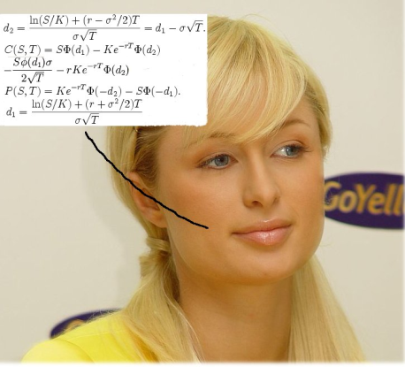
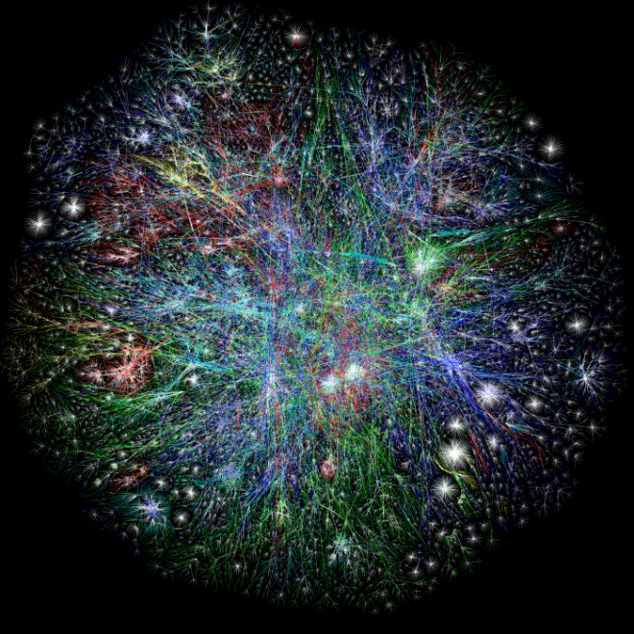
Industrialists
Black Scholes Option Pricing Formula (1973)
Quant model
Facilitated entire industry
John Bogle, 1974-75
Vanguard Group, 1st Index fund (S&P 500)
Internet
DARPA
Al Gore

Slide 9
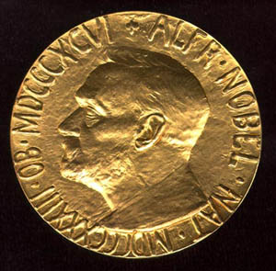
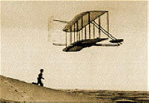
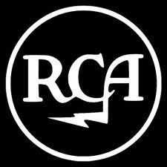
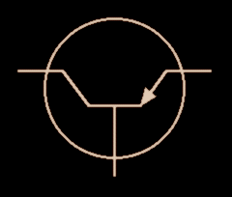
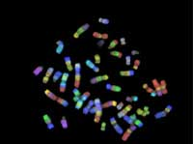
Inventor ≠ Industrialist
NOTE! Successful inventors do not necessarily become industrialists
Wright Brothers
Marconi
Bardeen
Crick, Watson, HGP
Notes:
Marconi: Nobel 1909; Hertz, Maxwell, Faraday, Popov, Lodge, Fessenden, Stone, Bose, and Tesla.
Bardeen: only person to win Nobel twice 1956 and 1972
Crick, Watson: 1953; HGP, ongpgon, began 1990’s Nobel 1962
Did not wil Nobel Prize: Wright Bros, and Fisher Black

Slide 10
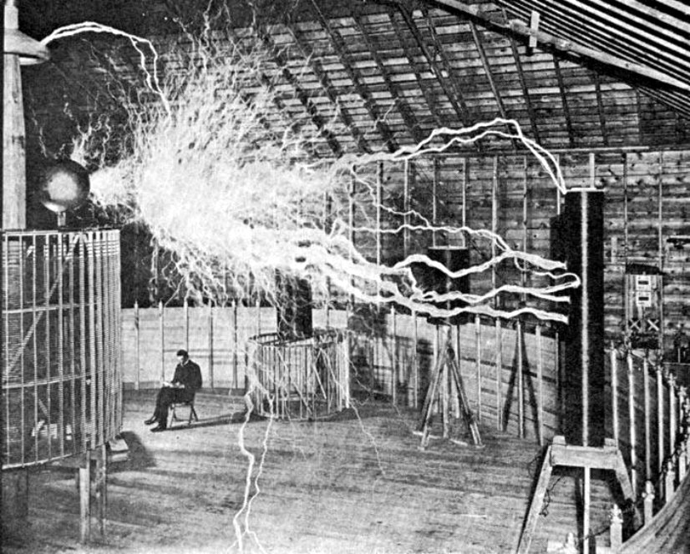
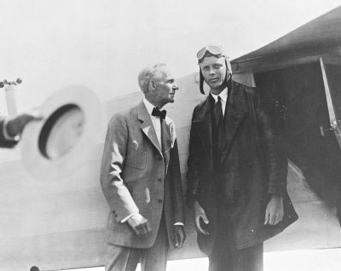
Not So Successful
Nikola Tesla
Henry Ford - Ford Airplane Division
Notes:
Nikola Tesla (Serbian raised Croatia)

Slide 11
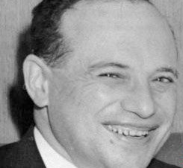
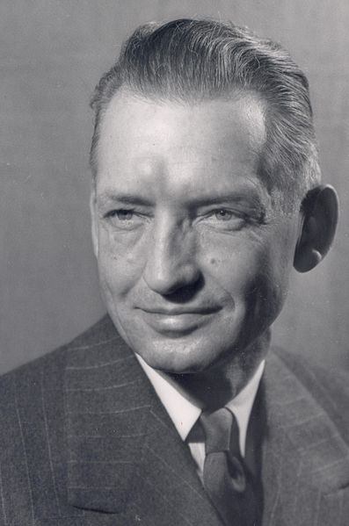
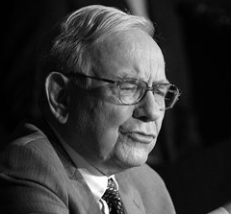
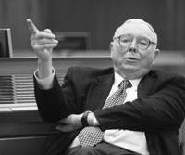
Investors - Fundamentals
Benjamin Graham & David LeFevre Dodd
Student Warren Buffett MS ’51
Notes:
Columbia university Ben Graham and David Dodd MS’21 took the notes for Graham

Slide 12


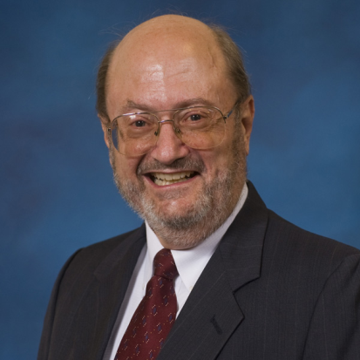
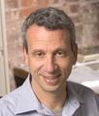
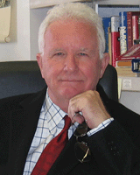
Academics as Advisors
Stephen A. Ross
Edward E. Williams
Stephen A. Ross
Richard W. Roll
Compensation Valuation, Inc.
Corr. Option valauation
TARP compliance
SIV consulting
Notes:
Stephen Ross
Richard Roll – BAAE, worked Boeing, then phd chicago; 1985-87, he was a vice-president of Goldman, Sachs & Co.

Slide 13

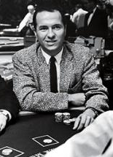
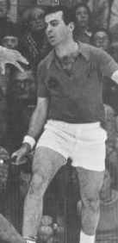
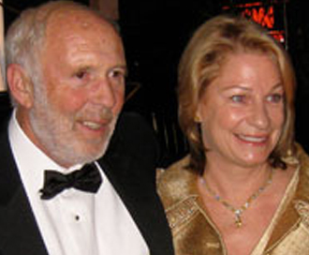
More Academics
Ed Thorp
“The World’s Largest Casino”
Victor Niederhoffer
Jim Simons
(Riesz, Schwarz, Bessel, etc.)
Notes:
James Simons had 2 students; Daniel BakerState University of New York at Stony Brook1976, and John MillsonUniversity of California, Berkeley1973

Slide 14

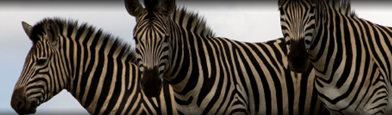

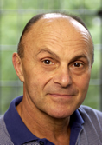
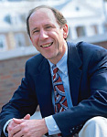

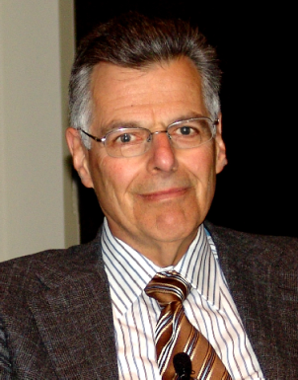
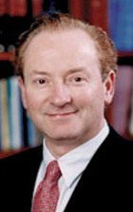
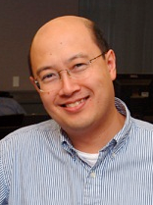
And More
Roger P. Ibbotson
Myron G. Scholes
Andrew Lo
Eugene F. Fama
Kenneth R. French
Myron G. Scholes
Notes:
French – Dartmouth Tuck Merton – MIT Sloan, PhD Economics, BS eng. math
Fama – Chicago Booth Scholes - Oak Hill Capital Management manages Oak Hill Capital Partners,
Ibbotson – PIP Yale SOM a private equi
Robert Merton -
Andrew Lo – MIT Sloan, Chairman and Chief Investment Strategist

Slide 15

Trying At Least
“Seeking alpha“ – About 13,100,000 results
Barras, et.al. (JOF 2010)
Pre-expense, positive alpha funds ~ 9.6%
Net fees, positive alpha ~ 0.6%
75% of funds exhibit zero alpha (net)
significant proportion positive prior to 1996
almost none by 2006
proportion of unskilled increased ↑↑
Skilled funds capture the entire surplus

Slide 16
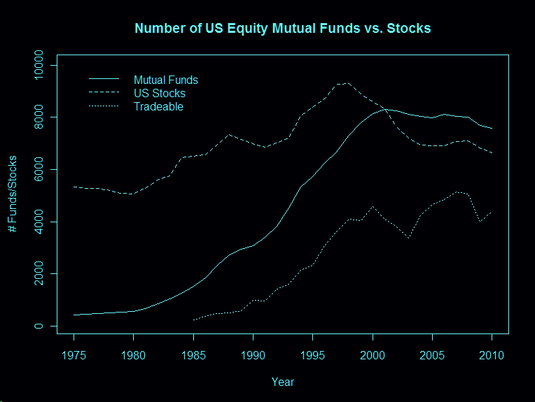
Notes:
C:\research\Eubank\E2011\Images\Plots\fundcounts.emf

Slide 17
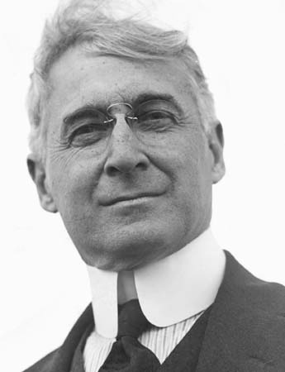
Traders/Speculators
Definitions Spectulation
“An investment operation ... not based upon thorough analysis” – G&D (1934)
“To profit by either a rise or a fall in the price of whatever he may be speculating in” – J. Livermore, c.1919
Not Quants
Greats of the Past
Bernard Mannes Baruch “Lone Wolf of Wall Street“
Old Fashioned way

Slide 18
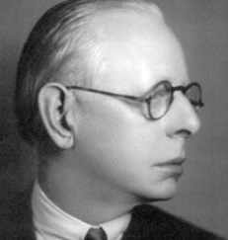
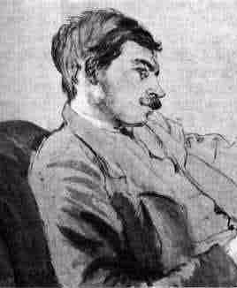
Great Traders
Jesse Livermore “Boy Plunger”
1907 "Banker's Panic,” and crash of 1929
John Maynard Keynes “I Didn’t Say Insolvency”
Kings College Bursar
Emerging equities (US), Currencies, commodities
13% returns
Not so lucky on his own
Notes:
Keynes operated in Depression era; at the beginning of March 1937, when in a conversation with Felix Somary ("the Raven of Zurich"), Keynes said "We will not have any more crashes in our time." Over the following year, the market lost about half its value, with the Dow reaching its trough near the 100 level. Keynes walked right into the 1937-1938 plunge.
Quote: Markets can remain irrational longer than you can remain solvent. [The handle Cancerward was used by the person who added the 1993 citation for Gary Shilling in Forbes.]

Slide 19
More Great Traders
George Soros - “The Man Who Broke the Bank of England" $1.1B shorting £ in 1992
Jim Rogers – Co-founded Quantum 1973
William O’Neil (founder of Investor’s Business Daily)
Warren Buffet and Berkshire Hathaway
Said his WORST trade was buying BRK.A
Paul Tudor Jones (Tudor Investment Corporation) - charges 4-23
Jim Simons (Renaissance funds) - charges 5-36 (or 5-44 after 2008)

Slide 20
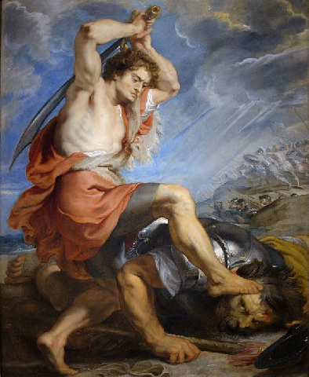
More Great Traders
Bruce Kovner, Largest interbank/futures currencies trader
Mai, Ledley and Hockett of Cornwall Capital
1st suit against BSC for SP hedge fund 8/1/07
“There can come a moment when you can’t trade with a Wall St. firm anymore, and it can come like that”
$205M CDS on AA tranche SP CDO’s @50bps
Fri 8/3, only UBS would buy w/o ISDA, and at 3000bps! By 8/6 everyone wanted them.
Got out at about 4100bps; ($81M/$1M)

Slide 21
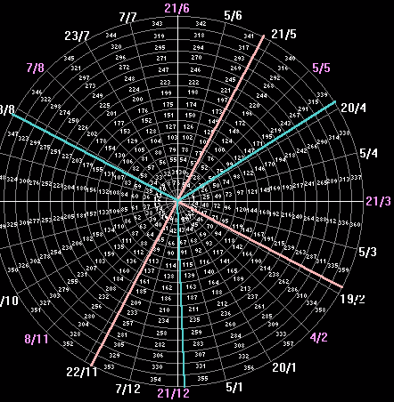
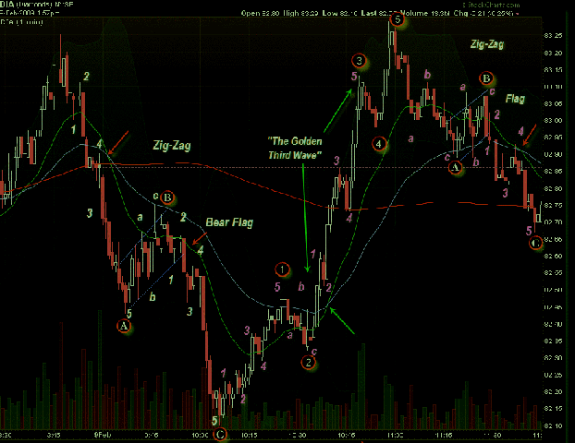
Not So Great
Dow Theory - Charles H. Dow (1851–1902)
William D. Gann
geometry, astronomy, astrology, ancient math
$uccess debated
Ralph N. Elliott
1871–1948
Robert Prechter
“Bearish since 1985”

Slide 22
Rogue
“A bank's trading desk is like a tribe - the smartest and most powerful tribe in the financial house's building”
“The job of a derivatives trader is akin to a bookie once removed, taking bets on people making bets”
“A successful trade makes you feel invincible. But when things start to go wrong … the creeping, paralysing panic takes hold… you just shut down your browsers and walk away...”

Slide 23

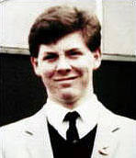
Nick Leeson, 1995
Wiped out Barings Plc, UK's 233 yo merchant bank, $1.4B losses
Simple Nikkei futures on SIMEX
By 1993 made £10m (10% yr’s profit)
By 1994 Acc’t 88888 in hole <$512M>
Long, but 1/17/95 Kobe earthquake
Bought > 20,000 contracts to move mkt
¥10,000,000 PER POINT! ~ £71,500

Slide 24
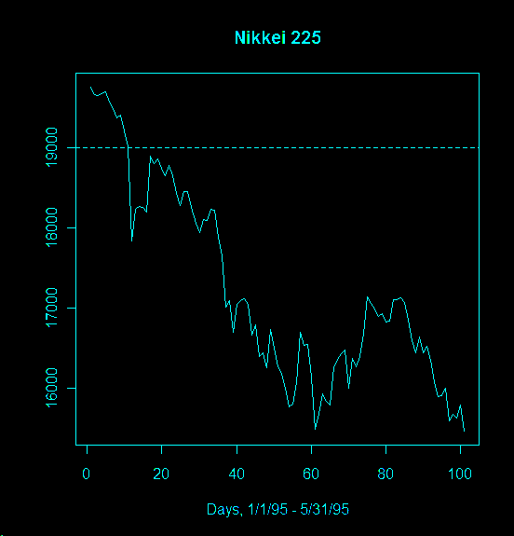
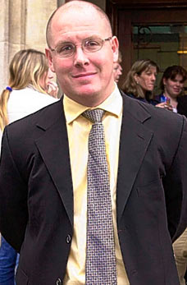

Served 4.3 Yrs
In Singapore prison, wife left him, he contracted colon cancer. Remarried, beat the cancer, had son, made CEO of Galway Fund; bookings at nickleeson.com

Slide 25
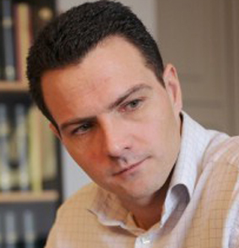
Jerome Kerviel, 2008
Caused Société Générale <$7.2B> losses
Former middle-office IT → trader
Delta-1 ETF arbitrage derivative products, to $73 billion in positions
3 Yr sentence in 2010, repay €4.9B

Slide 26
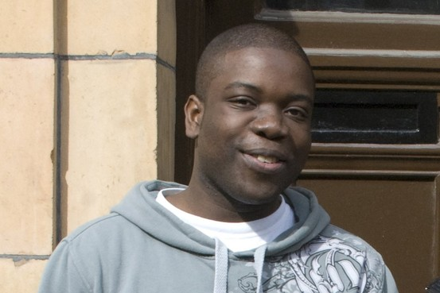
Kweku M. Adoboli, 9/15/11
UBS AG, <$2B > losses
Former back-office employee
Delta-1 Gold ETF trades
Engaged Kingsley Napley LLP (UK), also representing News Corp.’s Rebekah Brooks

Slide 27
Quants
Used to be called “Rocket Scientists”
Quant Finance Financial Engineering
Physics, Math and Computer Science as applied to financial products
Note: Eng = App_{κοσμοσ}(Science)
Backtest/develop systematic alpha generating strategies
Build models/forecasts (HF, Trendfollowing)
Models for risk management
Pricing: financial and credit derivatives, exotics and hybrid products, multi asset products, etc.

Slide 28
Quants
Modelers - Theoreticians/Practitioners
Traders/Advisors
Not usually both

Slide 29
Modelers/Engineers
Some Contributors
Bachelier, Kendall, Working, Cootner, Samuelson, Markowitz, Fama. French, Roll, Sharpe, B-S-M, Hull-White, CRR, JPM, CIR, Vasieck, BDT (B-Derman-Toy),
Breakthoughs – New Axioms
Risk ≡ σ (finite variance distributions)
= -C + ΔS (replicating portfolio)
Arbitrage-free/complete markets (discrete/continuous)
Fundamental theorems of asset pricing
FTAP1, FTAP2
Notes:
The First Fundamental Theorem of Asset Pricing: A discrete market on a discrete probability space (Ω, , P) is arbitrage-free if and only if there exists at least one risk neutral probability measure that is equivalent to the original probability measure, P.
he Second Fundamental Theorem of Asset Pricing: An arbitrage-free market (S,B) consisting of a collection of stocks S and a risk-free bond B is complete if and only if there exists a unique risk-neutral measure that is equivalent to P and has numeraire B.

Slide 30
Pedantics
Perhaps semi-variance; if long maybe we’d like some movement to the upside
No closed-form solution to M-V optimization
When they say they mean
The axioms REQUIRE an astute cadre of 24/7 arbitrageurs, individuals and funds:
Convertible & Fixed Income Arbitrage, Event Driven, Multi-Strategy

Slide 31
It’s an Honest Living
Quants are needed to:
create securities satisfying clients’ need for return vs. risk
provide models to price those securities
manage the high-frequency strategies present in many business models
for today’s businesses to compete in the increasingly quantitative world.

Slide 32
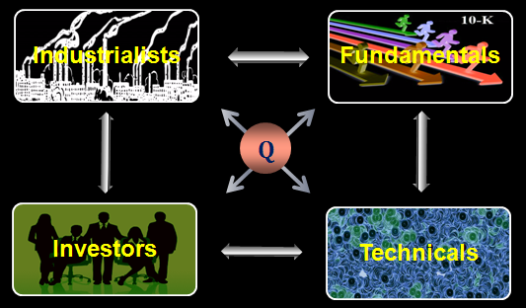
Quant Industrialists
Business analytics – SAP, Pricing, JIT Inventory, etc.
EBAY, Brokering, Information Collection and correlation (FB, Tweeter, NSA, CIA, etc.)

Slide 33
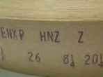
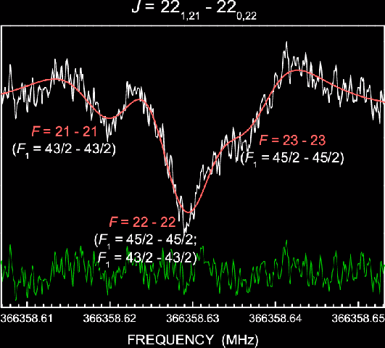
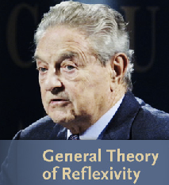
Quant Traders
Not the same as technical traders
Successful Quant Traders
Jesse Livermore
Ed Thorp 43/44 π
Jim Simons 39.15% CAGR
Soros’ Quantum Fund 30.1 CAGR 88-99
The 50 out of 9000 superior hedge funds
Notes:
Thorp: first market neutral hedge fund 1969

Slide 34
Modelers/Engineers
Ed Thorp - "godfather of the Quants“
Peter Muller of Morgan Stanley
Ken Griffin of Citadel
Boaz Weinstein of Deutsche Bank
Cliff Asness of AQR
B-S-M
Emanuel Derman - "The math of economics is so much more formal than that of physics - it reads like Euclid or set theory … You’d think that all this would produce precision. Yet, compared with physics, economics has so little explanatory or predictive power."

Slide 35
Big Daddy of ‘em All
B-S-M created for sell side (Dealers)
Black’s penchant for equilibrium resulted in the B-S PDE, which was eventually solved
B-S price is such to cover the cost to hedge over the life of the position
“Can sell as much risk as the client wants w/o taking on risk yourself”
Very utilized economic solution

Slide 36
Example-Securitization
“Originate and Sell!”
FNMA, FRE[FMCC], GNMA, FHLB
Mutual Funds, Pension Funds, Insurance Funds, Hedge Funds, Investments Banks (BSC, MER, GS, MS), Int’l
Asset Acquisition
Pooling
Standardize
Sell

Slide 37
Why Quants
Need to bid on pools offered by GSE’s
Bond Valuation Models (Salomon)
ARM’s tricky ≡ complex option
Estimate
Yield curve
Default/repay rates
Zipcode
Simulate → Value of pool
Do this in 30 minutes

Slide 38
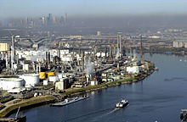
A History
1970 First MBS (GNMA)
1983 First CMO (First Boston/Salomon)
1985 2nd ABS $60M CARS
1986 $50M Credit Card CDO
1987 AIG FP formed for Carpe Diem
1991 Steve Eisner begins Jr. Analyst at Oppenheimer, covers “specialty finance”
“it was a piece of ---- I didn’t know you weren’t supposed to put sell ratings on companies”
“Lomas Financial is perfectly hedged - it loses money in every conceivable interest rate environment”
Notes:
1. According to Dexter at the 2011 conference, the "CARS deal was ABS#2; the first deal was 1-2 months earlier, for Sperry, securitized computer leases.“ (Wikiprob)
2. AIG FP by Drexel Burnham Lambert and finance scholar Sosin
3. Eisner: Yeshiva school, the UPA, then Harvard Law, then corporate lawyer. Went to parent’s Oppenheimer at 31yo.

Slide 39
History
1995 $30B in Subprime Loans (SP); 65% fixed-rate
1997 Eisman’s un-PC report on SP consumer finance
1997 SP lenders fail in boom of ‘97
2000 $130B SP → $55B CDO
2001 AIG FP doing $300M CDS per year, contributing 15% profit
“involuntary prepayments”, “manufactured housing loans” = high defaults in the mobile home loan space

Slide 40

History
2002 No public SP lenders save HFC; Eisner furious at fraud; helped ACORN get $484 class-action; sold to HSBC Group (UK) for $15.5B
2004 Concludes all consumer finance screwing poor; MS lets him set up fund
2004 CDS on corporate bonds available
2004 Michael Burry actually READ the SP bond prospectuses; wanted to short bonds, but was impossible. Sought CDS on SPMB
Notes:
HFC lying to subprime clients, 7.5% really 12%, 30 year really 15 years.

Slide 41
History
2005 SP back up and running; $625B SP → $507B CDO’s; 75% ARM’s; first resets not due till 2007, so do it now
2005 Only GS and DB interested; Burry was 1st “retail” customer.
BBB only (250bps); (AAA 20bps, A 50)
GS would do $5 in 6/05; By 7/05 offering $100M, not on other side!
AIG FP was selling to GS for 12! $400M riskless profit/yr to GS
2005 Offered $1-10B to Paulson

Slide 42
Getting Traction
“How do you explain to an innocent citizen of the free world the importance of a credit default swap on a double-A tranche of a sub-prime collateralized debt obligation”
-Ben Hockett

Slide 43
Bottom Line
Worst class of SPMB had a description:
“interest-only, negative-amortization adjustable-rate subprime mortgage”
What they needed and had manufactured by persistence
“CDS on AA-rated CDO’s on BBB-rated PMB’s”
Burry/Eisner bought the BBB
Cornwall bought the AA

Slide 44

July 18, 2007

Slide 45
8/31/07, 20 days after Cornwall sold their AA’s for 4100bps, Burry sold his BBB’s for 8500 bps to desperate Wall St. firms.
Burry’s fund made $750M
Fewer than 100 buyers of these CDS’s
Most were hedgers
Some were ill-advisedly doing convergence trades using them
Between 10-20 actually saw it coming and worked to get the product available

Slide 46
Back on Main St.
S&P 500
▲

Slide 47
Stocks Finally Caught Up

Slide 48

“Unsolved Mystery”
Huge problem with the equity hedge funds August 6-10, 2007
Quantitative equity market-neutral, and stat arb funds all suffered major losses

Slide 49
August 6-9, 2007
Khandani and Lo reversed engineered the crisis and posited a scenario of forced liquidation which cascaded into the other funds (“unwind” hypothesis)
Firesale liguidation of the other quant portfolios; the strategies are all highly interconnected
“Small world” phenomonon – SP spilling unrelated corner of market-neutral equity strategies

Slide 50

Summer 1997
Similar to the Asian financial crisis: Thai gov’t floats the Bhat.
Dr. Niederhoffer buys hammered Thai bank stocks, trusting “TooBigToFail”
10/27/97 sees -7σ drop; the puts were in pain, margin calls. Lights out.
Resumed trading 1998 Wimbledon Fund, w/offshore OPM Matador Fund in 2002
Matador closed in 2007 fallout, margin calls.

Slide 51


August 1998
Comparisons to the August 1998 fixed income convergence funds destruction after the Russian bond defaults.

Slide 52


Traders Quants
"The capacity to wreak destruction with your models provides the ultimate respectability"

Slide 53

Acknowledgements
Tom & Nancy Eubank
Hope Derosette Dobelman
Katherine B. Ensor, Director
Center for Computational Finance and
Economic Systems (CoFES)
James R. Thompson, Founding Chair
Noah Harding Professor of Statistics, Rice University

Slide 54
References
Laurent Barras, Olivier Scaillet, And Russ Wermers; "False Discoveries in Mutual Fund Performance: Measuring Luck in Estimated Alphas", J.Fin, v65, Issue 1, pages 179–216, February 2010.
Derman, Emanuel. "My Life as a Quant: Reflections on Physics and Finance." Wiley: Hoboken, NJ. 2004.
Ravi Jagannathan, Alexey Malakhov, Dmitry Novikov; "Do Hot Hands Exist among Hedge Fund Managers? An Empirical Evaluation", J.Fin, v65, Issue 1, pages 217–255, February 2010
Edwin LeFevre, Reminiscences of a Stock Operator, New York : J. Wiley, 1994.
Patterson, Scott. "The Quants: How a New Breed of Math Whizzes Conquered Wall Street and Nearly Destroyed It." New York: Crown 2010.

