Slide 1

alt.investments
George R. Brown School of Engineering STATISTICS
Sixth Eubank Conference on Real World Markets:
Risk and Opportunity - The Way Forward
John A. Dobelman
Department of Statistics
April 25, 2016

Slide 2
alt.investments
  alt.investments.stock
  alt.investments.cash
  alt.investments.bonds
  alt.investments.futures
Notes:
http://www.stern.nyu.edu/~adamodar/New_Home_Page/data.html

Slide 3
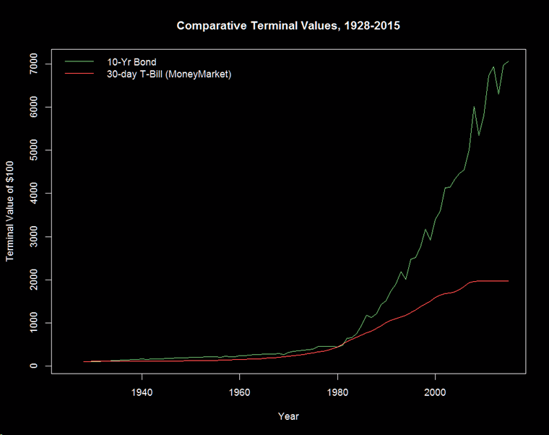
Notes:
$100 Beginnin principal in 1928 (88 years)

Slide 4
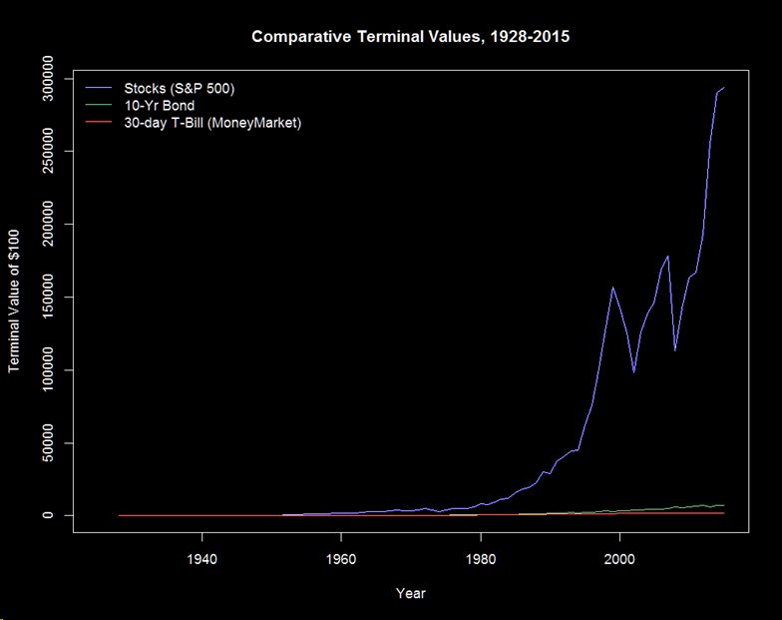
Notes:
$100 Beginnin principal in 1928

Slide 5
1st Eubank Conference
Recall the First Eubank conference (March 23-24, 2009) was held at the very bottom of investor sentiment and pessimism during the 2008-2009 meltdown
Recall the Third Eubank Conference October 17-18, 2011:
    Real World Markets - Investing During Troubled Times

Slide 6
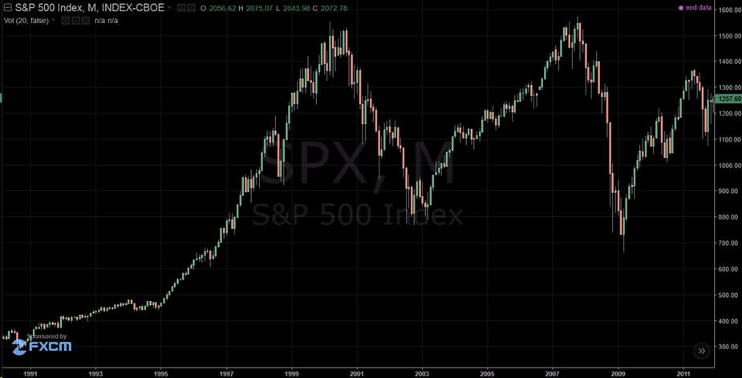



US Stock Market
(As of Third Eubank Conference)
Notes:
3: October 17-18, 2011
2: October 18-19, 2010
1: March 23-24, 2009

Slide 7
SPX: 1.04% CAGR
10/17/01
1,077.09
10/10/11
1,194.89
R_{T} = 10.9%
10 Yr: 1.04%
Notes:
The data is from Eubank 2010, 1928-2000 for 10 year horizon foir example

Slide 8
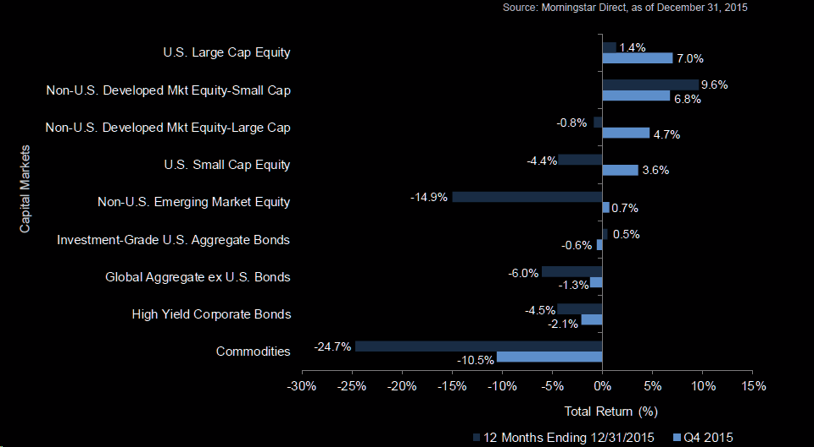
Back to 2015
Notes:
Source: Raymond James

Slide 9
2015-2016
Notes:
Lookin pretty bad at the beginning of the year 2016

Slide 10
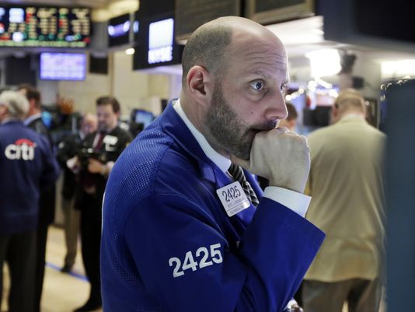
Headlines
USA Today (January 9, 2016)
Stocks close out week with worst start to year ever

Slide 11
1 Year

Slide 12
Last 2 Years

Slide 13
Since 3rd Eubank

Slide 14
Since GFC
Notes:
Global Financial Crisis

Slide 15
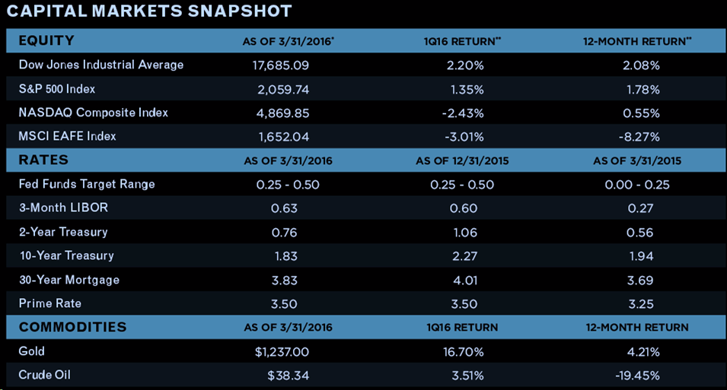
YTD 2016

Slide 16
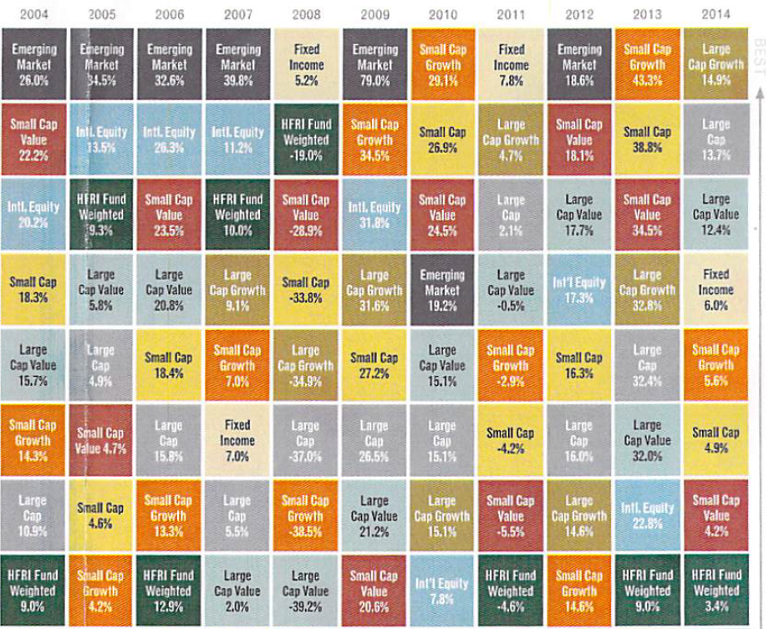
Traditional Vehicles
Notes:
In 2000-2002 the HFRI (HFR company index) was in the top third, and fixed income was in top two places, looking very much like 2008
HFRI: Broadly constructed indices designed to capture the breadth of hedge fund performance trends across all strategies and regions.
HFRX: Daily indices utilizing a rigorous quantitative selection process to represent the larger hedge fund universe.
HFRU: Euro-denominated performance benchmarks comprised of hedge funds compliant with established UCITS guidelines.
HFRL: Intra-day indices based on an optimized composition of liquid positions indicative of HFR's representative hedge fund universe.

Slide 17
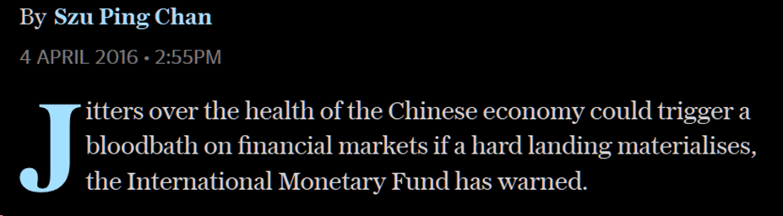
http://www.telegraph.co.uk/business

Slide 18
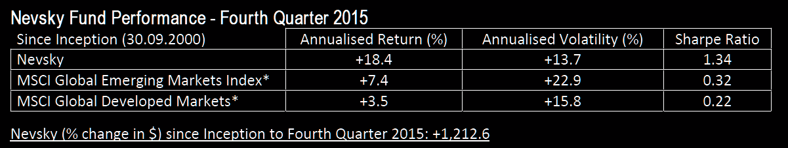
In summary, various factors now mean that it is more difficult than ever before for us to accurately forecast macroeconomic and corporate variables. It is therefore time to accept that what we have done has worked brilliantly for twenty years but does not work anymore and move on. We are confident our process will eventually work again – for the laws of economics will never be repealed – but for now they are suspended and may be for some time; an indefinite period involving indeterminate levels of risk during which we think it would be wrong for us to be the stewards of your money.
Notes:
1 Why have Nevsky Capital decided to cease managing the Nevsky Fund
2 Data quality has deteriorated
3 The transparency of decision making has also declined
4 Equity markets are also less transparent
5 Fat tail risk has also increased
6 Asia is becoming an increasingly dominant time zone

Slide 19
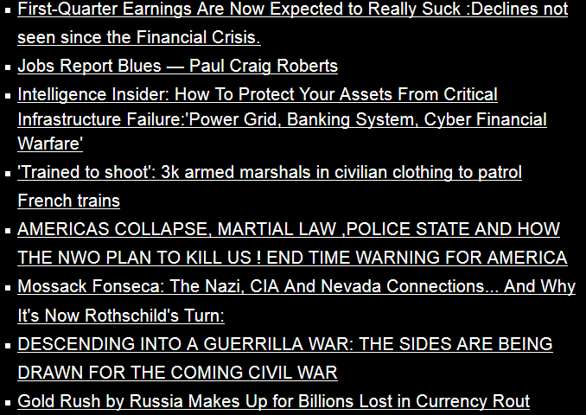
4 April 2016
http://www.zerohedge.com/(etc)

Slide 20
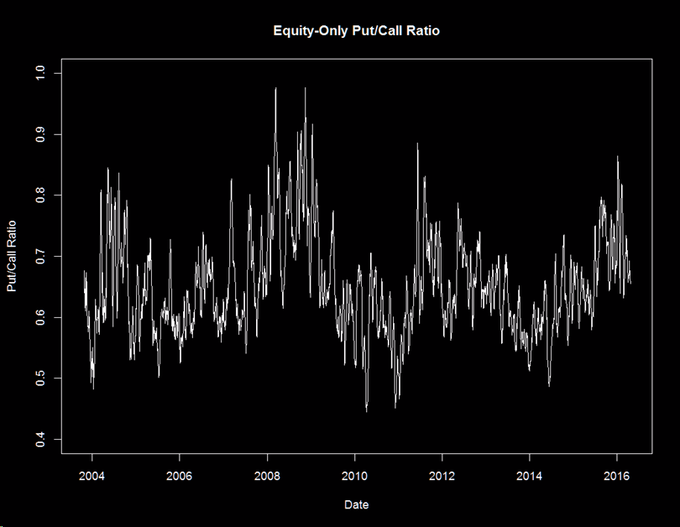
Put/Call Ratio
Notes:
Daily ratio of equity-only puts volume to call volume (10-day smooth)
> summary(pc$p_c)
Min. 1st Qu. Median Mean 3rd Qu. Max.
0.3200 0.5700 0.6400 0.6507 0.7100 1.3400
> summary(pc$call)
Min. 1st Qu. Median Mean 3rd Qu. Max.
182200 796200 1036000 1079000 1297000 3326000
> summary(pc$put)
Min. 1st Qu. Median Mean 3rd Qu. Max.
84570 513600 655200 695200 832400 2021000

Slide 21
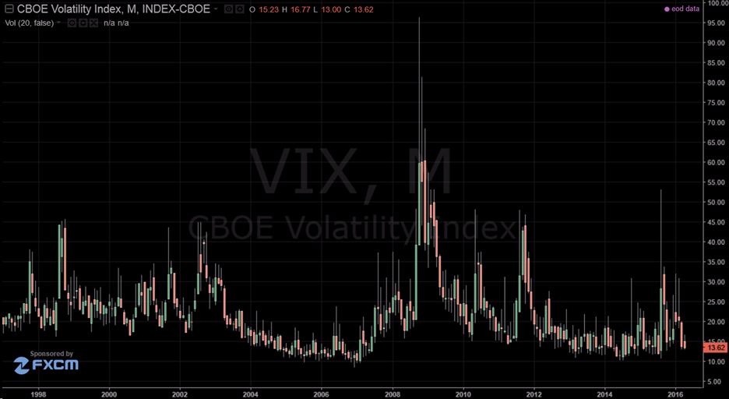
VIX

Slide 22
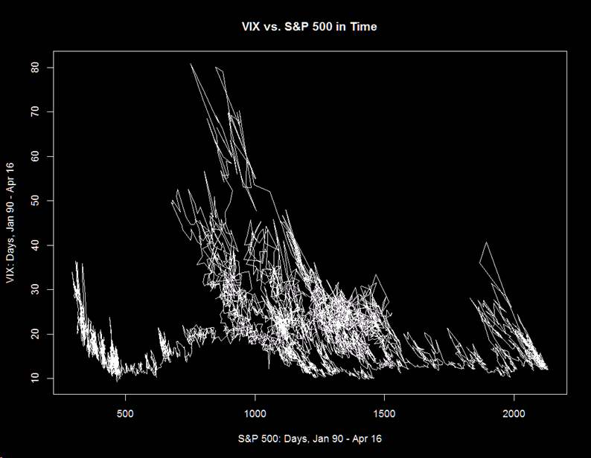
VIX vs. SPX

Slide 23
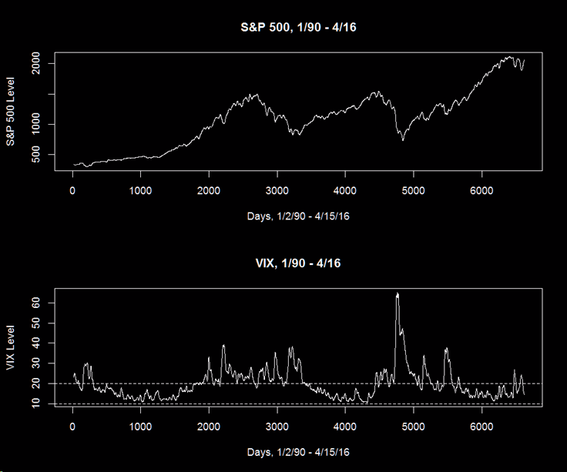

Slide 24
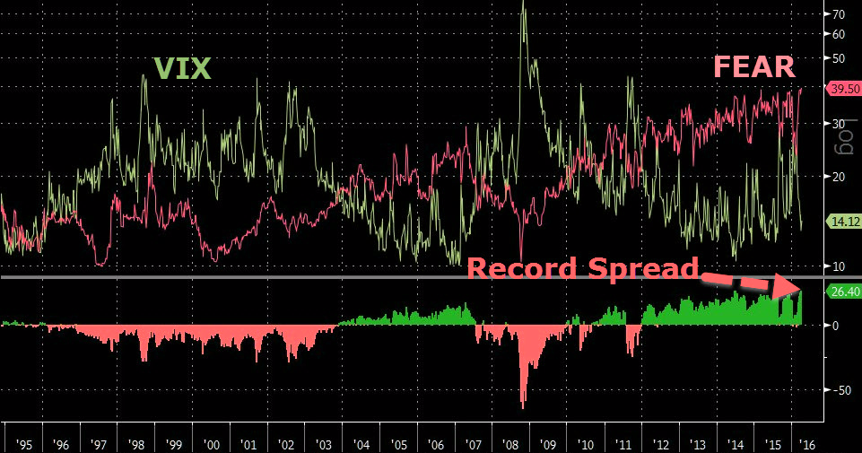
CSFB Divergence
Notes:
CSFB measures demand for put protection..
EXPLANATION:
The CSFB is an indicator specifically designed to measure investor sentiment, and the number represented by the index prices zero-premium collars that expire in three months. The collar is implemented by the selling of a three-month, 10 percent out-of-the-money SPX call option and using the proceeds to buy a three-month out-of-the-money SPX put option. The premium on both sides will be equal, resulting in a term commonly known as a zero cost collar.

Slide 25
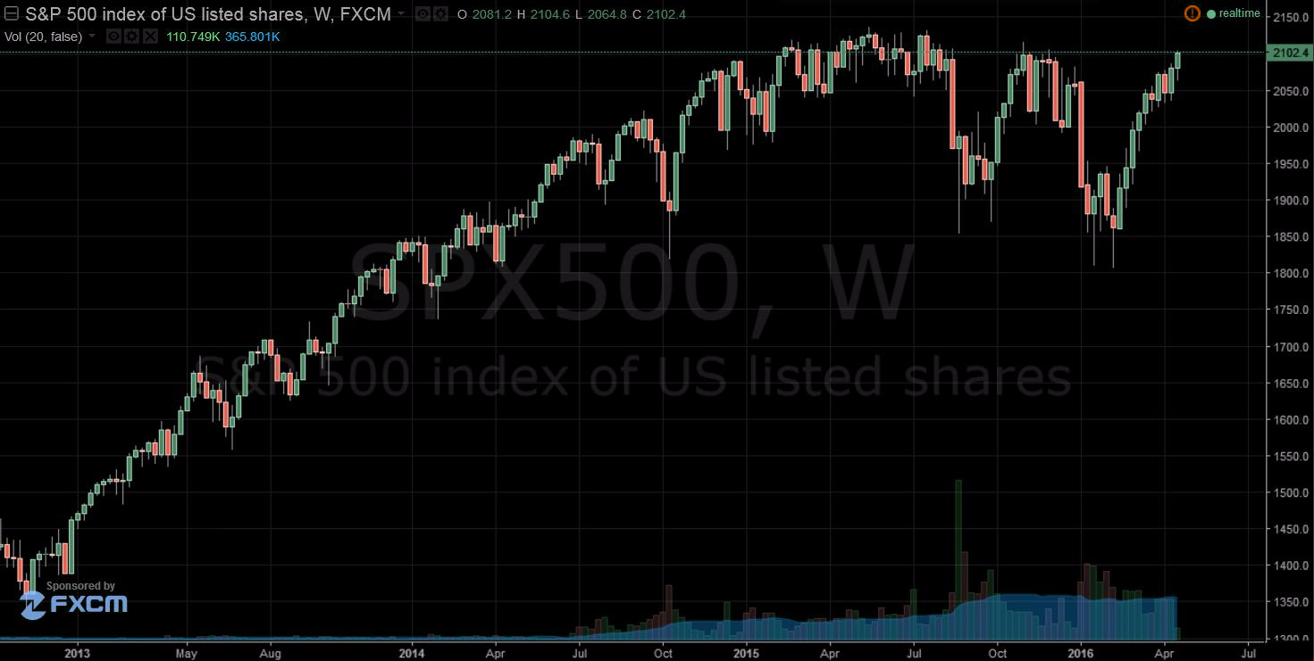
But but but
Notes:
April 19, 2016

Slide 26
Where to from here
Stable markets - [t, t+Δt)
Children
Grandchildren Δt
Great grandchildren
Catastrophe - [t, T]
Global financial chaos and destruction
Mahdi
Yom YHWH

Slide 27
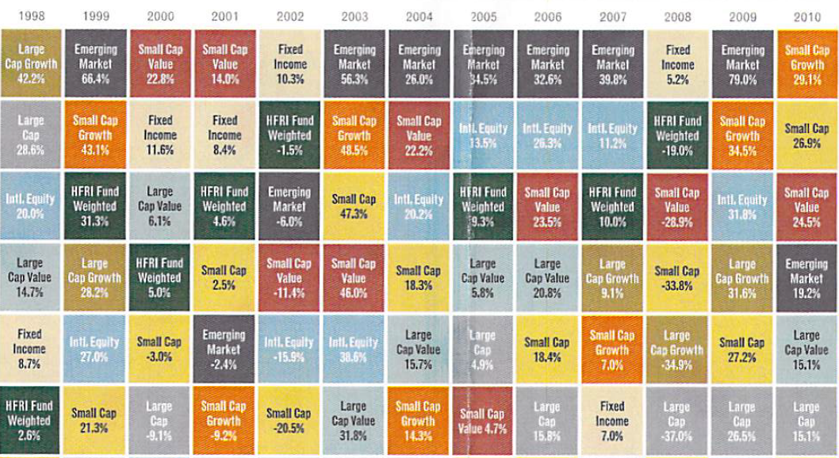
Recall Alternatives

Slide 28
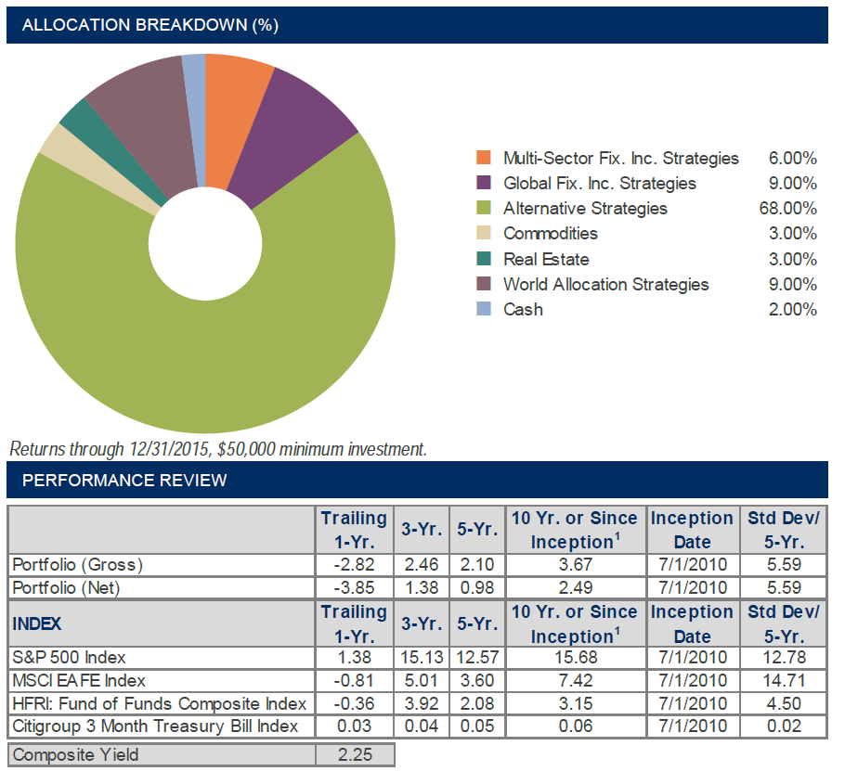
Typical Fund
Notes:
Raymond James Freedom Defensive Strategy 2016
HFRI Fund of Funds Composite Index –
MSCI EAFE Index is broadly recognized as the pre-eminent benchmark for U.S. investors to measure international equity performance (Europe, Australasia and the Far East,)

Slide 29
Alternative Strategies
Private Equity
  LBOs, mezzanine, M&A funds, int’l pvt equity
Marketable alternative strategies
  Hedge funds, abs. return, mkt neutral, long/short, 130/30, event-driven, derivatives
Venture Capital
Real Estate
Energy and natural resources
Commodities and managed futures
Distressed debt
Notes:
Hedge funds: Typical multi-strategies. Arbitrage opportunities: Delta One, Reversion/conversion, International Dividend Withholding Tax, Index Rebalancing.

Slide 30
Other tangible assets
  All of the above
  Collectibiles such as art, wine, antiques, coins, or stamps
  Real estate or forestry
  Oil production facilities
Alternative investment assets are held by:
  Institutional investors
  Accredited, high-net-worth individuals
Notes:
According to the SEC (2016), An accredited investor, in the context of a natural person, includes anyone who:
earned income that exceeded $200,000 (or $300,000 together with a spouse) in each of the prior two years, and reasonably expects the same for the current year, OR has a net worth over $1 million, either alone or together with a spouse (excluding the value of the person’s primary residence). https://www.investor.gov/news-alerts/investor-bulletins/investor-bulletin-accredited-investors

Slide 31
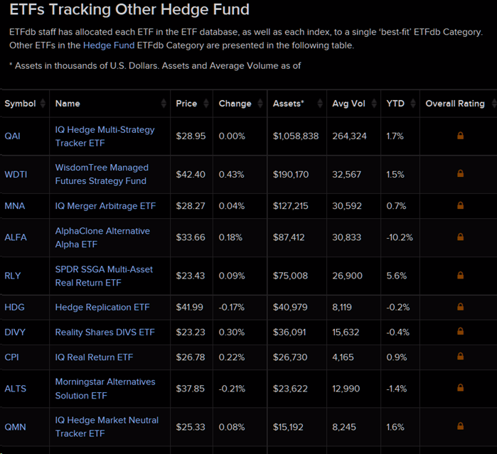
Where to get this

Slide 32
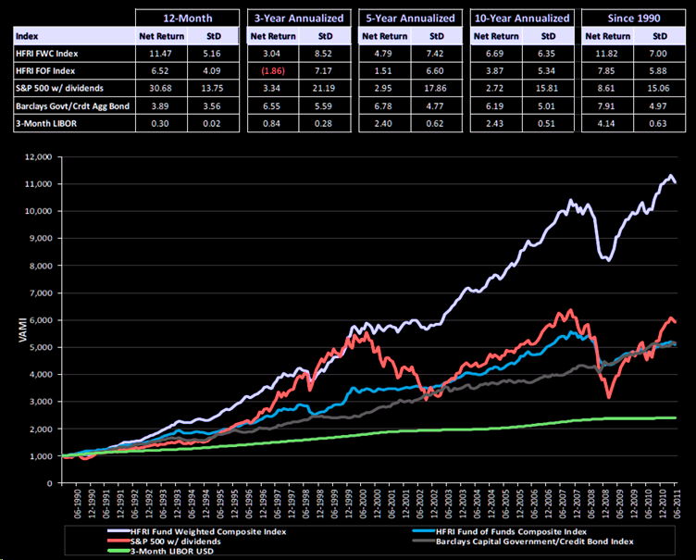
1990-2011
Notes:
HRFI Fund-Weighted Composite
Value added monthly index, or VAMI -
Source: HFR Hedge Fund Research Inc.
Presentation to:
US Department of Labor
Advisory Council on Employee Welfare and Pension Benefit Plans
July 19, 2011
200 Constitution Avenue N.W.
Washington, D.C. 20210

Slide 33
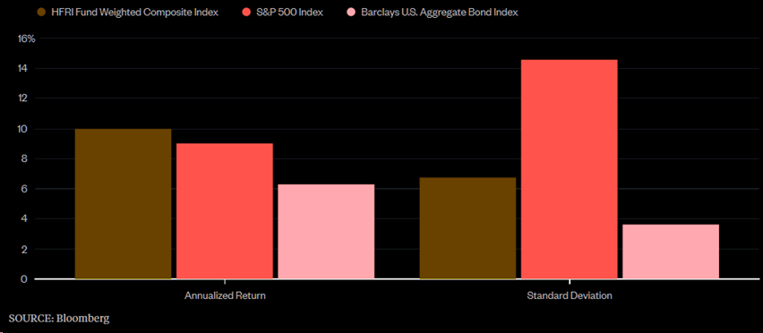
1990-2016
Annualized (μ,σ), January 1990 to February 2016

Slide 34
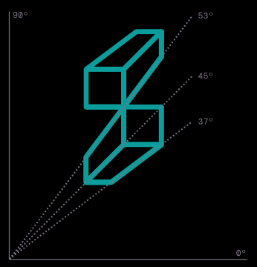
              MLPs and Energy
              Real Estate and Infrastructure
              Quantitative Strategies
              Equities
              Credit Strategies
              Broadmark Asset Management LLC (sub-advisor)
              Pacific Investment Management Company LLC (PIMCO) (sub-advisor)
              Pictet Asset Management Limited. (PAM LTD) (sub-advisor)
Institutional, Investor, Class C and Advisor
Notes:
FCOMX - Forward Commodity L/S Strategy Inv

Slide 35
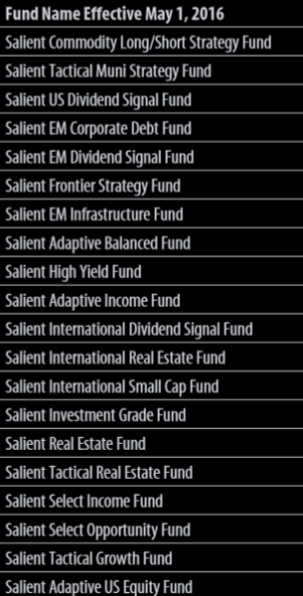
Some Salient funds

Slide 36
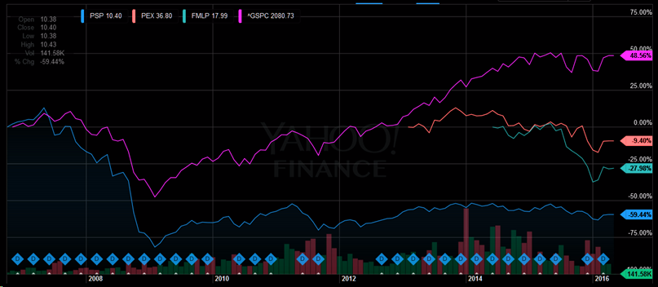
Private! equity
Publicly traded private equity funds [sic]
  PowerShares Global Listed Private Equity Portfolio (PSP)
  ProShares Global Listed Private Equity ETF
  ETRACS Wells Fargo MLP Ex-Energy ETN

Slide 37
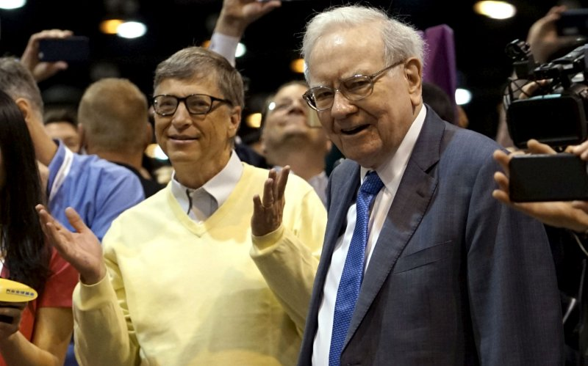
Why not try Berkshire Hathaway!
Notes:
Bill & Melinda Gates Foundation (or the Gates Foundation, abbreviated as BMGF) is the largest private foundation in the world It was launched in 2000; is controlled by its three trustees: Bill Gates, Melinda Gates and Warren Buffett.

Slide 38
20.1% CAGR
Notes:
4/16/1985 1730 12/31/2015 197800 30.707734 114.3353 1.166876 31 year horizon
3/17/1980 290 4/12/2016 213,700 36.07118 736.8966 1.200862 36 year horizon
02/02/98 buy BRKA Berkshire Hathaway 1 52,029.95 52,029.95 03/24/98 64,800 64,800.00 14.98 64,785.025 12,755.08 03/11/98 buy BRKA Berkshire Hathaway 1 60,344.00 60,344.00 03/24/98 64,800 64,800.00 14.98 64,785.025 4,441.03

Slide 39
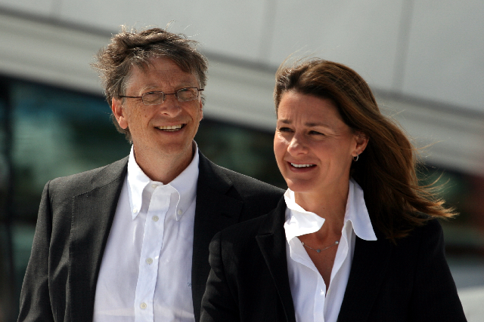
MSFT
3/31/86 – 12/29/00: 44.4% CAGR
Notes:
Photo from Gates Foundation website, 2009

Slide 40
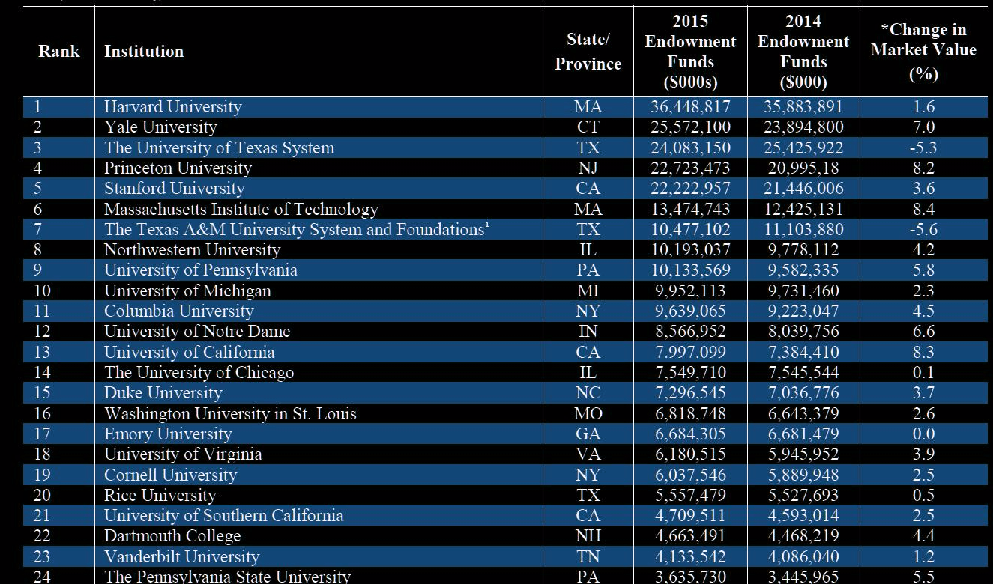
Endowments
NACUBO-Commonfund Study of Endowments (NCES)

Slide 41

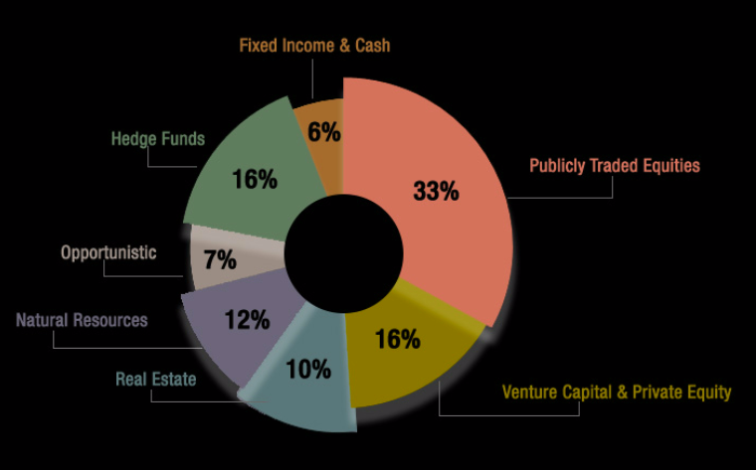
Rice Endowment
Notes:
As of 6/30/2015
The original charter for Rice prohibited the University from incurring debt. The charter was amended in 1998 permitting Rice to issue its first tax-exempt debt in 1999. It now totals $967M

Slide 42
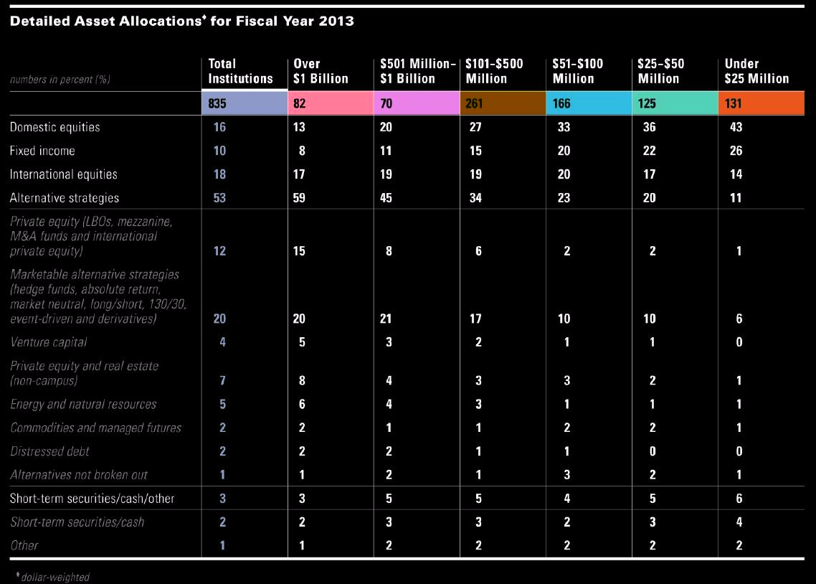
Allocations

Slide 43
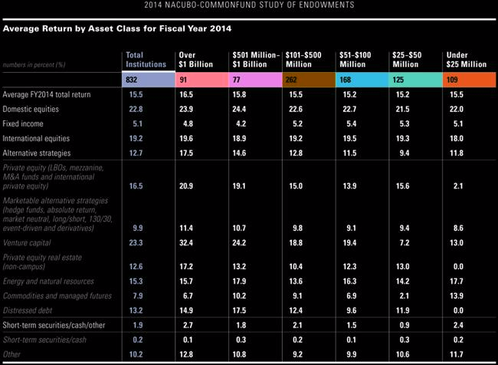
Returns

Slide 45
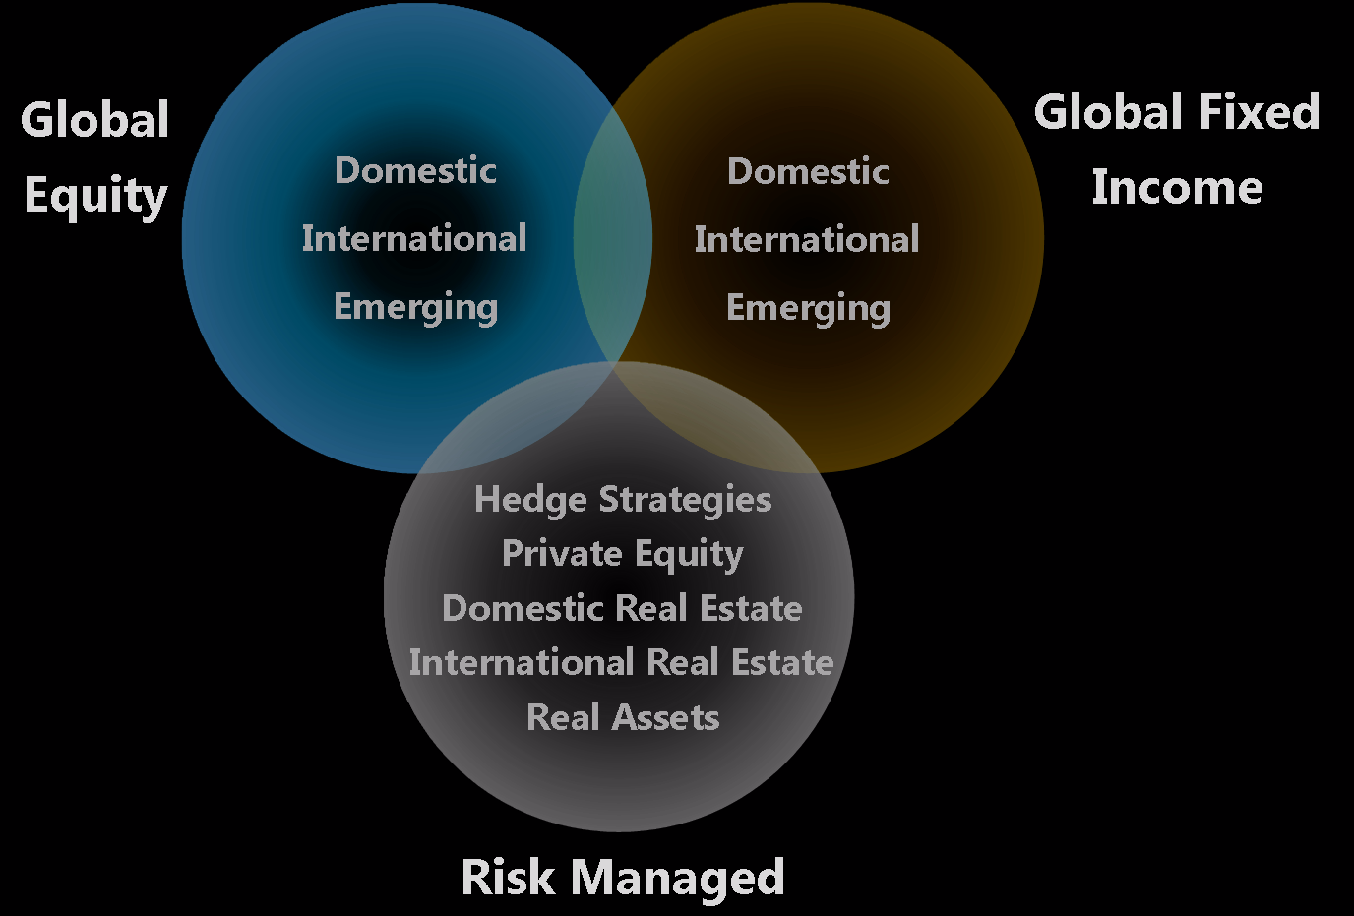
How to Get?

Slide 46
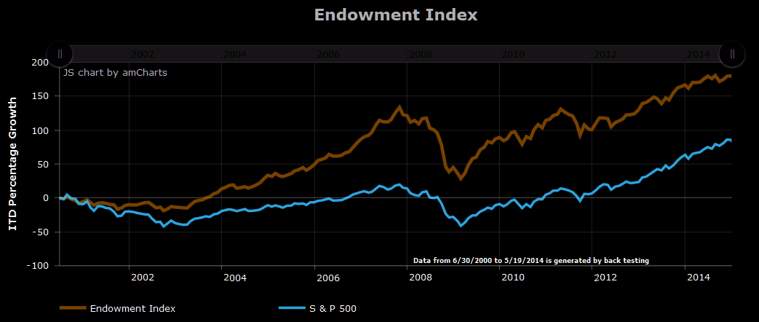
Be an institution
  Foundation/Endowment/Family Office
  401(K) Plan Sponsor/Adviser
  Investment Adviser
Construct your own Endowment Index using ETF’s (Similar to ^ENDOW)
  19 sub-indexes (ETF)
  Represents over 30,000 securities
Notes:
The Endowment Index® has been co-created by ETF Model Solutions, LLC and Endowment Wealth Management, Inc. ETF Model Solutions, LLC is the portfolio manager for the Endowment Multi-Asset ETF Allocation, a collective investment trust sponsored by Alta Trust. Contact: Tim Landolt, Managing Director, 920.785.6012.

Slide 47
^ENDOW

Slide 48
Others
Other viable alternative investments
  Real estate (residential, commercial, industrial/office, hotels, self-storage, 10% CAGR since 1900)
  Water (44% 2009-2014)
  Carbon Emissions (Quite volatile ’05-’16)
  Gold (-4.2% 2011-2016) [Entry dependent]
  Art (4% 2006-2016)
  Wine (14% 7-yr CAGR)
  Oil wells [Entry dependent]
Notes:
Real estate (manuf 26.84% 2011-2016))
Water (44% 2009-2014)
Emissions (Carbon emissions, EUA Futures 1 lot 1,000 tonnes EU allowances Trading will occur on the ICE Futures Europe electronic platform known as the ICE Platform accessible via WebICE or through a conformed Independent Software Vendor. The contracts are physically settled and delivered by the transfer of the EU Allowances from the seller's account to the buyer's account at the Union Registry. All transfers always pass through your clearing member's account and ICE Clear Europe. Delivery takes place 3 days after the last trading day. Price 2005-2016 from $28 down to 5.7$/tonne. Carbon Emissions Futures - Dec 16 (CFI2Z6) http://www.investing.com/commodities/carbon-emissions-advanced-chart
Gold -4.2% (2011-2016)
Art 4% (between 5-10 years, 2016-2006)
Wine 14% (7-yr cagr) with 7.2% sigma
Oil wells 10bbl/day = 6,000/mo = $48k/yr

Slide 49
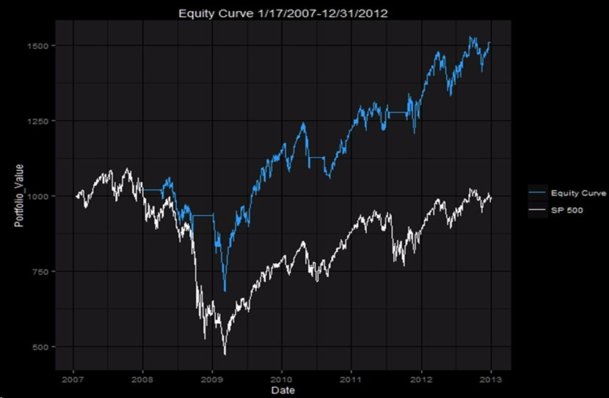
DIY Quant Strategies
James Yuan and Alex Sokolyk, 2016
Notes:
James Yuan and Alex Sokolyk, "Successfully Mining Greed and Fear: An Analysis“ 2016

Slide 50
References
Philip Ernst, James Thompson, and Yinsen Miao, "Tukey's Transformational Ladder for Portfolio Management", To appear in J. Port. Mgt. Submitted on 19 Mar 2016, http://arxiv.org/pdf/1603.06050v1
McMahon, Ethan K. and Dobelman, John A., A Market for Water: Constructing a Custom Weighted Water Index, The Rice University, Statistics Department TR2014-02 (1/2014).
James Yuan and Alex Sokolyk, "Successfully Mining Greed and Fear: An Analysis", Rice University 6th Eubank Conference, 2016.
Fernandez, Pablo and Carelli, The Market Portfolio is NOT Efficient: Evidences, Consequences and Easy to Avoid Errors (March 16, 2016). Available at http://dx.doi.org/10.2139/ssrn.2741083

Slide 51
Acknowledgements
Tom & Nancy Eubank
Katherine B. Ensor, Director
Center for Computational Finance and
Economic Systems (CoFES)
James R. Thompson, Founding Chair
Noah Harding Professor of Statistics, Rice University

