Slide 1
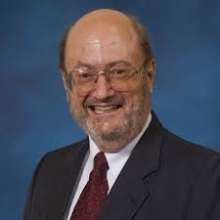
Edward E. Williams
6th Eubank Conference
Houston, Texas
George R. Brown School of Engineering STATISTICS
A Note in Honor of Jim
Thompson’s Retirement
April 26, 2016

Slide 2
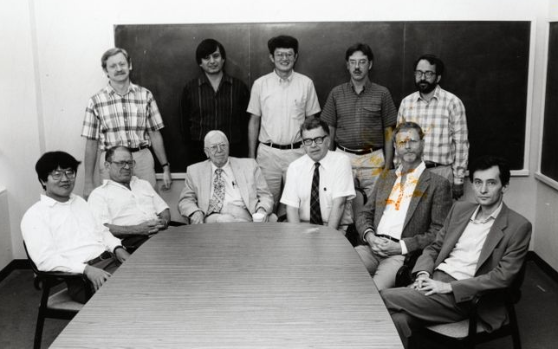
Prof. Ed E. Williams

Slide 3
Eubank Conference April 2016
A Note In Honor of Jim Thompson's Retirement.
Due to a commitment made many months ago, I regret that I cannot provide a testimonial to Jim in person, but I know John Dobelman can deliver my comments with gusto.
First, let me say that my collaborative work with Jim goes back almost four decades. We have taught classes together, co­authored several books and numerous scholarly papers. Jim's intellect and willingness to work hard made him an ideal colleague. He welcomed my work in the statistics department and has made me more at home there as a place for scholarship than the Jones School where I taught for 36 years.
But Jim has been more than an ideal colleague. He has been a delightful friend. Although we disagree on a number of deeply important philosophical issues, I have always found his vast knowledge (on just about every subject) to be inspirational. Moreover, he is simply fun to work with because of his intellect.

Slide 4
We first met when my office was in Herman Brown, along with an assortment of pure and applied mathematicans. Bob Thrall had the office just down from mine and Bob and I had tea almost every morning. It became very clear that Bob and I had very different political views. Were he still alive today, I know he would be "Berning" for Bernie, where Bernie gives me heart burn. In any case, he said I had a soulmate in Jim Thompson and we should meet. Soon thereafter we did, and so began a personal and academic friendship that lasts to this day.
Even though Jim is "retiring" I know his will be like Ewa's and mine. We will no longer get a paycheck but we will teach some and do a lot of research because that is what we do. So let me say to Jim: you are the father of the statistics department, a hero to many of us who have not always liked the path Rice University has taken, but more than anything else you have been a wonderful friend, a mentor, and a teacher to many, many people, myself included.
Edward E. Williams
April 26, 2016

Slide 5
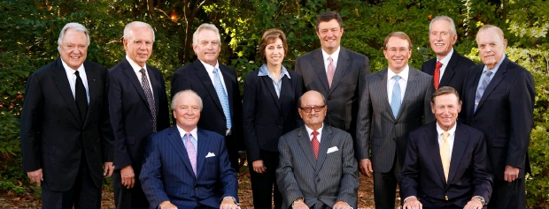

Slide 6
