Slide 1
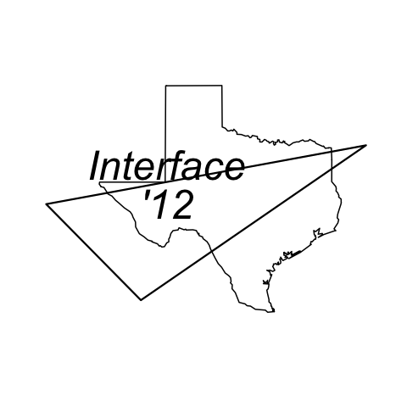

Model Specification Error with High-Speed Computational Propagation Seen in the Subprime Meltdown
George R. Brown School of Engineering - STATISTICS
J.A. Dobelman
Department of Statistics
Interface 2012
Rice University

Slide 2

The capacity to wreak destruction with your models provides the ultimate respectability - E. Derman
We do not know the web of interconnections between banks that has been established through derivatives. The market is losing transparency and we do not know who is dependent on whom anymore. Now we will only know after the fact, and by then it could be too late. - A. Lamfalussy, GM, BIS
26 year olds with computers are creating financial hydrogen bombs." - F. Rohatyn (Lazard Feres)

Slide 3
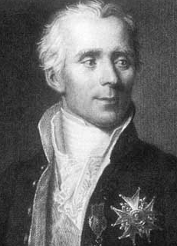
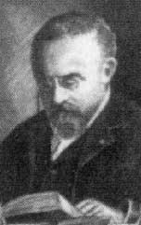
Laplacian Determinism
Laplacian Dæmon – 19th century ideal
  Perfect knowledge of the past and the system → perfect prediction
Poincare complication (per Mirowski, 1990)
  Imperfect knowledge of past (minor errors) → wildly discrepant future predictions
  60 years before Mandelbrot
Notes:
Simeon Denis Poisson Ph.D. École Polytechnique 1800 France
Advisor 1: Joseph Louis Lagrange; Advisor 2: Pierre-Simon Laplace
Mirowski, Philip. From Mandelbrot to Chaos in Economic Theory, Southern Economic Journal, Vol. 57, No. 2 (Oct., 1990), pp. 289-307

Slide 4
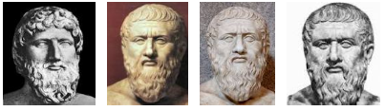
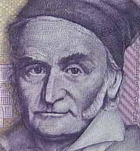
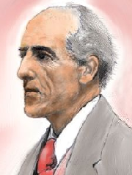
Axiomatic Model
Plato
(333 BCE;
Platonic Ideal
Form)
Gauss (1809)-Pearson (1900) Decomposition
Engenders many models for evaluation. Y=x^{.95} instead of y=x
Notes:
Ekström, Joaqin. The Gauss-Pearson Decomposition and the Link Between Classical Philosophy and Modern Statistics. UCLA
Ross’ summary: of forms.
(i) Each and every phenomenon has an underlying true nature, a Platonic ideal form.
(ii) The senses are inherently unreliable and observations inevitably subject to flux
Postulate (Gauss’ observation postulate). Each observation consists of two parts: the true
value of the phenomenon that has been observed, and an accumulation of random errors that is
unavoidable and cannot be eliminated.
Both Gauss (1809) and Pearson (1900), moreover, contain an explicit expression for
the observation as a function of the ideal and random parts

Slide 5
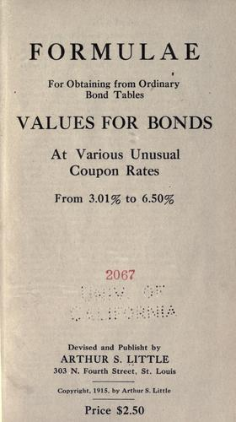
Yield/Amortization
Deterministic growth
Economics and Finance
Only noise is precision
Notes:
Sprague’s 1905 “ordinary” rate tables (beef (plat boiling) 0.16/pound = 15.25# in 1915
1.08^100 = 2199.761, with 1.08005^100 = 2209.96

Slide 6
Econometrics – 1930-33
Mathematical economics (Thanks to Pareto)
  “(1) Use mathematics as shorthand language, not an engine of inquiry. (2) Keep to them till you have done. (3) Translate to English. (4) Illustrate by germane examples. (5) Burn the math. (6) If 4 fails burn 3. This I do often.”
Knight/Keynes formalized risk vs. uncertainty by 1921
Risk → data → computational requirements
Econometrics = Mathematical economics + statistics
E[η(Y))]=Xβ
Notes:
H. P. Pesaran (1990), "Econometrics," Econometrics: The New Palgrave, p. 2, citing Ragnar Frisch (1936), "A Note on the Term 'Econometrics'," Econometrica, 4(1), p. 95.

Slide 7
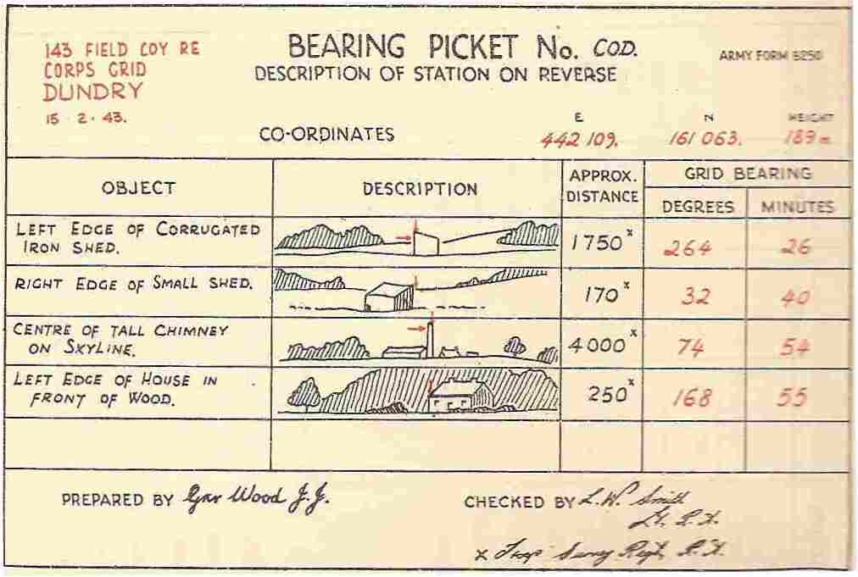
Artillery Model & Computation

Slide 8
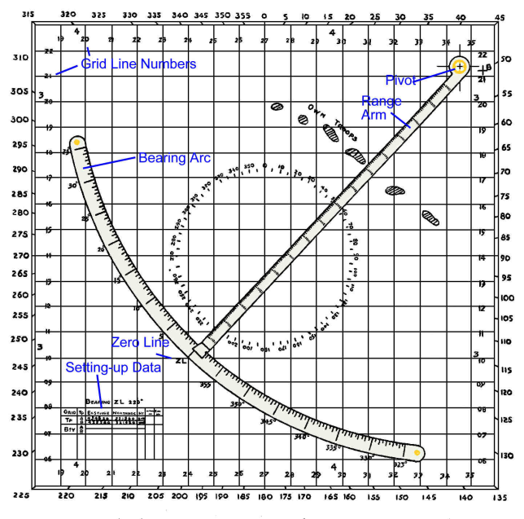
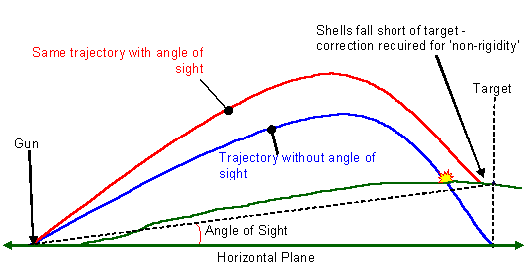
Artillery
Physics Model
Some statistics
  Non-standard conditions
  Probable error of the gun
Range/Firing tables

Slide 9
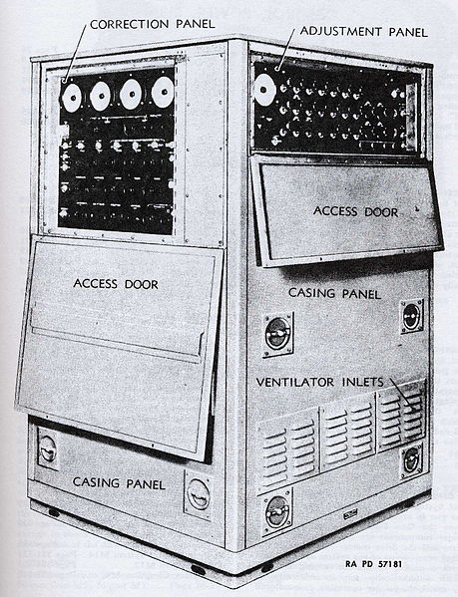
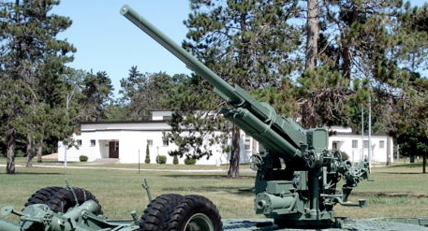
1944 Software
M3/M4 gun data [analog] computer
Computes all data:
  AZ, EL, fuse time
Continuous firing
NOT manual “computerization”
  New approach
  Better accuracy
  NEEDED DATA
Notes:
Note the “IV” correction panel

Slide 10
1944 Econometrics
The Probability Approach in Econometrics (Havelmo 1944)
Tool to evaluate mathematical theories of economic actors
Still based on Knight’s concept of risk
  Distribution(s) known
    Outcomes known
    Law known
Precise statistical analysis
John von Neumann (Game Theory)
Notes:
Ragnar Frisch coined the word "econometrics" and helped to found both the Econometric Society in 1930 and the journal Econometrica in 1933.^{[120][121]} A student of Frisch's, Trygve Haavelmo published The Probability Approach in Econometrics in 1944,
John von Neumann

Slide 11

0.0001 MT Manhattan 1945
New Physics, including statistical physics
Delivery includes artillery model
Solved the fire control and noise problems
J. Von Neumann/Metropolis:
Marchant calculator → ENIAC
Notes:
May 7 - The 100-ton test was conducted. 108 tons of Composition B, laced with 1000 curies of reactor fission products, were exploded 800 yards from Trinity ground zero to test instrumentation for Trinity. This was the largest instrumented explosion conducted up to this date.
--Japanese city of Hiroshima. Nicknamed "Little Boy," the bomb created an explosion equivalent to 15,000 tons of TNT

Slide 12
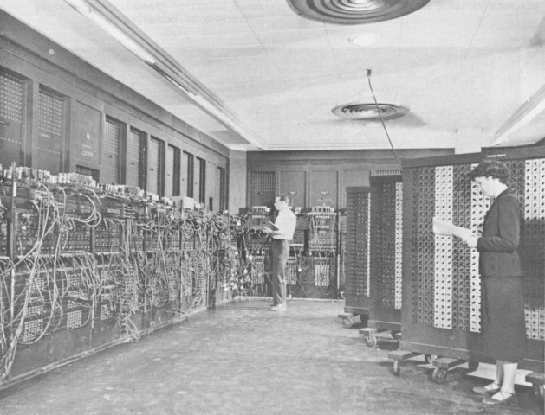
ENIAC-20 Seconds
Electronic Numerical Integrator & Calculator
Notes:
http://www.computersciencelab.com/ComputerHistory/HistoryPt4.htm
http://www.lanl.gov/history/story.php?story_id=82
U. Pennsylvania
Took 20 seconds to run the Hydrogen bomb calculations. First progream still classified.
The calculations were run in December 1945 and January 1946. A half-million punched cards of data were transferred from Los Alamos to Philadelphia to run it, and mathematician Stan Ulam, who von Neumann had recruited to come to Los Alamos from Princeton, recalled "the spirit of exploration and of belief in the possibility of getting trustworthy answers in the future. This partly because of the existence of computing machines that could perform much more detailed analysis and modeling of physical problems.“

Slide 13





Finance/Fin Econ 1959
Gordon & Howell, 1959 Pierson, 1959
Notes:
http://www.economist.com/node/12762453
15 years later….

Slide 14
Science Pedigree
M. Friedman (1953)
  Rational speculator and positivism
Arrow and Debreu construct (1954)
Modigliani & Miller (1958)
  Re-proved J.B. Williams (’38) result
  Used “arbitrage” and “equilibrium” arguments
  Therefore scientific
H. Markowitz (1952, 1959)
  MPT and equilibrium concepts
  Diversification (e.g., into unknown foreign credit markets or sovereign CDS!)
Notes:
one of the most general models of competitive economy and is a crucial part of general equilibrium theory, as it can be used to prove the existence of general equilibrium (or Walrasian equilibrium) of an economy.
Foreign CR markets: Dunbar blog http://www.nickdunbar.net/articles-and-reviews/risky-finance-dr-frankenstein-of-dusseldorf/

Slide 15
Finance Science
Roberts and Cootner codify random walk concepts (1959, 1964)
MLPFS funds CRSP at U. Chicago (1960)
  J. Lorie and L. Fisher
CAPM (Treynor 1962; Sharpe ’64, Lintner ’65 and Mossin ‘66)
60’s-70’s MSI/LSI (e.g., TI’s 1973 SR-50 for $150)
1970:
  Box & Jenkins Time Series Analysis
  RW generalized to EMH (Fama)
  First MBS (GNMA)
  1st Draft of BSOPM to J.Pol.Economy

Slide 16

BSOPM 1973

Slide 17
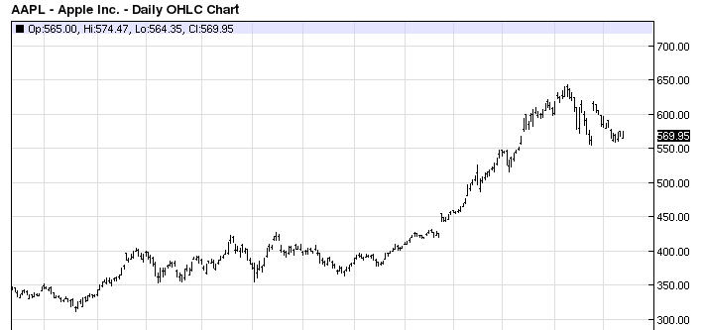
BSOPM
Developed for the “sell-side”
Eliminates differing views on growth of an underlying instrument.
  E.g., AAPL: (μ,σ) ≠ (60%,22%), μ = r =0!
“Can sell as much risk as the client wants w/o taking on risk yourself” -Emmanuel Derman
Notes:
Another “equilibrium”-based model in finance economics

Slide 18
Financial Engineering
Many of these models provide the illusion of certainty. There is a kind of assurance that ultimately can't be satisfied." - Henry Kaufman
An approximate answer to the right problem is worth a good deal more than an exact answer to an approximate problem. -John Tukey
Statisticians, like artists, have the bad habit of falling in love with their models. -and-
All models are wrong, but some are useful. -George E. P. Box
Notes:
Henry Kaufman (Economist) of Kaufman & Kubarych. (From failed zwizards 1998)

Slide 19
A Routine Day
For non-quantitative investors
Vol: 98.5th percentile, but only 1.4σ
Note low

Slide 20
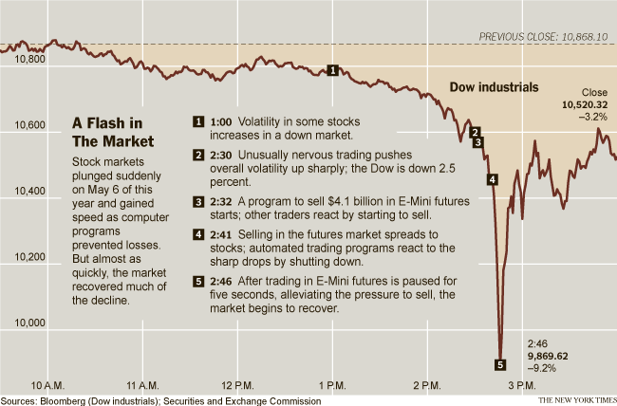
60 Very Long Minutes
May 6, 2010

Slide 21
Observations
E-mini ESM12: 2.8M OI, 2.5M vol.
Automated sell algorithm targeting 9% prev. minute’s volume (75k, no P,t)
  3 that size that year (~$4M/pt, $4.1B notional)
  Limit example took 5 hours
Sell pressure absorbed by
  HFT futures traders
  Fundamental futures traders
  X-mkt arbitrageurs ⇒ equities
    Buy ESM10, sell SPY/equities
    ETF’s/Index arbitrageurs → program sell stocks
Notes:
FINDINGS REGARDING THE MARKET EVENTS OF MAY 6, 2010 ,
REPORT OF THE STAFFS OF THE CFTC AND SEC TO THE JOINT ADVISORY COMMITTEE ON EMERGING REGULATORY ISSUES

Slide 22
Modeling Process
Testing
(non-op, subset)
Deployment/
Implementation
Calibration
Specification
Requirements

Slide 23
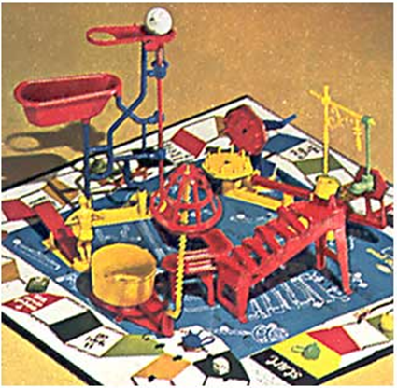
Model Specification
BSOPM 1971-1973

Slide 24
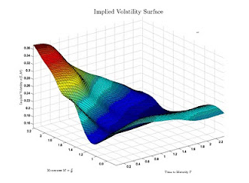
Accelerated Process
Testing (offline)
  Paper trading documented in 1972 J.Fin. On 66-69 OTC option broker data
Implementation
  1973 CBOE
Calibration
Stop Dev. Cycle
Notes:
Black, F. (1988a): "How We Came Up With The Option Formula" Journal of Portfolio Management, Winter 1989, pp.4-8
Fischer Black and Myron Scholes, The Valuation of Option Contracts and a Test of Market Efficiency, The Journal of Finance, Vol. 27, No. 2,

Slide 25
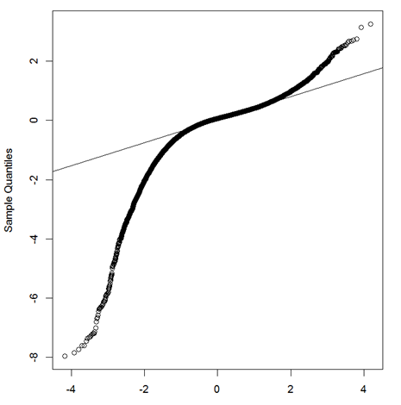
Important Developments
1973 CBOE standardizes and lists exchange-traded options
  Greatly reduces friction (spreads, fees)
  Backtest models COULD be more realistic
“Mayday” 1975 Retail equity commissions fully deregulated.
Frictions and efficiency improves
Mis-specification of returns
distribution does not
Notes:
May Day (see Jones and Seguin (1997), for example).

Slide 26
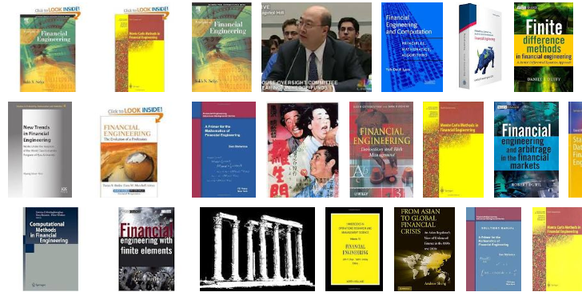
In Process of Time
Financial Engineering discipline erupts
Seeds sown for various financial crises and panics 1974-2012

Slide 27
2 Long Years

Slide 28
2 ½ Long Years
Notes:
120 weeks vs 140 weeks; SPX was almost to the week.

Slide 29
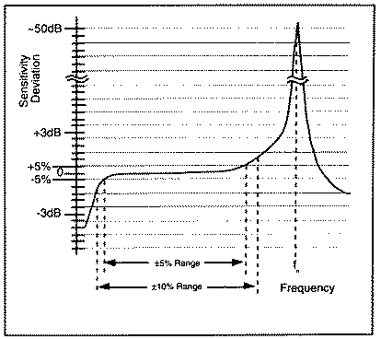
Fin. Engineering 1980’s
Based on:
  Knightian risk
  Arrow-Debreau state price approach
  Existence of elementary tradeables
  No-arbitrage and BS assumption sets
  BS constructs:
    ‘Equlibrium’ and the risk-free hedge
    Closed-form “dynamics” of BS SDE
FTAP-1 and FTAP-2
Any position possible
Notes:
AD_ (1) not friction since no $$$$ can obtain unknown states (2) can’t elicit subjective probabilities either.
FTAP-1 The First Fundamental Theorem of Asset Pricing: A discrete market on a discrete probability space (Ω, , P) is arbitrage-free if and only if there exists at least one risk neutral probability measure that is equivalent to the original probability measure, P.
FTAP-2 The Second Fundamental Theorem of Asset Pricing: An arbitrage-free market (S,B) consisting of a collection of stocks S and a risk-free bond B is complete if and only if there exists a unique risk-neutral measure that is equivalent to P and has numeraire B.

Slide 30
Regime Changes
Vast spread of computational power and ubiquitousness in 80’s-90’s
Proliferation of OTC and ET derivatives
Large-scale networking breakthroughs in 90’s-00-10’s in CONUS and the world
Wild growth of mixed strategy hedge funds 00-10’s
Direct access/HF market trading continued to eliminate arbitrage opportunities

Slide 31
New Co-variation Issues
Asia and Russian Financial Crisis

Slide 32

AAA/ABS/MBS/CMO/CDO/CDS

Slide 33
“How do you explain to an innocent citizen of the free world the importance of a credit default swap on a double-A tranche of a sub-prime collateralized debt obligation”
-Ben Hockett

Slide 34
Securitization
“Originate and Sell!”
FNM[A.OB], FRE[FMCC.OB], GNMA, FHLB
Domestic and other countries
Mutual Funds, Pension Funds, Insurance Funds, Hedge Funds, Investment Banks (BSC, LEH, MER, GS, MS, BOA, C, DB, UBS)
Asset Acquisition
Pooling
Standardize
Sell

Slide 35
Securitization
ABS/MBS
  MBS (GNMA, 1970)
  ABS (Cash Flow producing assets)
    1st Eurozone ABS – IKB 1924 (German war reparation payments)
    Iceland’s fish privatization and securitizing of quotas in early 1970’s
    First US ABS 1985
      1st Sperry timeshare leases
      2nd $60M CARS (auto receivables)
    Credit card, HELOC, student, auto loans
    Subprime loans (mortgage and non-mortgage)

Slide 36
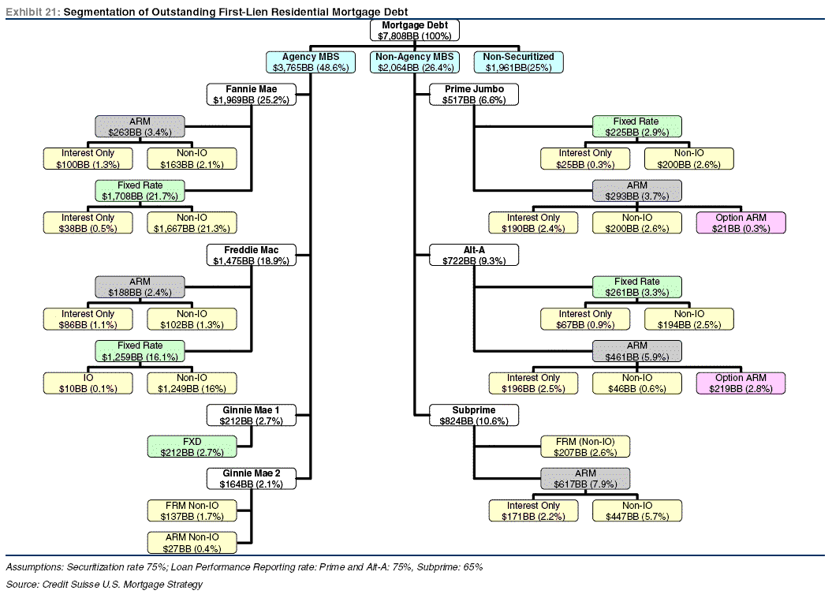
ABS (MBS)
Notes:
Does NOT include non-mortgage ABS
Fixed Income Research
http://www.credit-suisse.com/researchandanalytics

Slide 37
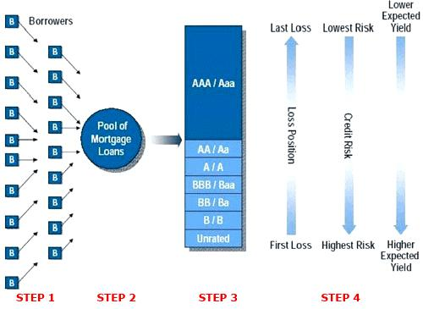
CMO/CDO

Slide 38
CDS
CMO and CDO are bonds, with reference securities (underlying assets) of M’s or D’s
  Can also have reference securities of other CDO’s/Synthetic CDO’s!
CDS are Insurance on these bonds

Slide 39
Economics of CDO/CDS
CDO:
  AAA rated tranch might pay to buyer
    2% if based on “good” loan pool
    it might pay 5% based on SP pool.
  Buyer ponies up cash, receives fixed pmts
CDS:
  In good times
    On AAA instruments buyer might pay 17 bps p.a. i.e., $1,700 per year on $1M underlying bond
    No payoff, lose $170k on $100M face; repeat until can no longer stand this.

Slide 40
Economics of CDS
  Seller makes $170k per year with little risk of payout since AAA rated (“risk-free”)
If things go wrong:
  Underlying downgraded 30+%, might want to divest, but can’t due to illiquidity.
  Seller could buy possibly back the CDS but now it is quoted at 3500 bps.
  Buyer receives payment of downgraded portion (50, 70, 100%)
In 11/2007, 5yr CDS on Italy sovereign debt could be bought for 15 bps.
Notes:
The Italians were going up in price no default yet but yields → prices going up.

Slide 41
Economics (CONT’D)
October 2011 price was 550 bps. (3666%)
May 13, 2012, price was 460 bps. (3066%)
Greece CDS rates are 5496.7 bps 5/12/12

Slide 42
1983 First CMO (First Boston/Salomon)
1985 First ABS (Sperry’s Leases)
1986 $50M Credit Card CDO
1987 AIG FP formed for Carpe Diem
1995 $30B in Subprime Loans (SP); 65% fixed-rate
1997 SP lenders fail in boom of ’97
2000 $130B SP → $55B CDO
2001 AIG FP doing $300M CDS per year (all-types), contributing 15% profit
Notes:
AIG FP Michael Milken and Drexel refugees
1994 – LTCM formed

Slide 43
2004 CDS on corporate bonds available
2005 SP back up and running; $625B SP → $507B CDO’s; 75% ARM’s
2004-2005 Various parties observed increase in SPM activity and growth of the SP ABS markets and wanted to short
  Could not
  No CDS on SP CDO
Notes:
Mike Burry had to get others to develop the instruments, he needed standard specifications, etc.

Slide 44
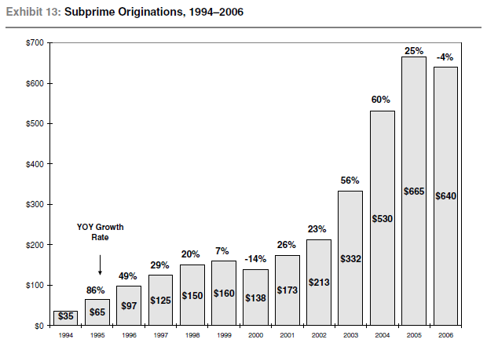

Slide 45
2005 Credit card delinquencies @ all-time high
5/19/05 CDS on SPD (CDO) available.
  Only GS and DB interested; Burry was 1st “retail” customer. Insisted on collateral
  BBB only (250bps); (AAA 20bps, A 50)
  GS would do $5M in 6/05; By 7/05 offering $100M (not on other side! Found seller)
  AIG FP was selling to GS for 12! $400M riskless profit/yr to GS

Slide 46
2006 Mid-2006 Bass’ Hayman Capital formed, amongst < 20 others
10/16/06 Cornwall buys its first CDS
By 2/2007, Cornwall had $205M of CDS on AA tranches of SPD CDO’s.
1st half 2007 Dozens subprime companies, (long) FI hedge funds, and banks fail
AA SPD CDO’s still quoted at 98!
MLPFS reports record Π; DJIA breaks 14,000 on 7/19/07
Notes:
MER 10-k was Feb 2007, so this was 1Q (3/30/07), which was filed 5/7/07 ($2.50 vs. $.49 in 06)
, or 6/30 filed 8/3/07 $2.48 vs. $1.79

Slide 47
8/1/07 “Last” SPD CDO CDS since BSC lawsuit.
August 2007 SP assets discovered teeming everywhere
Week of August 5, 2007.
  Cornwall closes $205M in SPD CDO CDS, avg. 4000 bps on 50 bps investment (80x)
8/31/07 Burry closes BBB’s at 8000
Party is over
“There can come a moment when you can't trade with a Wall Street firm anymore and it can come like that!" -Ben Hockett

Slide 48
Bottom Line
Worst class of SPMB had a description:
  “interest-only, negative-amortization adjustable-rate subprime mortgage”
What they needed and had manufactured by persistence
“CDS on AA-rated CDO’s on BBB-rated SPMB’s”
8/31/07, 20 days after Cornwall sold their AA’s for 4100bps, Burry sold his BBB’s for 8500 bps to desperate Wall St. firms.

Slide 49
Back on Main St.
S&P 500
▲
IB Damage done by EOY 2007; shakeout ensues:

Slide 50
2008-2009
Stocks Finally Caught Up

Slide 51
A Routine Week
For non-quantitative investors
Not so for many hedge funds executing quantitative equity market-neutral strategies (Long/Short stocks)

Slide 52
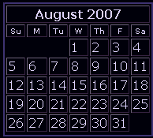
“Unsolved Mystery”
Huge problem with the equity hedge funds August 6-10, 2007
Quantitative equity market-neutral, and stat arb funds all suffered major losses

Slide 53
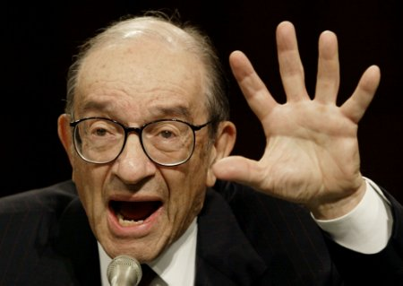
Did the Quants Fail?
“What Happened To The Quants In August 2007?” – Andrew Lo and Amir E. Khandani, J.Inv.Mgt. 2007
Near-destruction of many non-fixed income arbitrage funds Aug. 6-9, 2007

Slide 54
Week of 8/5/12
Aug 5 – S
Aug 6 – M
Aug 7 – T
Aug 8 – W
Aug 9 – Th
Aug 10 – F
Lo’s Question – FI Fund Unwinding and Unraveling
MTM, Massive liquidations/unwinding
MTM, cascading liquidations, unusual losses
Perfect storm over, now calm
Notes:
Cornwall – 205M, 50M/day

Slide 55
In Conclusion
Adverse risk spills over into unrelated sector
Risk
  Market
  Credit
  Liquidity
  Moral hazard
Yet, very few people aware of the contagion and its outcome; by Friday 8/10 all was well.

Slide 56
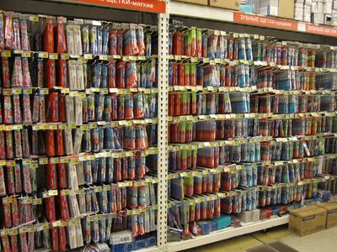
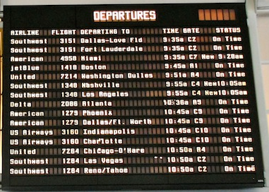
Price Optimization
Scientific analytics
Pricing execution and optimization

Slide 57
CDO Pricing
By 2004 IKB “could value a CDO down to the last basis point”
In 2005, IKB’s US-trained Dirk Röthig denied better originator ID/CDO pricing tool at $6.5M (on book of $20B, $200M Π)
Notes:
See Dunbar’s Risk article. IKB bailed out by a Landesbank on 7/28/07.
- - IKB (Industriekreditbank) was granted its banking license in 1924 as "Bafio" (Bank für deutsche Industrieobligationen, Bank for German Industry Obligations). Bafio dealt in long-term real estate financing in an effort to aid the German economy grow under the weight of the World War I reparations the country owed.
- The great German structured credit experiment, Risk, February 2004, page 17

Slide 58
Final Thought
“The pointer can sometimes
get stuck”
“Computers get it fast, but people can get it wrong”
“Umm, bogey at 14 nanoseconds”
“Better be right at light’s speed”

Slide 59
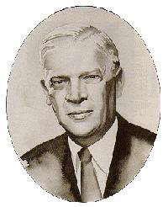
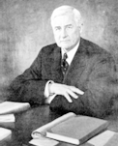
Acknowledgements

Slide 60

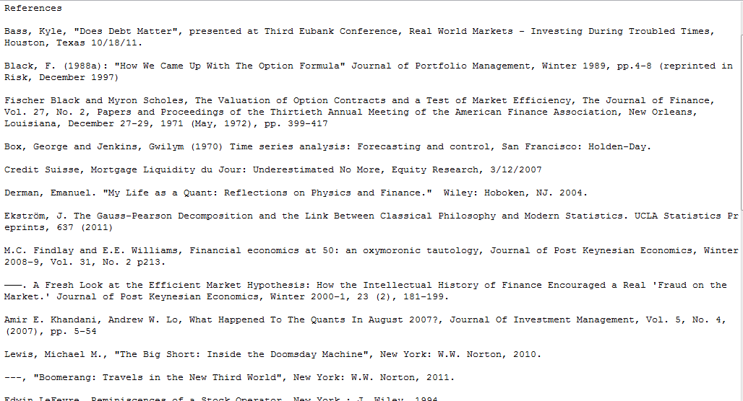
dobelman@stat.rice.edu 713 348 5681 5/16/2012

