Slide 1

“Big Math”
J.A. Dobelman
George R. Brown School of Engineering - STATISTICS
Math-Science Scholars Program
July 16th, 2015
Notes:
a new and exciting one-month summer program directed at promising minority and low income high school students in mathematics called the Tapia Math-Science Scholars Program. The program has been approved and will be partially funded by the Houston Independent School District (HISD). The program will run from July 5 to August 1, 2015. The program will teach content, but a new and exciting addition will be enhancement lectures. In the enhancement lecture I want a distinguished Rice researcher to explain to the high school students the role that mathematics plays in his/her research.

Slide 2
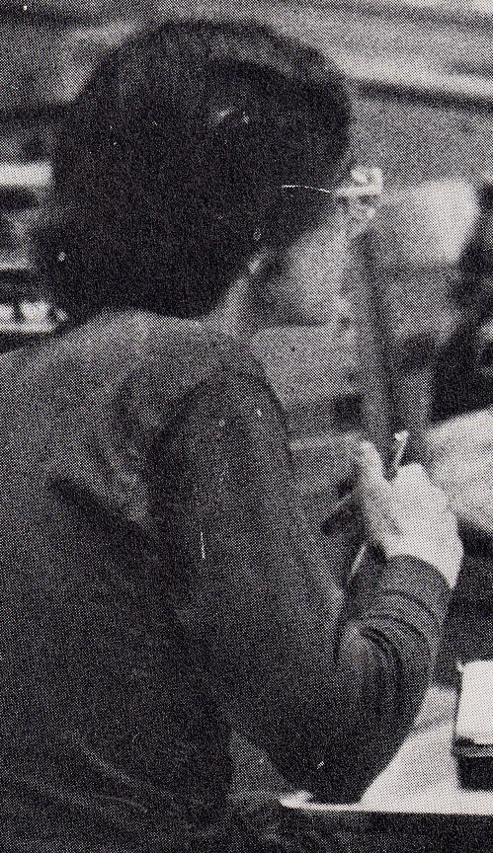
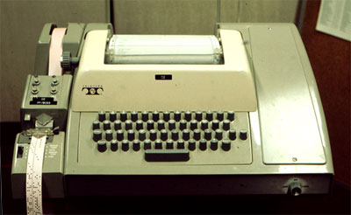
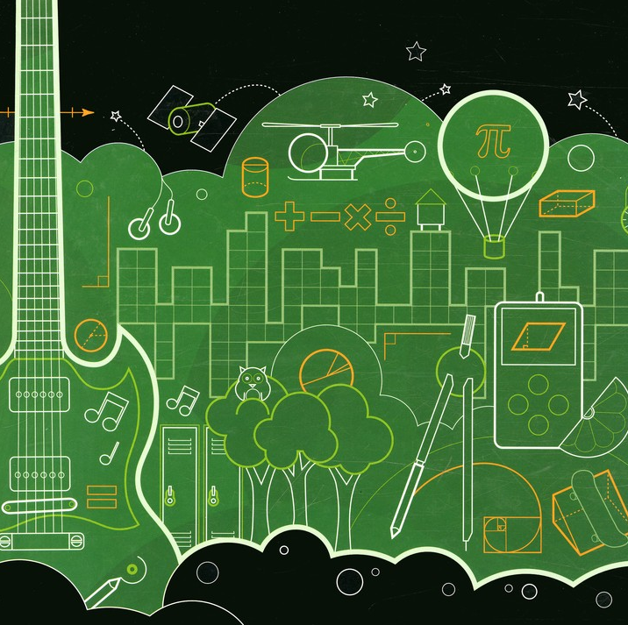
Notes:
8-hole punched paper tape to CDC xxxxxx CPU

Slide 3
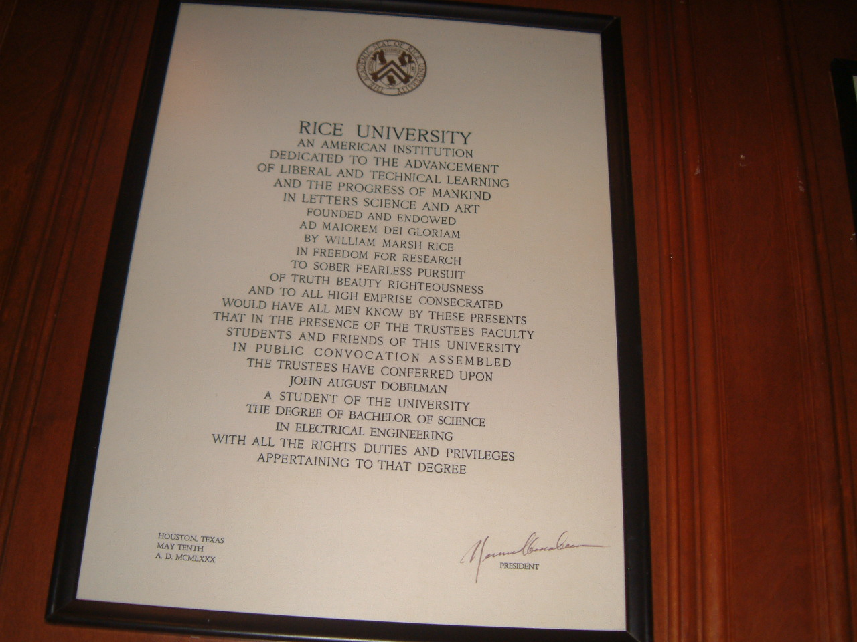

Slide 4
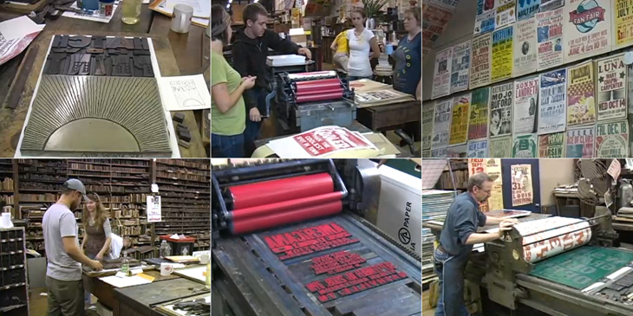
Old School S&E
First post-college job: Bindery Operator

Slide 5
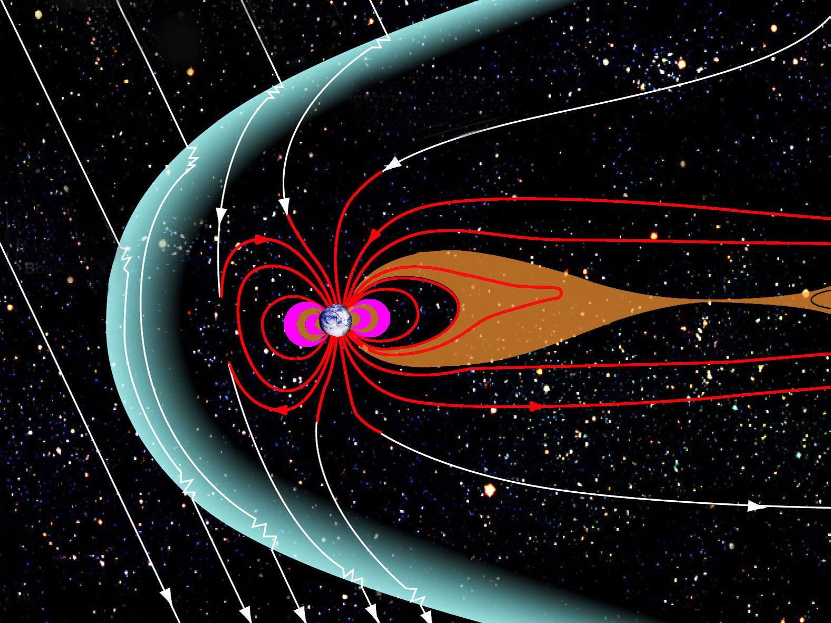
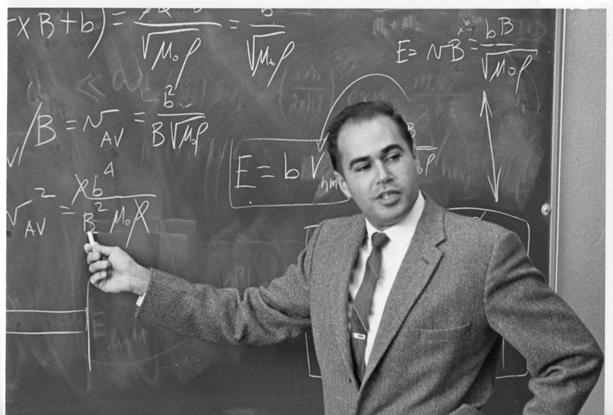
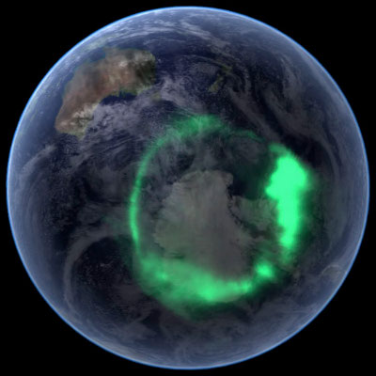

Space Physics and Astronomy
Notes:
Dessler, professor emeritus of space physics and astronomy, joined Rice in 1963 and founded the world’s first university department of space science.
The shape of the Earth's magnetosphere is the direct result of being blasted by solar wind. It prevents most of the particles from the Sun, carried in the solar wind, from hitting the Earth. The Sun and other planets have magnetospheres, but the Earth has the strongest one of all the rocky planets.

Slide 6
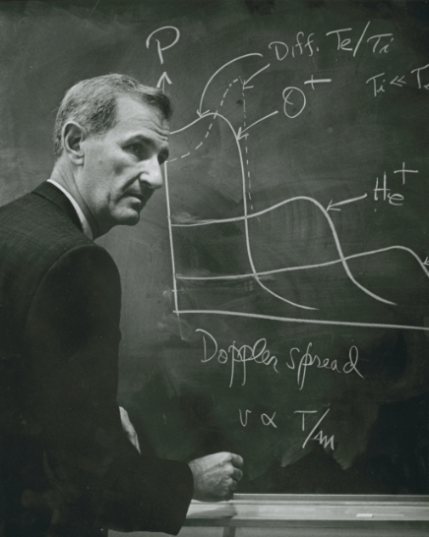
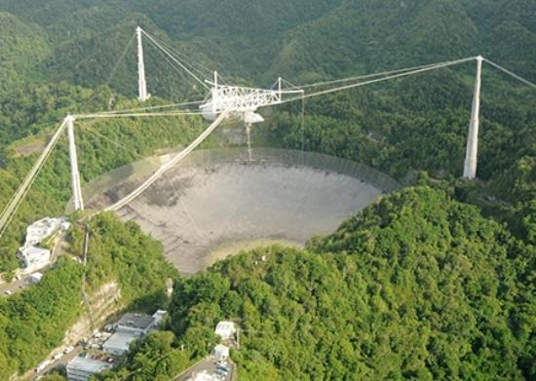
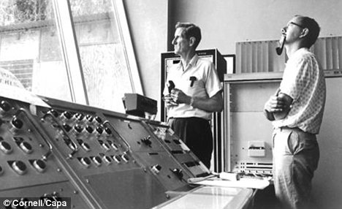
W.E. Gordon

Slide 7
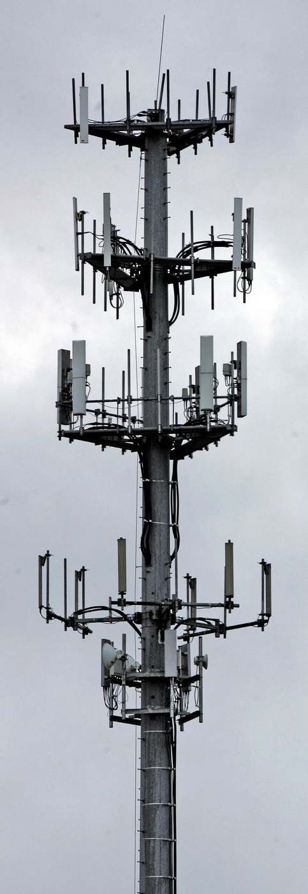
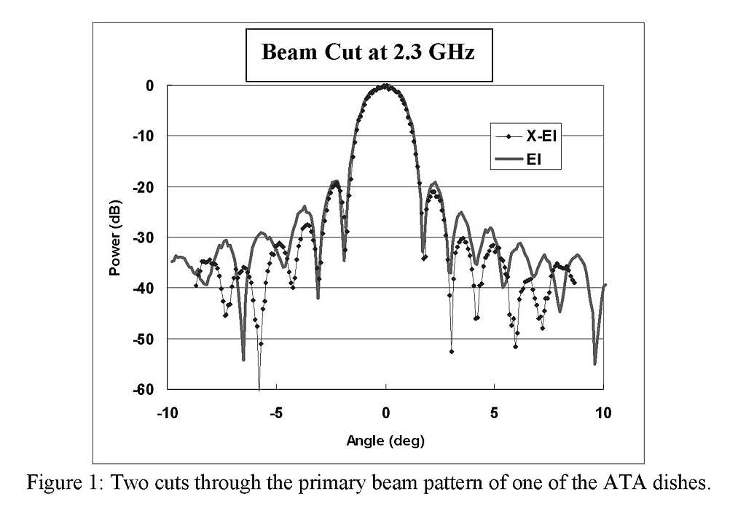
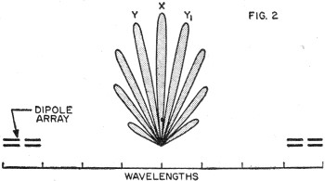
Down to Earth
Notes:
Enroute aircraft (5 mi)
Troposphere 20 km (12 mi)
Ionosphere 50-400 km (30-240 miles)
Low Earth Orbit (100mi)
Geosynchronous orbit (22,236 mi)

Slide 8
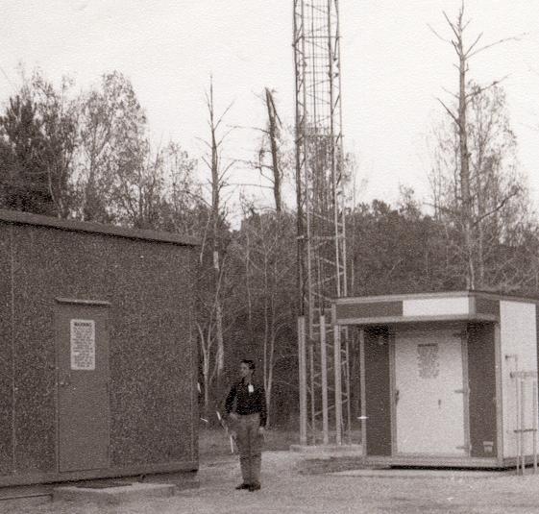
IAH RTR

Slide 9
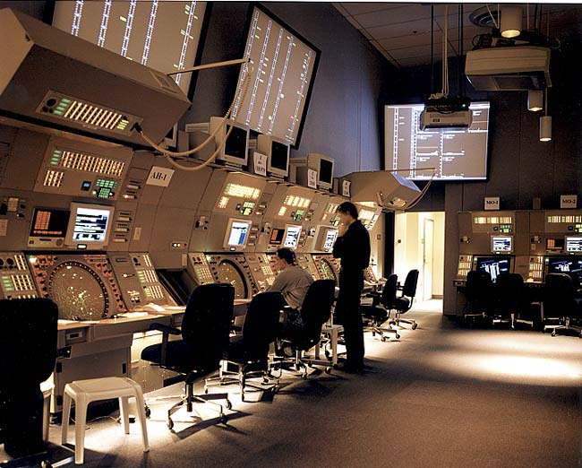
Terminal CNS
Notes:
NY TRACON

Slide 10
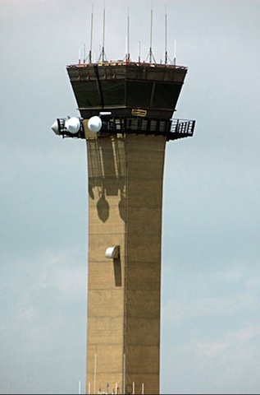
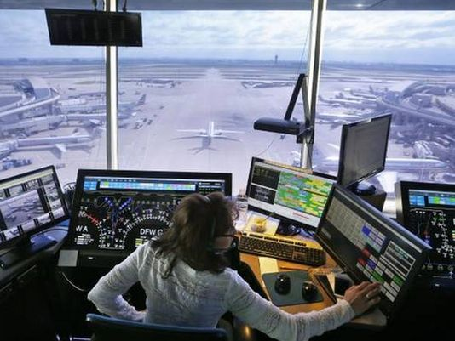

ATCT
Notes:
EWR ATCT at night
DFW AA Ops
Pei ATCT

Slide 11
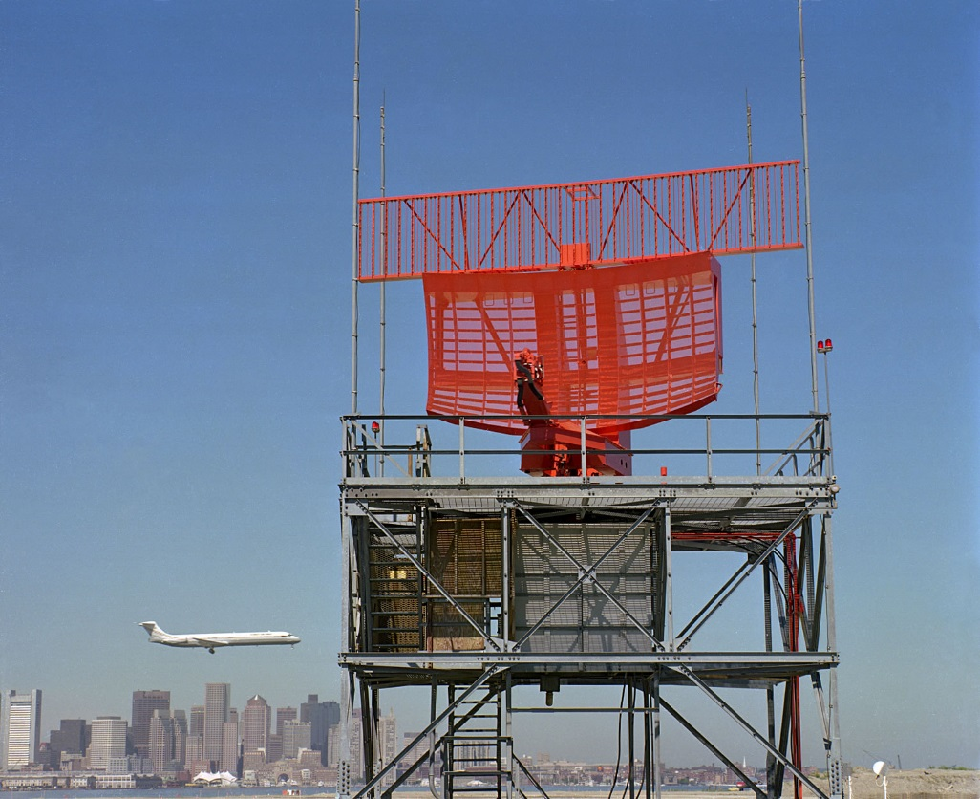
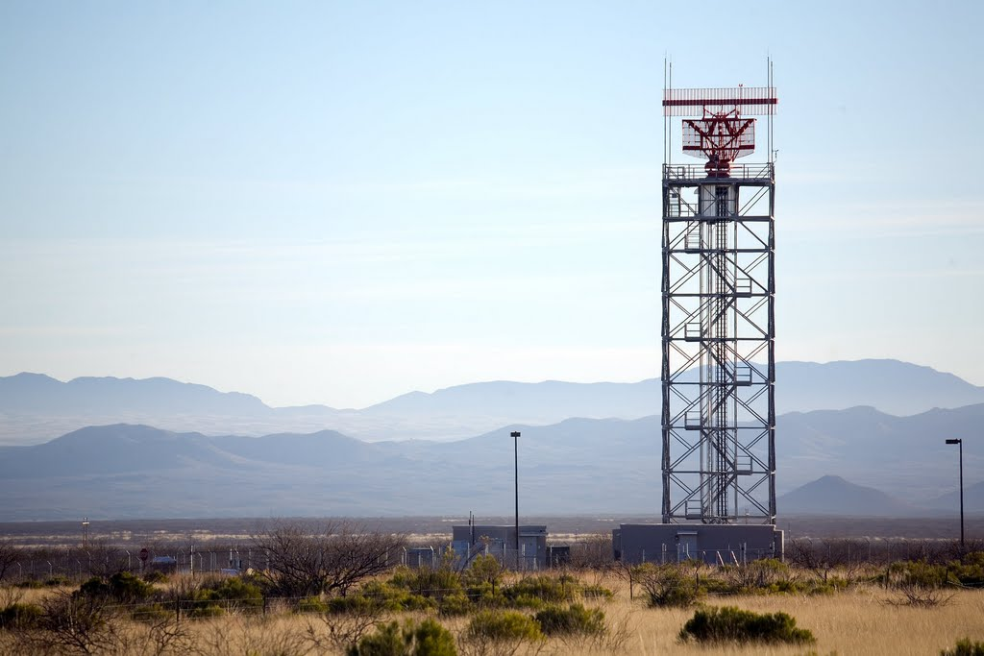
Surveillance

Slide 12

ILS/NAV

Slide 13
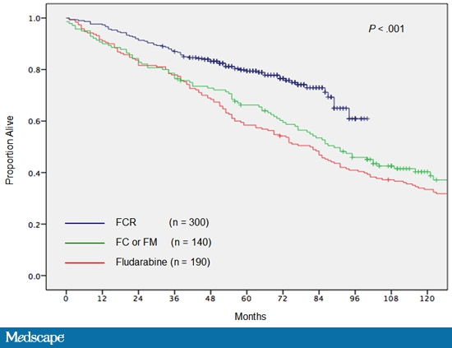
Catharsis/Epiphany
Notes:
Catharsis: the process of releasing, and thereby providing relief from, strong or repressed emotions.
Epiphany: a sudden, intuitive perception of or insight into the reality or essential meaning of something, usually initiated by some simple, homely, or commonplace occurrence or experience. (Revelation of Christ to the Magi)

Slide 14
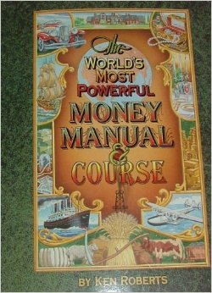
Quit your Day Job

Slide 15
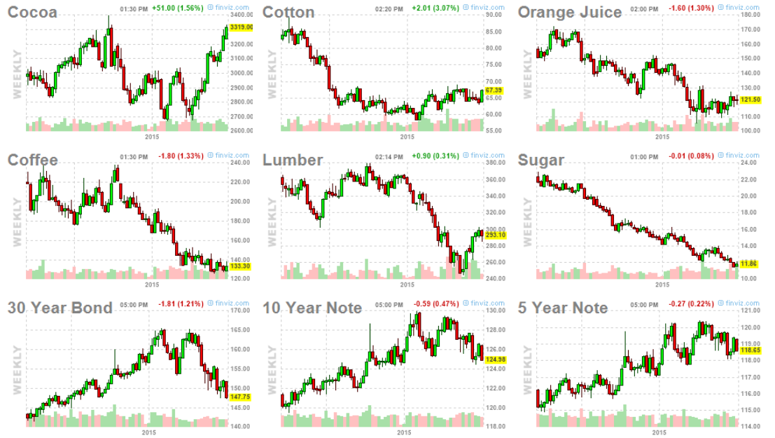
$500 a week!
CC: 10T CT: 50k# JO: 15k# KC: 37.5k# (250 bags)
Notes:
CC 10T CT /50k# ($500/cent) JO 15k# $150/cent KC 37.5k# LB 110k ft
SB 112k # US 100k 10Y 5Y7

Slide 16

Back to Rice!

Slide 17

Research Program
Investments analysis
stochastic modeling for markets and finance
simulation-based and quantitative portfolio selection and management
display of quantitative information
improved communication
applications of engineering models to other statistical problems

Slide 18


2006-8 Predictions
ABC News
Notes:
U.S. debut at the 2006 Sundance Film Festival and international premiere at Cannes, An Inconvenient Truth

Slide 19

2006 Predictions
Notes:
January 23, 2006

Slide 20
Why Math Will Rock
“Quants” turned finance world upside down in 1973
30 years later “Data Mining” emerges
Mathematics and computer science
Modeling YOU as a customer, a specimen and a target
Behavioral prediction
  Revenue management and optimization
  Surveillance

Slide 21


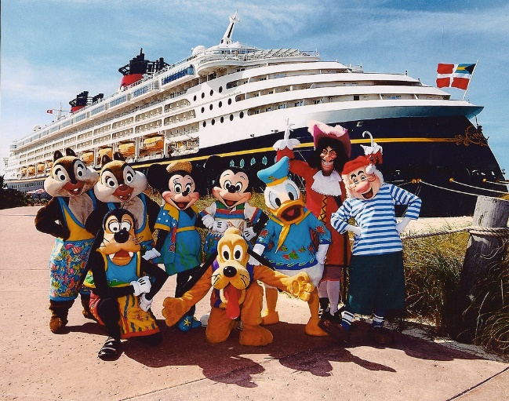



Security, Privacy & Convenience

Slide 22

More Your Cup of Tea?

Slide 23
Notes:
August 25, 2014 Cover Story
1951-2014 Robin Williams
He Brought Joy and Light to Millions but Struggled with a Darkness That May Have Led to His Death. Friends Remember a Comic Virtuoso Who 'could Make Everybody Happy but Himself'
Pg. 62

Slide 24

Percent (%)

Slide 25
Percent (%)
“Per Cent (hundred)”
90% is
We can also write it as 9/10, or 0.90
Gives resulting balance: For example, 95% of $1,000 is $950. Or, 70% of $50 is $35
10% is easy to work with, just divide by ten or multiply by .10 E.g., 10% of 1,000,000 is 100,000
¼ of 400 is 25% of 400 which is 100

Slide 26
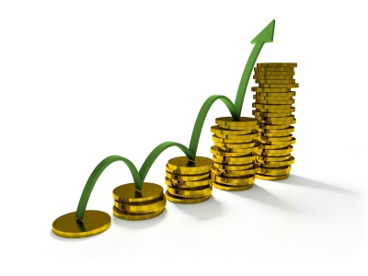
Percent Return
Return is composed of
  Return OF investment
  Return ON investment
Start a project or investment with $100
At the end of one year you have $110
$100 is the return “of” your investment
$ 10 is the return “on” your investment

Slide 27
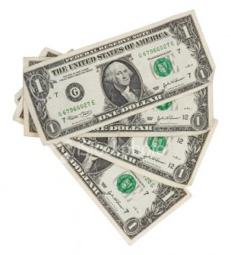
Seneca Tribe Returns
Notes:
Seneca: “"Great Hill People.“, and “"Keeper of the Western Door,“”
Actual winnings 7/8/15

Slide 28
Large Percentages Tricky
“Double your Money,” or start with $200, end up with $400
  200% is a 100% gain (2.00-1)= 1 = 100%
$200 grows to $300 represents 50% gain
  R=300/200=1.5
  r%=R-1=0.50 = 50% gain
Make ten times your money:
  R=10, r%=10-1=9.0 = 900% gain

Slide 29
Simple Return
Principal of $1,000, with 8% simple interest per year.
  Yr 0: 1,000
  Yr 1: 1,080
  Yr 2: 1,160
  Yr 3: 1,240 … Yr 10: 1,800

Slide 30
Compound Return
Principal of $1,000, with 8% interest reinvested (compounded)
  Yr 0: 1,000
  Yr 1: 1,000x(1.08)=1,080
  Yr 2: 1,080x(1.08)=1,000x(1.08)² =1,166
  Yr 3: 1,166x(1.08)=1,000x(1.08)³ =1,259
  …
  Yr 9: 1,000x(1.08)⁹= 1,999
  Yr 10: 1,000x(1.08)¹⁰= 2,153

Slide 32
Experiment 1
Which would you rather have?
  A. $10 per day for one month
  B. 10¢ on day 1, then 20¢ on day 2, then 40¢ on day 3, etc. for one month
Option A gives you $310 for the month.
Option B gives you…
  .10
  .20
  .40
  .80
  1.60 …
Notes:
Note: Option B gives you 100% return each period!

Slide 33
Time is Key
Option B give you $107,374,182!!
Notes:
Simple comparison is to arithmetic sum of 0.10 per period

Slide 34
Large Numbers

Slide 35
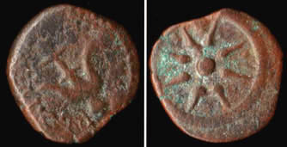
Experiment 2
“And there came a certain poor widow, and she threw in two mites, which make a farthing” Mk 12.42
Worth one-half of a quadrans or 1/128 of a denarius, or about six minutes of an average daily wage
  $15 x 8hrs = $120/day
  60x8=480 min.per day
  6/480 = .0125 = 1.25%
  $120 x .0125 = $1.50
Notes:
A bronze mite, also known as a Lepton (meaning small), minted by Alexander Jannaeus, King of Judaea, 103 - 76 B.C. obverse: the blooming lotus scepter of ancient Egypt in circle, reverse: star of eight rays. https://en.wikipedia.org/wiki/Lesson_of_the_widow%27s_mite#/media/File:Widowsmite.jpg
Golden age of Rome; The Nerva–Antonine Dynasty was a dynasty of seven Roman Emperors who ruled over the Roman Empire during a period of prosperity from 96 CE to 192 CE. These emperors are Nerva, Trajan, Hadrian, Antoninus Pius, Marcus Aurelius, Lucius Verus, and Commodus.
Source: Boundless. “The Golden Age of Rome.” Boundless World History I: Ancient-1600. Boundless, 10 Jul. 2015. Retrieved 14 Jul. 2015 from https://www.boundless.com/world-history/textbooks/boundless-world-history-i-ancient-1600-textbook/the-roman-world-5/the-roman-empire-33/the-golden-age-of-rome-130-13196/

Slide 36

Give it Time
Principal: $1.50 (in today’s money)
Interest: 6% per annum (typical)
Yeshua to Muhammed: $13.9 Qn
Time: 30 CE – 2015 CE (1,986 years)
Taxrate: 0% 30%
Value: 2.713x10⁵⁰ 4.58x10³⁵
4.65x10¹⁰ years at light speed to get to edge of the observable universe
Notes:
Yeshua died in 30AD (mas o menos)
Abū al-Qāsim Muḥammad ibn ʿAbd Allāh ibn ʿAbd al-Muṭṭalib ibn Hāshim d. 8 June 632
$13,934,527,311,807,600
Universe extent: 46.5B LY

Slide 37
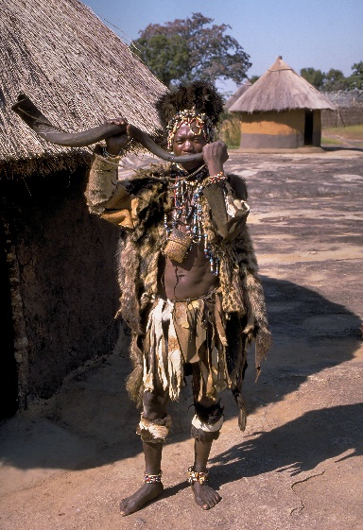
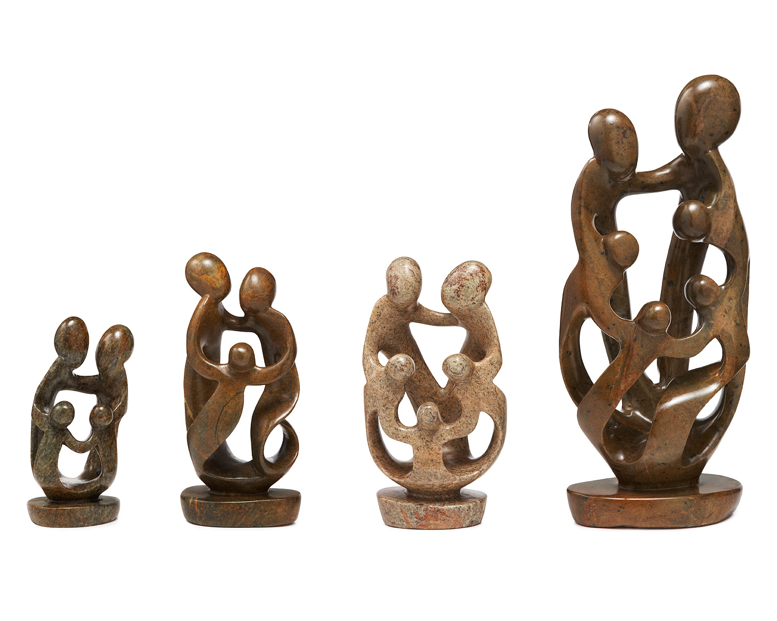
The Shona
Notes:
Zimbabwe literally means "stone dwelling" in the Shona language. British destroyed the traditional power in the 1890 and colonised the plateau which the named Rhodesia
The Shona (10.7M in Zimbabwe as of 2015) people are known for the high quality of their stone sculptures. Also traditional pottery was of a high level. The traditional textile production was poor, i. e. expensive and of low quality. People preferred to wear skins or imported tissues.^{[15]} Shona traditional music, in contrast to European tradition but embedded in other African traditions, tends to constant melodies and variable rhythms. The most important instrument besides drums is the mbira.

Slide 38
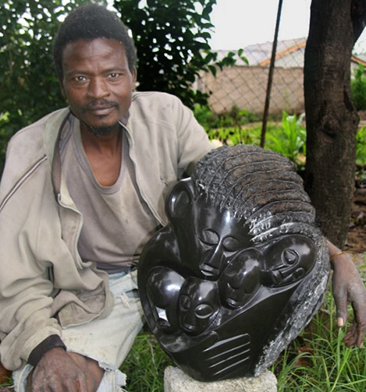
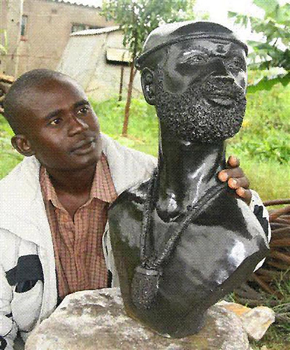
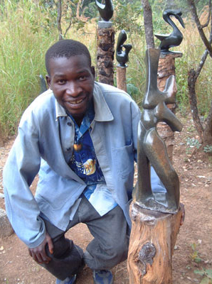

Slide 39
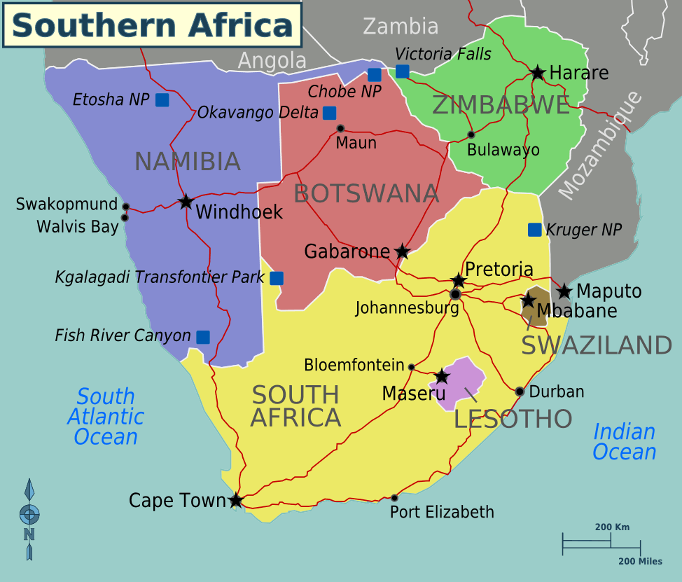
Zimbabwe

Slide 40
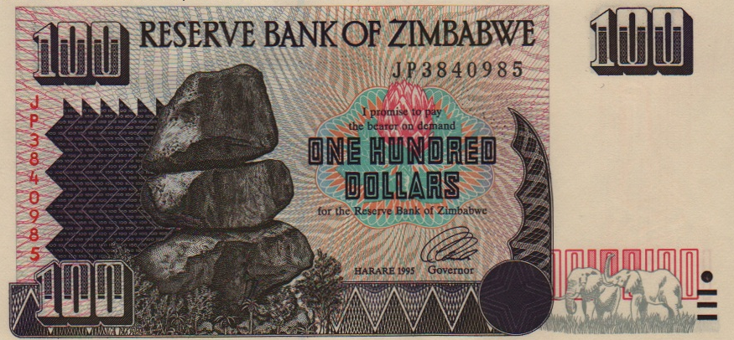
$10 US
Chiremba Balancing Rocks in Epworth, Harare
Notes:
1983 exchange rate of 1st ZD was $1; in 1997 it had devaled to 1/10 $US
Still using $100 in 2007. Rocks are the Chiremba Balancing Rocks in Epworth, Harare

Slide 41
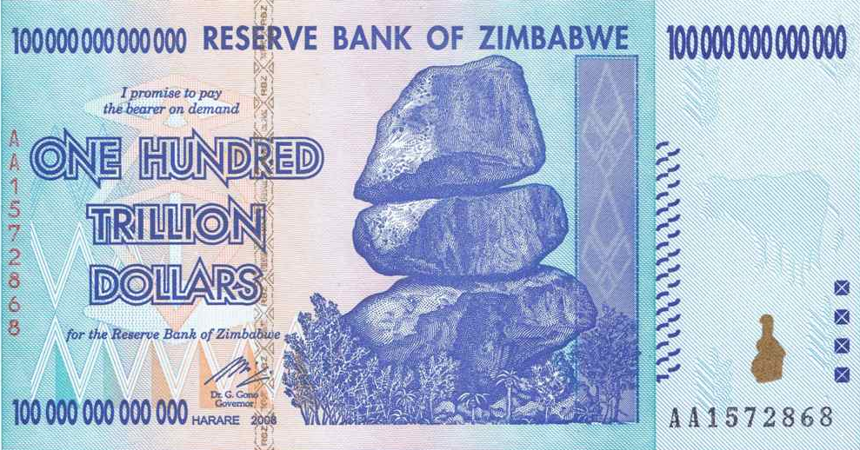
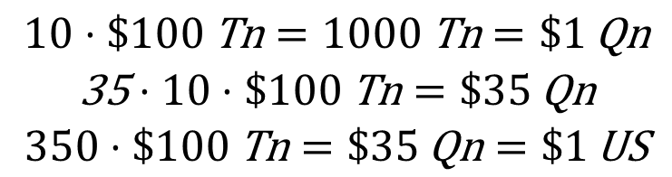
0.285¢ in 2015
$$\begin{matrix}10⋅\$100 \text{Tn}=1000 \text{Tn}=\$1 \text{Qn} \\ \text{35}⋅10⋅\$100 \text{Tn}=\$35 \text{Qn} \\ 350⋅\$100 \text{Tn}=\$35 \text{Qn}=\$1 \text{US}\end{matrix}$$
Notes:
June 15, 2015: 35 * 10 * 100Tn = 35Qn == $1 US
100Tn = 0.00285714285714286 $US

Slide 42
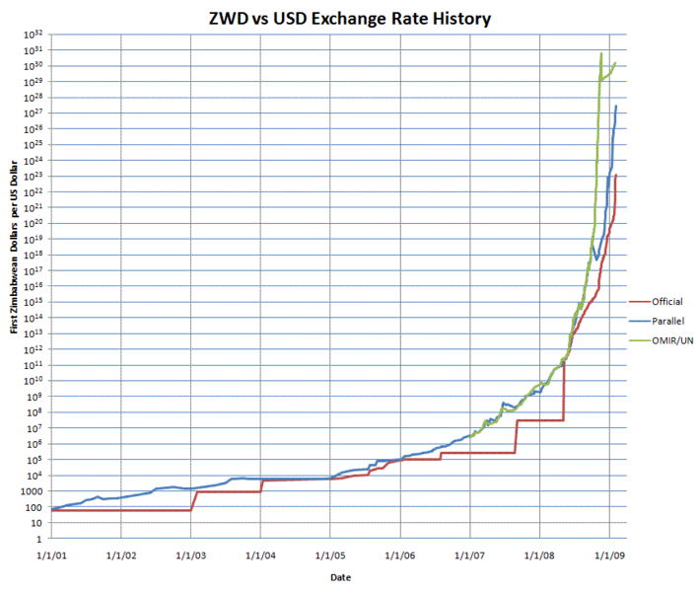
Notes:
Note logaritymic scale

Slide 43
Constant Inflation

Slide 44
$1 Becomes

Slide 45
Linear Inflation Growth

Slide 46
$1 Becomes
Notes:
Constant inflation is the geometric rate of 12.51% from 1980-1990

Slide 47
Exponential Growth
Notes:
Exponential growth in growth is explosive growth

Slide 48
$1 Becomes

Slide 49
Actual Inflation Growth

Slide 50
$1 Becomes

Slide 51
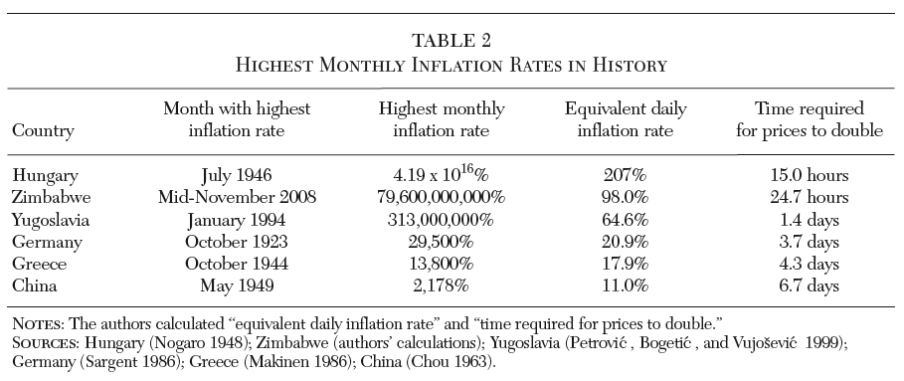

Slide 52
K
M
B
B
Qin
Qin
Sx

Slide 53
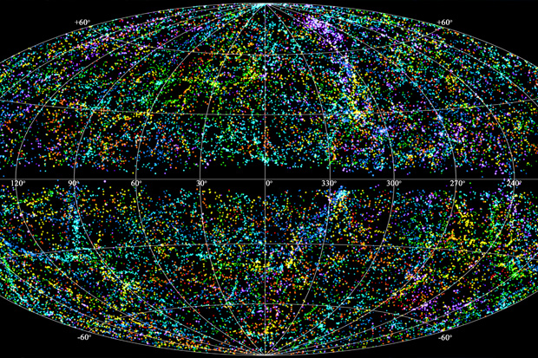
$1 in 1980 Becomes
Notes:
$1 in 1980

Slide 54

Notes:
Could add notes on VKD

Slide 55

Student Debt
Rice University – 4 years
4-year increase: 19%
Compound annual growth rate: 4.5%
4-year total: $211,288
Notes:
2014 median home price in Minneapolis St.Paul, MN = 210k

Slide 56
30-year loan, 7%
  Monthly payment of $1,405.70
  1st payment 9/1/2020
  last payment 9/1/2050
Principal repaid: $211,288
Total Interest paid: 294,756
Principal and Interest: 505,994
If left unpaid for 30 years: total principal and interest due $1,714,918
If left unpaid 60 years: $13,919,132

Slide 57

Why Not?

Slide 58

Lets Go to Work
22-32 (2020-2030, 10 years)
32-42 (2030-2040, 10 years)
42-52 (2040-2050, 10 years)
52-62 (2050-2060, 10 years) → 40 Years

Slide 59
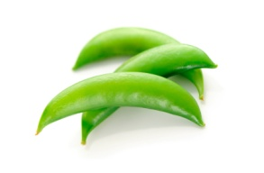
Accumulation Model
Starting salary (2020)
  $17,680 minimum wage (+ SNAP)
  $50,000 Rice undergraduate degree BA/BS
Cost of living raises (COLA) = 2.5% per yr.
Investment rates of return ✓
  Bonds rate of return = 4% per year
  Stocks rate of return = 9% per year
401k retirement savings account
  Employee contributes 5% of salary
  Employer matches 4%
  Total contributions 9% of salary (off top)

Slide 61
Investment Options

Slide 62
Add Some Variability
Promotion model
  10% promotion/raise on average every 5 years
Job change model
  25% salary increase upon job change average every 10 years
Focus on at terminal value of retirement account after 40 years

Slide 63
Just one Path

Slide 64
Investment Options

Slide 65
Do this 5,000 Times

Slide 66

Make it Happen!

Slide 67

Discussions

