Slide 1

Computational Finance –
A Statistical Approach
J.A. Dobelman
George R. Brown School of Engineering - STATISTICS
Math-Science Scholars Program
Math Camp
June 12, 2017
Notes:
a new and exciting one-month summer program directed at promising minority and low income high school students in mathematics called the Tapia Math-Science Scholars Program. The program has been approved and will be partially funded by the Houston Independent School District (HISD). The program will run from July 5 to August 1, 2015. The program will teach content, but a new and exciting addition will be enhancement lectures. In the enhancement lecture I want a distinguished Rice researcher to explain to the high school students the role that mathematics plays in his/her research.

Slide 2
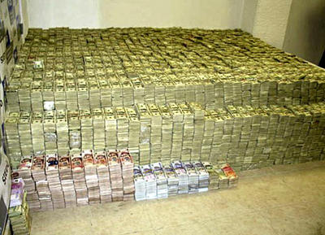
Important Questions
How did we get here?
What does Math have to do with real life?
What does Finance have to do with real life?
What is the deal with computational finance?
What is a statistical approach to computational finance?
Notes:
The United States government paid $400 million in cash - in small unmarked euros and Swiss francs and other currencies packed on pallets and delivered in unmarked cargo planes. The money represented the first installment of a $1.7 billion settlement the Obama administration reached with Iran to resolve a decades-old dispute over a failed arms deal signed just before the 1979 fall of Iran’s last monarch, Shah Mohammad Reza Pahlavi. The settlement, which resolved claims before an international tribunal in The Hague, also coincided with the formal implementation that same weekend of the landmark nuclear agreement reached between Tehran, the U.S. and other global powers the summer before. “With the nuclear deal done, prisoners released, the time was right to resolve this dispute as well,” President Barack Obama said at the White House on Jan. 17, 2017—without disclosing the $400 million cash payment.

Slide 3

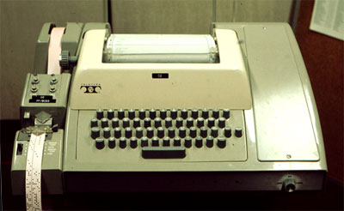

Back in High School
Notes:
8-hole punched paper tape to CDC 6600 CPU

Slide 4
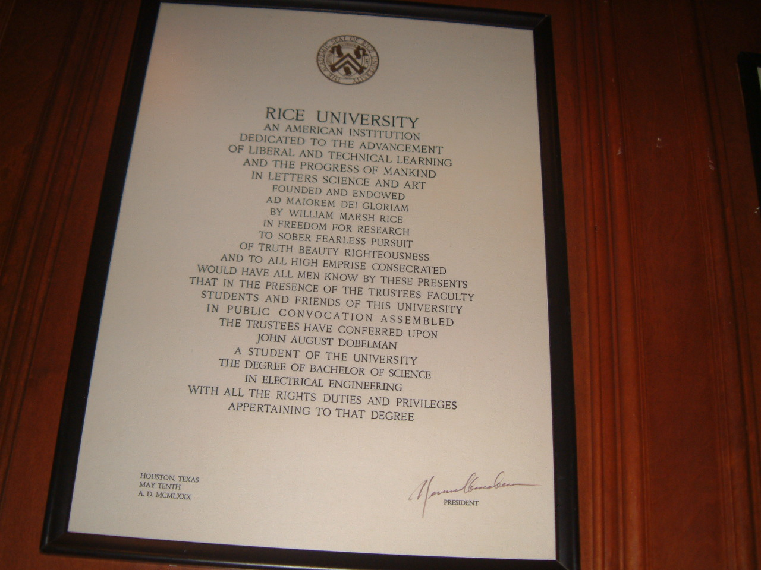
Favorite

Slide 5

Old School S&E
First post-college job: Bindery Operator

Slide 6
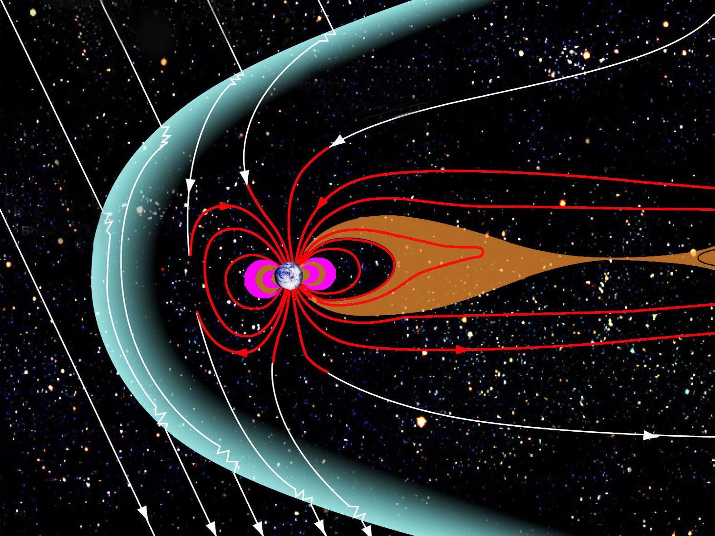
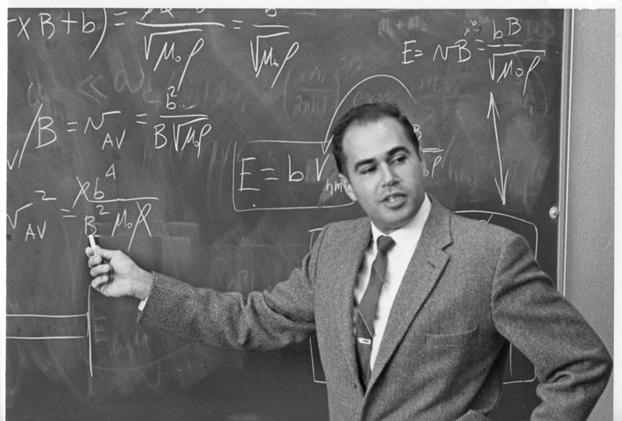
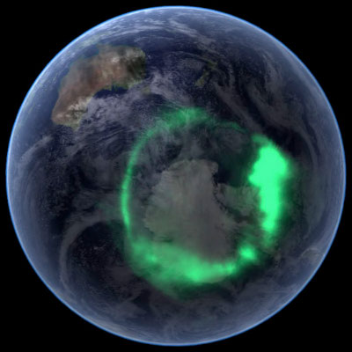

Space Physics and Astronomy
Notes:
Dessler, professor emeritus of space physics and astronomy, joined Rice in 1963 and founded the world’s first university department of space science.
The shape of the Earth's magnetosphere is the direct result of being blasted by solar wind. It prevents most of the particles from the Sun, carried in the solar wind, from hitting the Earth. The Sun and other planets have magnetospheres, but the Earth has the strongest one of all the rocky planets.

Slide 7
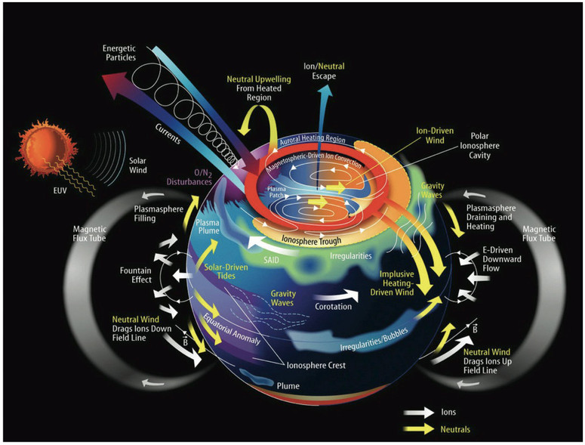

Slide 8
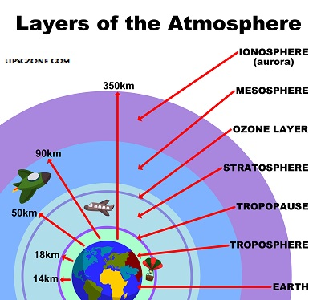
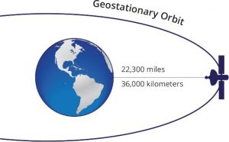
Enroute aircraft (5 mi)
Troposphere 20 km (12 mi)
Ionosphere 50-400 km (30-240 miles)
Low Earth Orbit (100mi/160 km)
Geosynchronous orbit (22,236 mi)

Slide 9
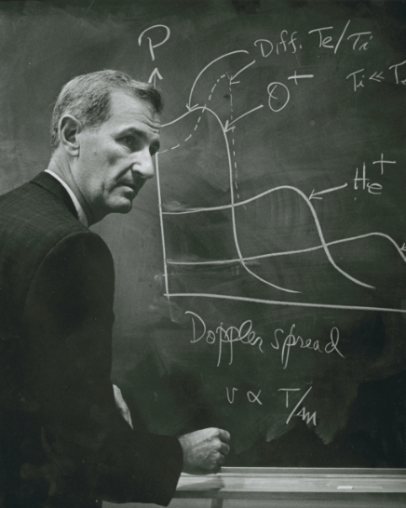
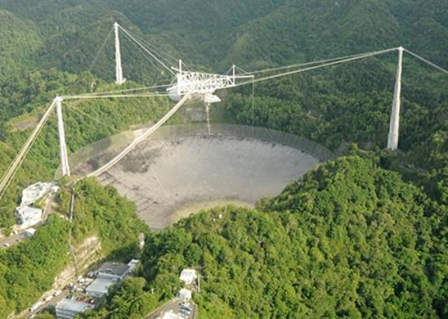
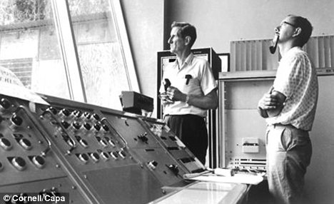
W.E. Gordon

Slide 10
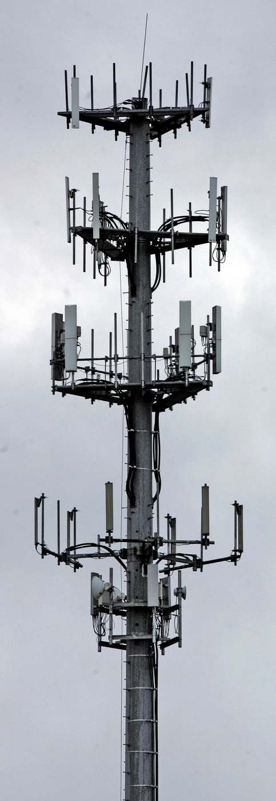
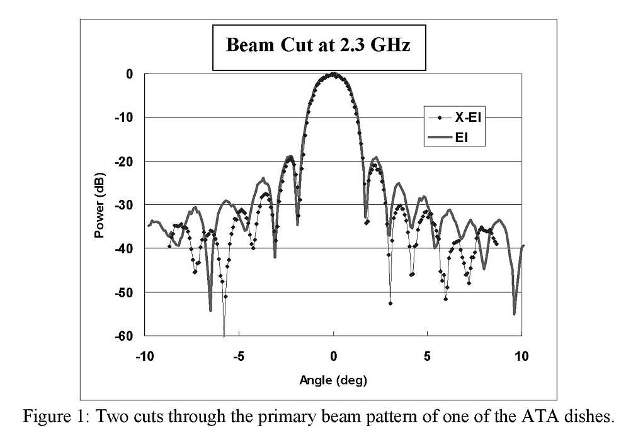
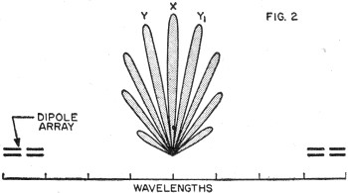
Down to Earth
Notes:
Enroute aircraft (5 mi)
Troposphere 20 km (12 mi)
Ionosphere 50-400 km (30-240 miles)
Low Earth Orbit (100mi)
Geosynchronous orbit (22,236 mi)

Slide 11
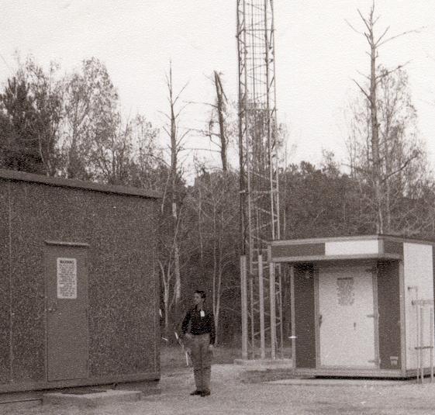
IAH RTR

Slide 12
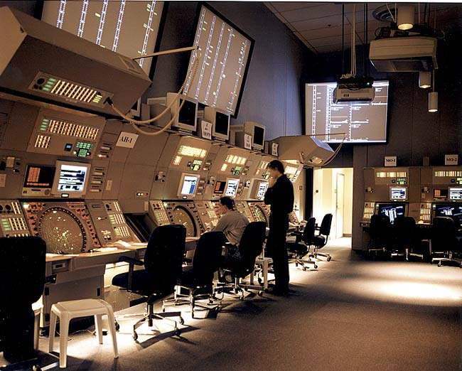
Terminal CNS
Notes:
NY TRACON

Slide 13
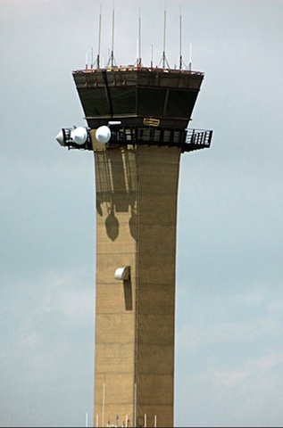
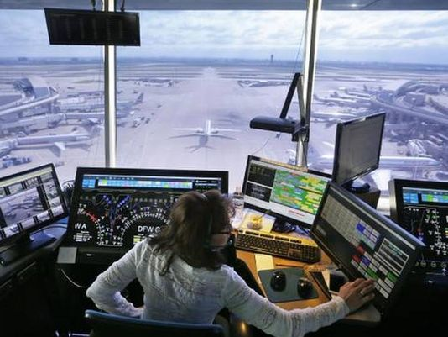

ATCT
Notes:
EWR ATCT at night
DFW AA Ops
Pei ATCT

Slide 14
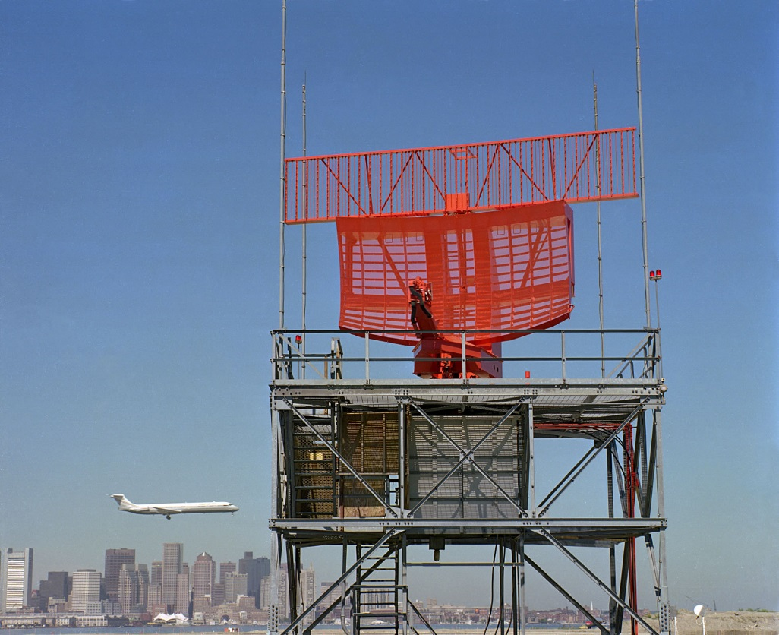

Surveillance

Slide 15

ILS/NAV

Slide 16
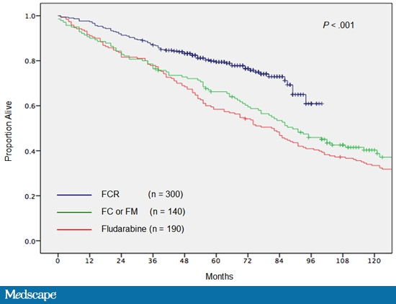
Epiphany/Catharsis
Notes:
Epiphany: a sudden, intuitive perception of or insight into the reality or essential meaning of something, usually initiated by some simple, homely, or commonplace occurrence or experience. (Revelation of Christ to the Magi)
Catharsis: the process of releasing, and thereby providing relief from, strong or repressed emotions.
Fludarabine / Cytoxin / Rituxin

Slide 17
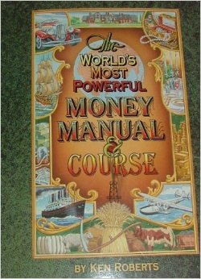

Quit your Day Job

Slide 18
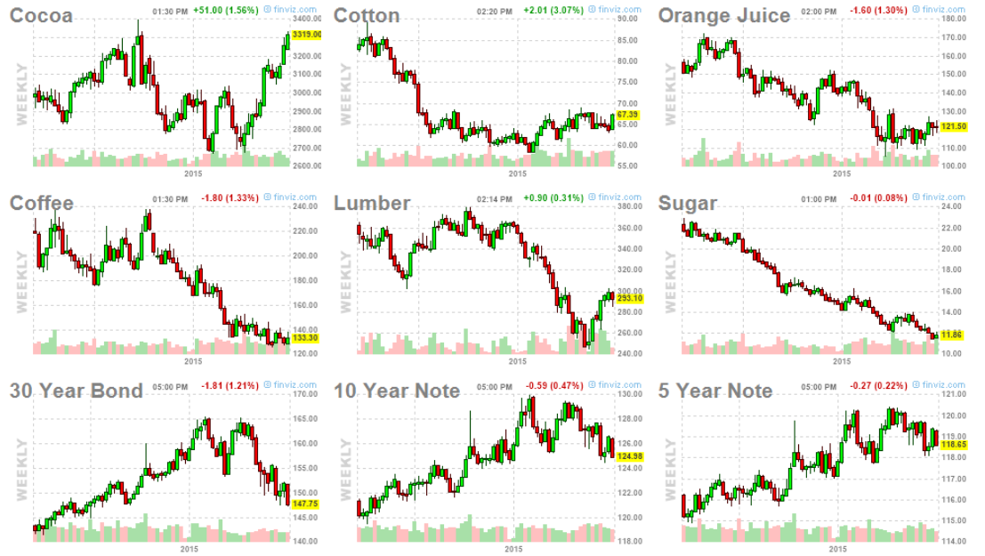





Futures Contracts
CC: 10T CT: 50k# JO: 15k# KC: 37.5k# (250 bags)
Notes:
CC 10T ($10/dollar) CT /50k# ($500/cent) JO 15k# $150/cent KC 37.5k# ($375/cent) LB 110k ft
SB 112k# ($1120/cent) US 100k 10Y 5Y7

Slide 19

Back to Rice!

Slide 20
Why Math
More than puzzles and unsolved ?’s

Slide 21

Millennium Prize Problems (Clay Mathematics Institute in 2000)
  P versus NP (CS)
  Hodge conjecture (analytic geometry)
  Riemann hypothesis (1859; zeta fn. zeros)
  Yang–Mills existence and mass gap (physics)
  Navier–Stokes existence and smoothness (fluid mechanics and turbulence building blocks)
  Birch and Swinnerton-Dyer conjecture (number theory)

Slide 22
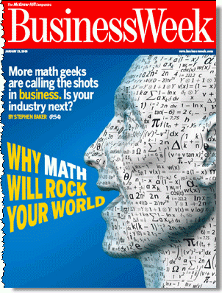
2006 Predictions
Notes:
January 23, 2006

Slide 23
Why Math Will Rock
“Quants” turned finance world upside down in 1973
30 years later “Data Mining” emerges
Mathematics and computer science
Modeling YOU as a customer, a specimen and a target
Behavioral prediction
  Revenue management and optimization
  Surveillance
AI/Robotics

Slide 24

Problem Solving
Science and Engineering
  Mathematical biology & bioinformatics
    CURE for cancer
    GROW new organs
    FOREVER YOUNG
  Nanotechnology

Slide 25
Engineering
  Bioengineering
  Chemical and Biomolecular Engineering
  Civil and Environmental Engineering
  Computer Science
  Electrical and Computer Engineering
  Materials Science and NanoEngineering
  Mechanical Engineering
  Computational and Applied Math
  Statistics

Slide 26
Finance and Real Life
In previous TMSS lectures we discussed making money
The magic of compounding and regular contributions was discussed
  Suppose one doubles their money every year
  This is a compounding rate of 100% per year

Slide 28
$60,000,000,000,000
Estimate of all the money in the world
  Money, bills & coins: $5 trillion
  Add checking accounts: $25 trillion
  Add savings and CD’s < $100,000: $60T
    $60T = $60,000B = $6x10¹³.
Before long….
Notes:
http://gizmodo.com/5995301/how-much-money-is-there-on-earth

Slide 29
If your money tripled each year
Lets be more realistic
  r = 8%, or 10% per year
  Stock market with dividends reinvested
  Start with $1,000, no more additions for 40 years

Slide 30
What difference 2% makes

Slide 31
NOTE!
Compounding miraculous
  “Gentlemen, if the man who invented compound interest had of secured a patent on his idea he would have had without any doubt the greatest invention the world has ever produced.” - Security Investment Co., 1916.
  Oftentimes attributed to Einstein
Compounding unsustainable
  Even at 8%, after 422 years all the money in the world would be gone

Slide 32
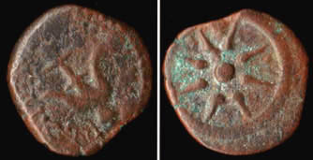
Experiment
“And there came a certain poor widow, and she threw in two mites, which make a farthing” Mk 12.42
Worth one-half of a quadrans or 1/128 of a denarius, or about six minutes of an average daily wage
  $15 x 8hrs = $120/day
  60x8=480 min.per day
  6/480 = .0125 = 1.25%
  $120 x .0125 = $1.50
Notes:
A bronze mite, also known as a Lepton (meaning small), minted by Alexander Jannaeus, King of Judaea, 103 - 76 B.C. obverse: the blooming lotus scepter of ancient Egypt in circle, reverse: star of eight rays. https://en.wikipedia.org/wiki/Lesson_of_the_widow%27s_mite#/media/File:Widowsmite.jpg
Golden age of Rome; The Nerva–Antonine Dynasty was a dynasty of seven Roman Emperors who ruled over the Roman Empire during a period of prosperity from 96 CE to 192 CE. These emperors are Nerva, Trajan, Hadrian, Antoninus Pius, Marcus Aurelius, Lucius Verus, and Commodus.
Source: Boundless. “The Golden Age of Rome.” Boundless World History I: Ancient-1600. Boundless, 10 Jul. 2015. Retrieved 14 Jul. 2015 from https://www.boundless.com/world-history/textbooks/boundless-world-history-i-ancient-1600-textbook/the-roman-world-5/the-roman-empire-33/the-golden-age-of-rome-130-13196/

Slide 33

Give it Time
Principal: $1.50 (in today’s money)
Interest: 6% per annum (typical)
Yeshua to Muhammed: $13.9 Qn
Time: 30 CE – 2015 CE (1,986 years)
Taxrate: 0% 30%
Value: 2.713x10⁵⁰ 4.58x10³⁵
4.65x10¹⁰ years at light speed to get to edge of the observable universe
Notes:
Yeshua died in 30AD (mas o menos)
Abū al-Qāsim Muḥammad ibn ʿAbd Allāh ibn ʿAbd al-Muṭṭalib ibn Hāshim d. 8 June 632
$13,934,527,311,807,600
Universe extent: 46.5B LY

Slide 34
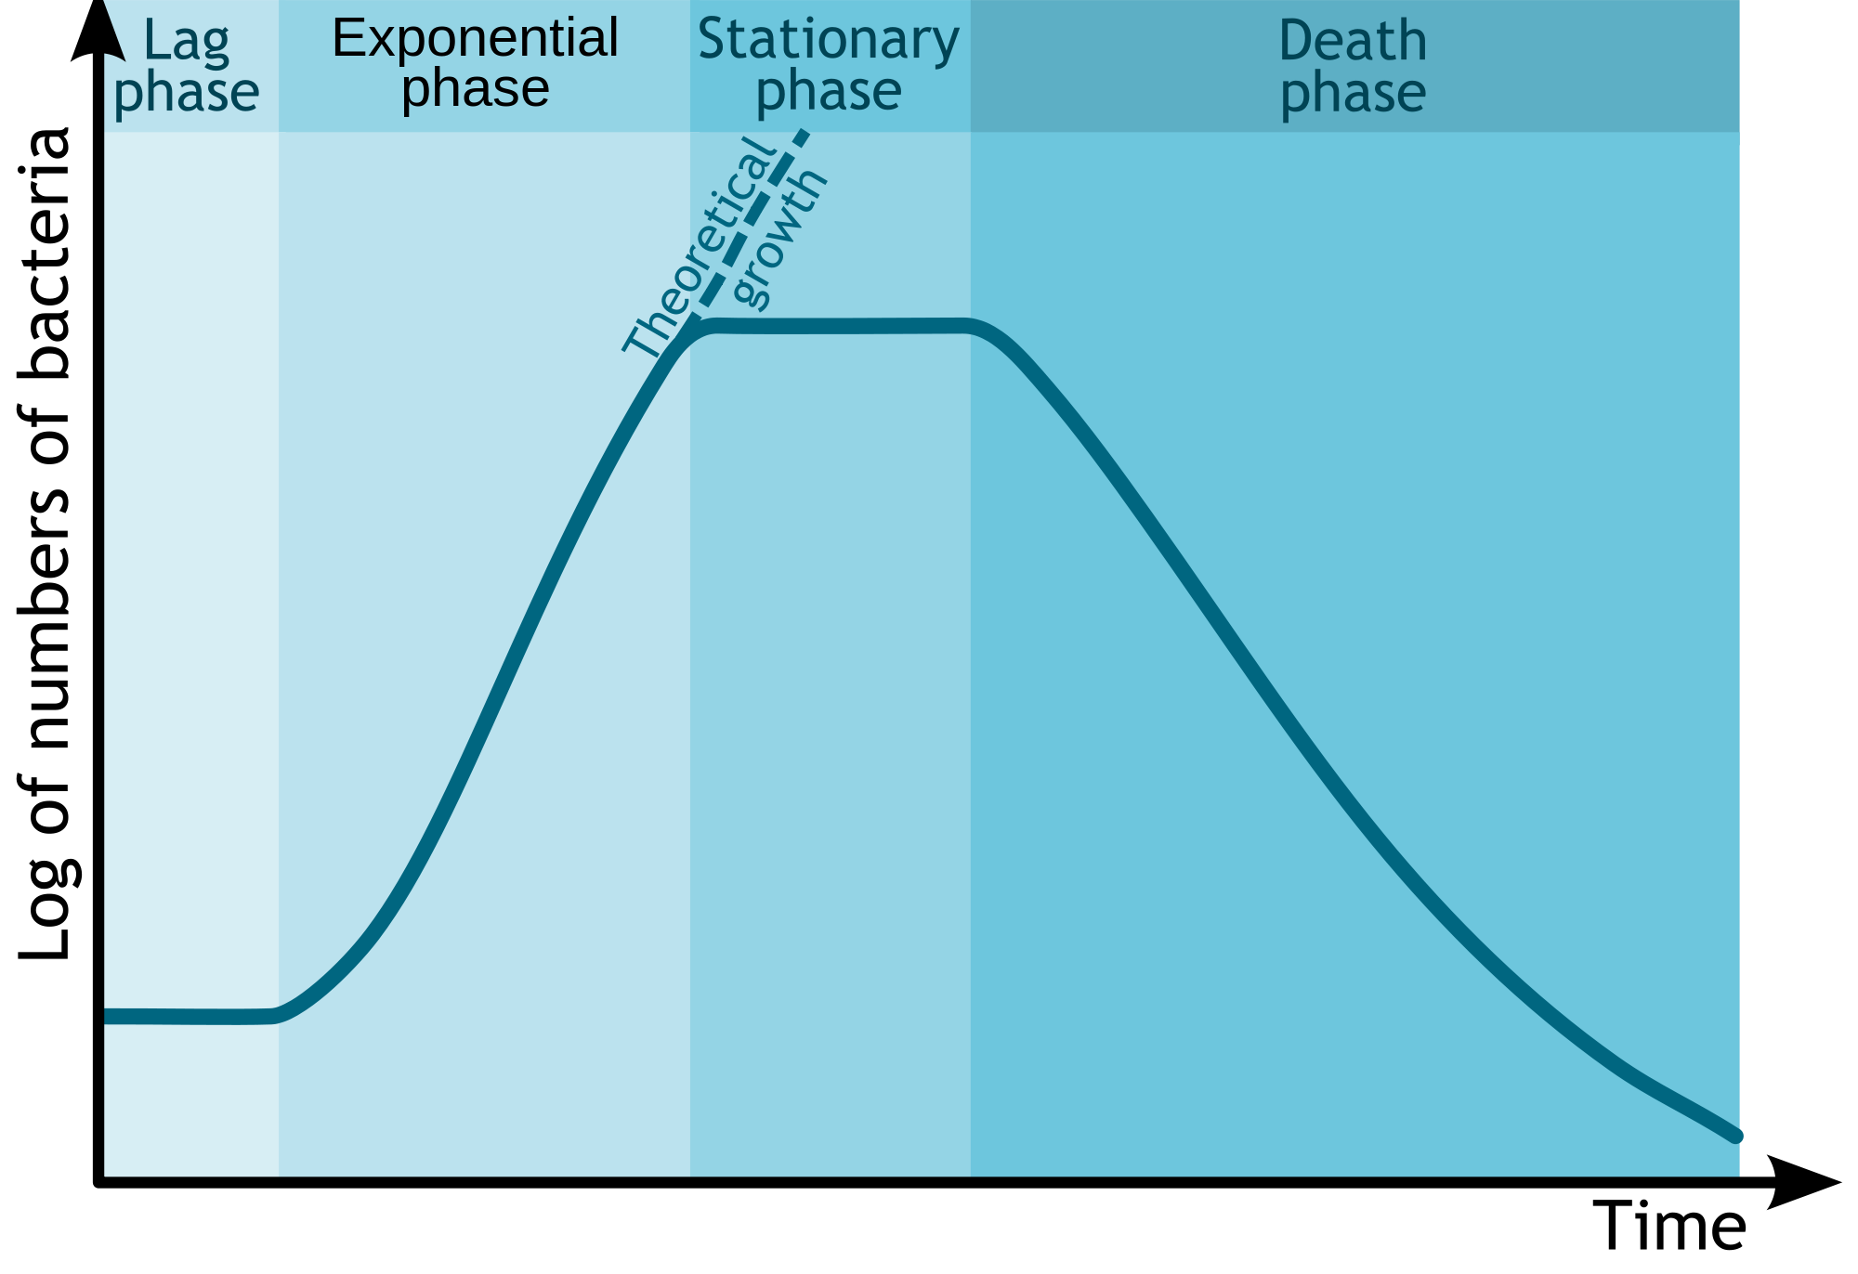
WRH

Slide 35
Finance
Definition:
  1 plural : resources (as money) available to a government, person, group, or business
  2 : the obtaining or providing of funds or capital
  3 : the system that includes the circulation of money, the providing of banks and credit, and the making of investments

Slide 36
Finance
What is Finance?
  Personal (your money)
  Academic (no money)
  Professional (other peoples money)
Capital Markets
  Funding for chop shop
  How to get financing for SNAP
Asset pricing
  AAPL
  Bitcoin

Slide 37

Notes:
AAPL: 12/12/80 High 8/18/12: 702.10; split factor as of 12/31 is 56
BITCOIN: First transaction by Sataoshi 1/12/09; July 12, 2010 Bitcoin value increases tenfold
Over a five day period beginning on July 12, the exchange value of Bitcoin increases ten times from US$0.008/BTC to US$0.080/BTC.

Slide 38
What Return
AAPL (CAGR)
AAPL (TV)
  $100 →$443
  (3/4 iPhone)
Bitcoin (CAGR)
Bitcoin (TV)
  $100 →$3,221,200
  (5,369 iPhones)

Slide 39
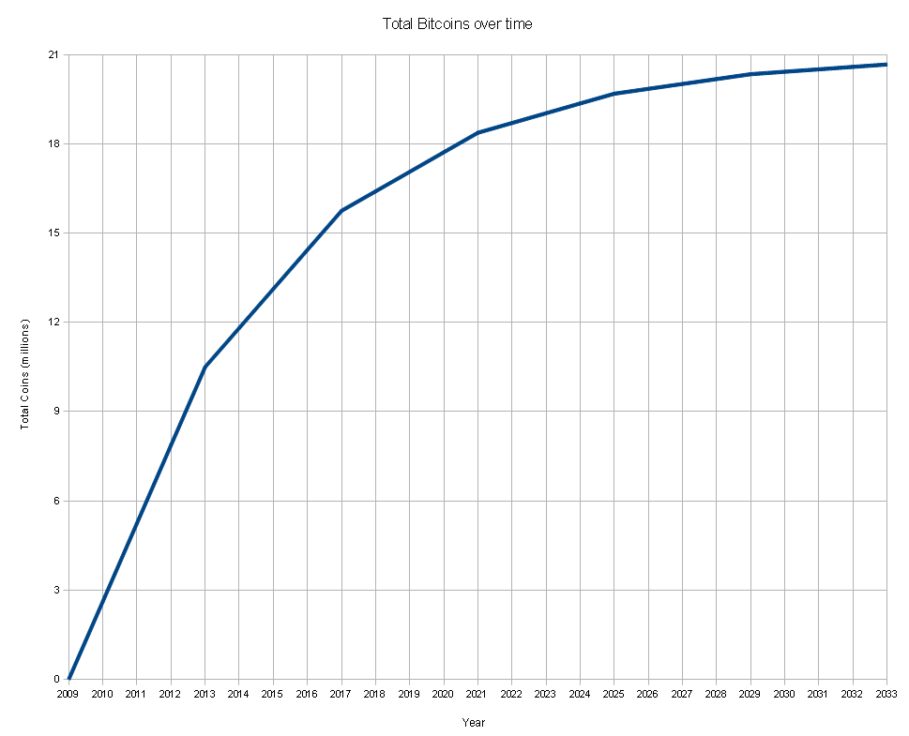
NOTE:
  Only 21 million Bitcoin can be produced
    By year 2140
  $60 trillion total money in the world
    As of today
  Eventual value of Bitcoin

Slide 40
Academic Career
A doctoral degree in finance qualifies you to pursue an academic career as a researcher and educator. An academic career provides not only tremendous intellectual freedom, but makes it possible to work with bright people throughout your life. You can make a difference through the scholarly research you create, and the lives you shape through your teaching.
Notes:
https://www.scheller.gatech.edu/degree-programs/phd/phd-concentrations/phd-finance.html

Slide 41
Not to mention:
  The starting salary for finance PhD graduates’ often ranges from $180K to $210K, depending on placement, which is largely determined by performance in the doctoral program.
  The job market for finance PhDs has been strong, and in recent years more positions have been available than candidates pursuing jobs.
  The position of a university professor is frequently ranked as one of the most desirable jobs in the world

Slide 42
Academic Finance
“XXX is a good place for learning what it is to be an academic – a member of the finance and economics community – and what that entails.”

Slide 43
PhD Program
Accounting
Business & Public Policy
Finance
Management of Organizations
Marketing
Real Estate

Slide 44
Finance PhD
Structure of financial markets
Formation and behavior of financial asset prices
Banking and monetary systems
Corporate control and capital structure
Saving and capital formation
International financial markets

Slide 45
Asset Pricing
Formation and behavior of financial asset prices
  Asset pricing models
  Stochastic modeling
    Real and Functional Analysis
    Theory of Probability
    Stochastic Processes
    Dynamic Optimization
  Time-series econometrics
    Time Series Analysis
    Topics in Financial Econometrics

Slide 46
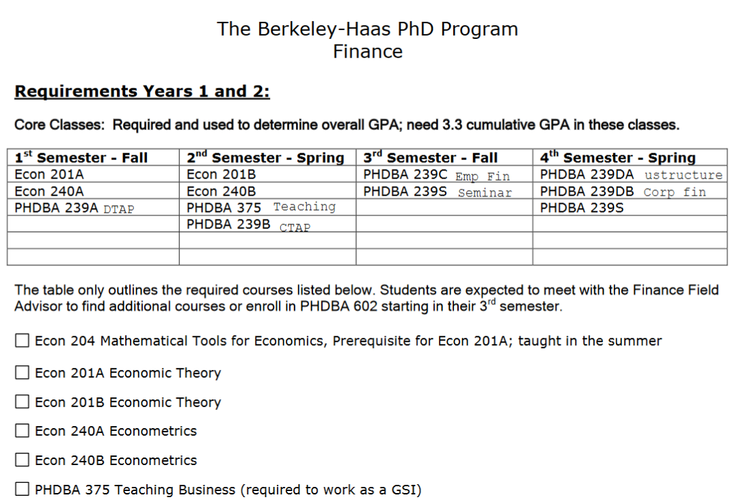
Curriculum

Slide 47
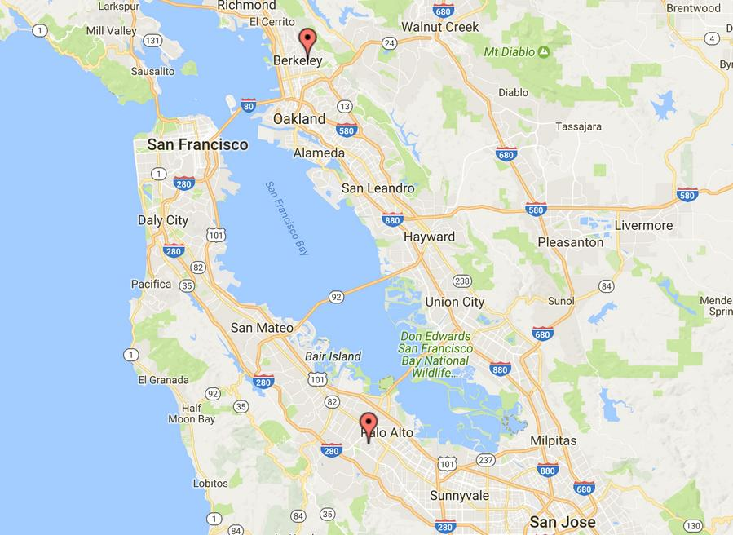

Slide 48
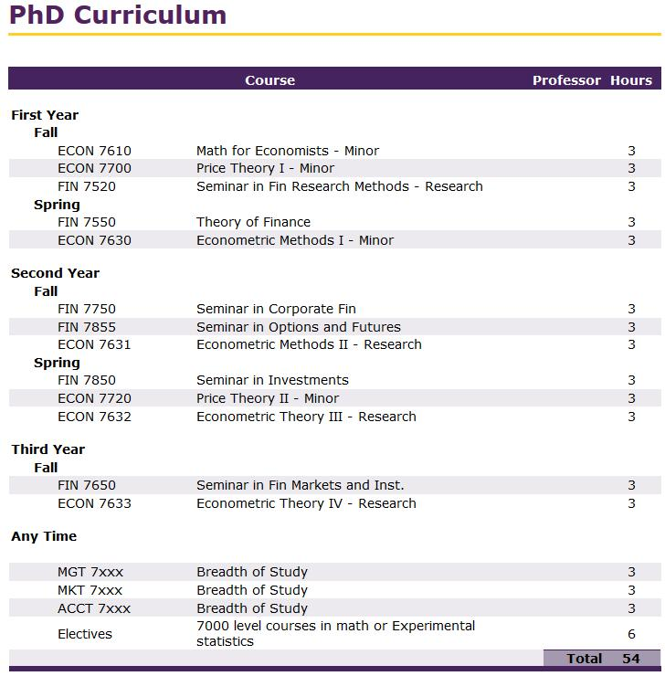
LSU

Slide 49
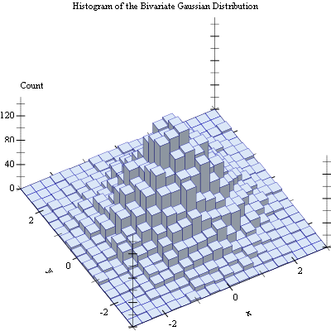
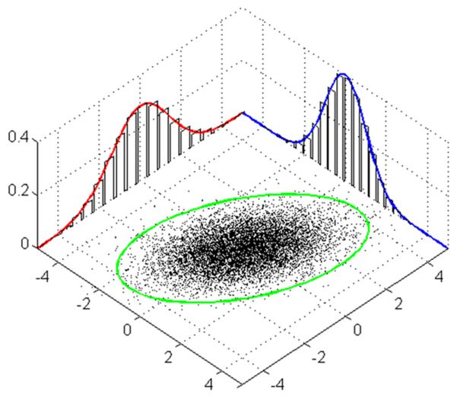
Beautiful

Slide 50
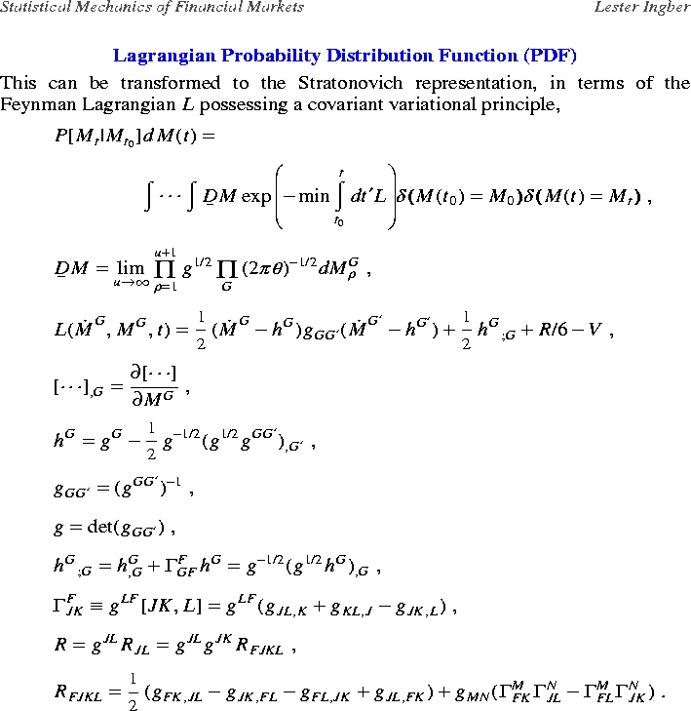
Analytic Solutions

Slide 51
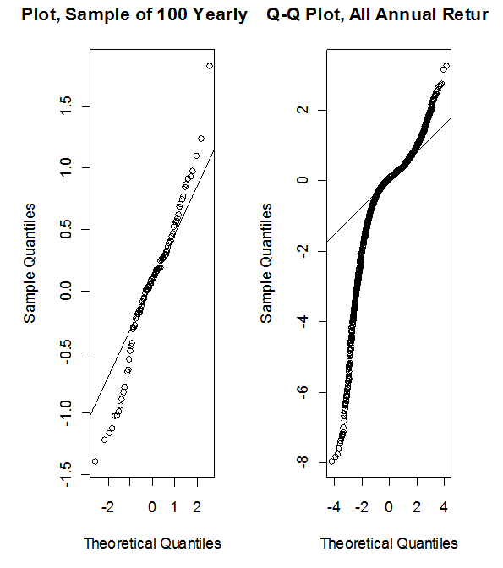
Model Mis-Specification

Slide 52
Computational Finance
Numerical solutions of pricing equations: finite differences, finite elements, and spectral techniques in one and multiple dimensions
Simulation approaches in pricing and risk management: advances in Monte Carlo and quasi-Monte Carlo methodologies; new strategies for market factors simulation.
Optimization techniques in hedging and risk management

Slide 53
Fundamental numerical analysis relevant to finance: effect of boundary treatments on accuracy; new discretization of time-series analysis
Developments in free-boundary problems in finance: alternative ways and numerical implications in American option pricing

Slide 54
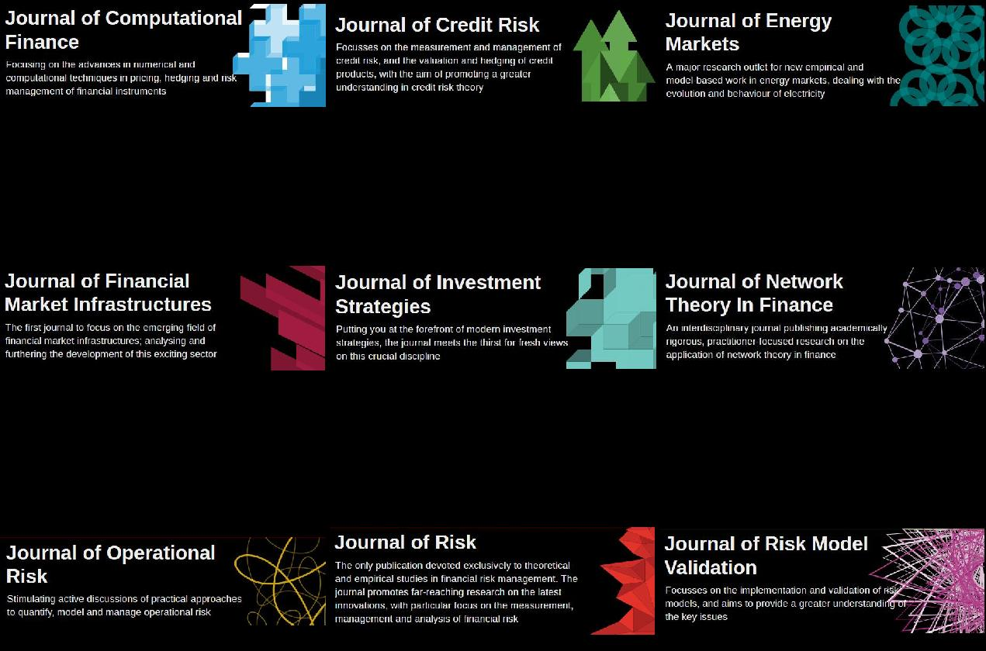
Risk

Slide 55
Risk ≠ σ
“Dispersion of possible outcomes” –P. Jorion (father of VaR)
“Risk is that in the long run, returns will be terrible”
"If you put a gun to my head and asked me what my firm's risk was, I would use VaR." -Richard Bookstaber, hedge-fund manager
“In peacetime, you think about other people's intentions, In wartime, only their capabilities matter. VaR is a peacetime statistic" -Aaron Brown, Risk Manager at AQR, formerly Morgan Stanley.
Notes:
Both (quoted in Joe Nocera, Risk Mismanagement, NYT, January 2, 2009) "If you put a gun to my head and asked me what my firm's risk was, I would use VaR." -Richard Bookstaber, hedge-fund manager

Slide 56

Research Program
Investments analysis
stochastic modeling for markets and finance
simulation-based and quantitative portfolio selection and management
display of quantitative information
improved communication
applications of engineering models to other statistical problems

Slide 57
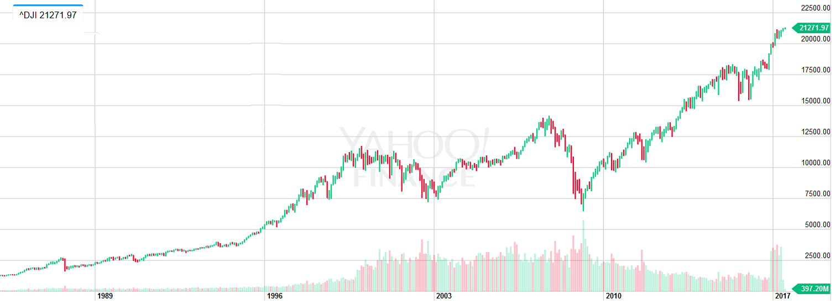

Academic finance tells you the best you can do is invest in the total market
Notes:
1/1/85 DJIA=1284; 6/9/17 DJIA = 21,272
Number of years: 32.5 Years
Total Return = 21272/1284 = 16.57 → r*= 9%

Slide 58
The Grail
Over very long periods (91 years) the major stock indexes return about 6% (excluding dividends); lately (32 years) it’s been 9%
Mutual funds claim to do better
  Charge 1% to 1.5%
Hedge funds claim to do better
  Charge 2% of principal + 20% of gains (when there are gains)

Slide 60
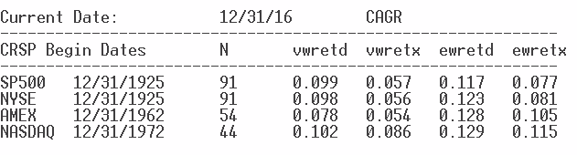
Max Median Approach (excluding divs)
  CAGR 1958-2015: 8.6%
  Exceeds EWX S&P 500 with only 20 stocks
MaxMeasures (Including dividends)
  Lookback – 5 months, harmonic mean
  CAGR 1970-2011: 14%

Slide 62
What Would You Do?

Slide 63

Discussions

